Slide 1
High Frequency Data Capture Systems: How do centers leverage them to improve outcomes?
Jeremy Affolter, MD
Joshua Salvin, MD
Nathaniel Sznycer-Taub, MD
Moderated by Josh Wolovits, MD and Richard Lion, DO

Slide 2
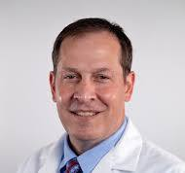

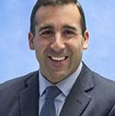
High Frequency Data Capture Systems: How do centers leverage them to improve outcomes?
Jeremy Affolter, MD
University of Texas at Austin
Joshua Salvin, MD
Boston Children’s Hospital
Nate Sznycer Taub, MD
University of Michigan

Slide 3
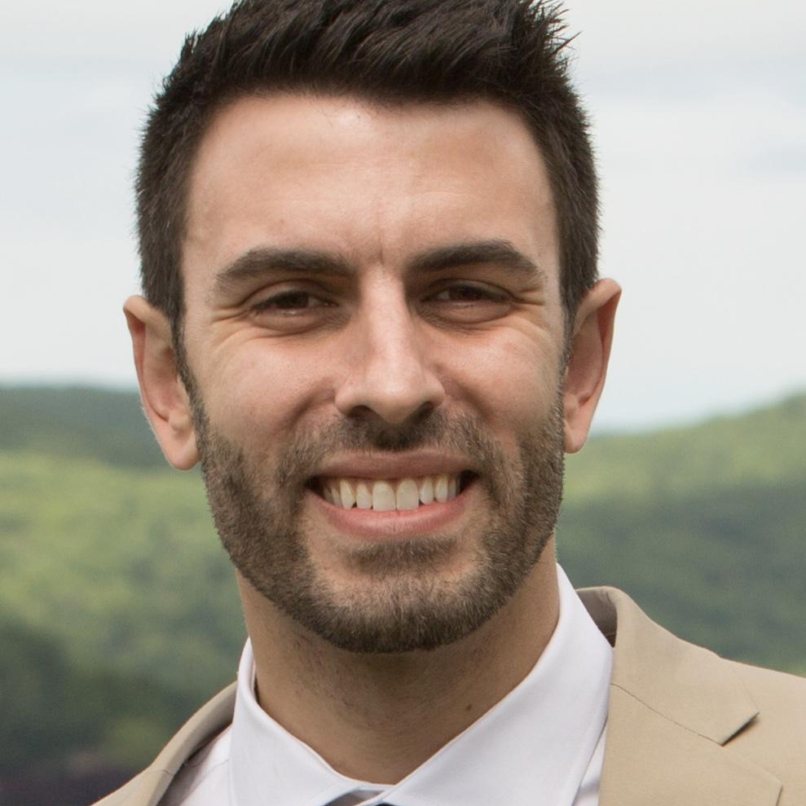
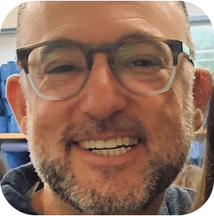
High Frequency Data Capture Systems: How do centers leverage them to improve outcomes?
Josh Wolovits, MD
University of Texas Southwestern Medical Center
Richard Lion, DO
Texas Childrens Hospital Austin Campus

Slide 4
Disclosures
No financial disclosures
No backing/influence from either platform mentioned here
Will just be providing our ”story” and honest assessment of each platform
  *** May not be necessarily applicable to another individual center

Slide 5
Session Agenda
What exactly is a High Frequency Data Capture System?
How is HFDC being utilized for patients in the CICU and other clinical areas?
How has HFDC been integrated into clinical workflow, QI and research?
How can we leverage and integrate HFDC data with PC4 data?

Slide 6
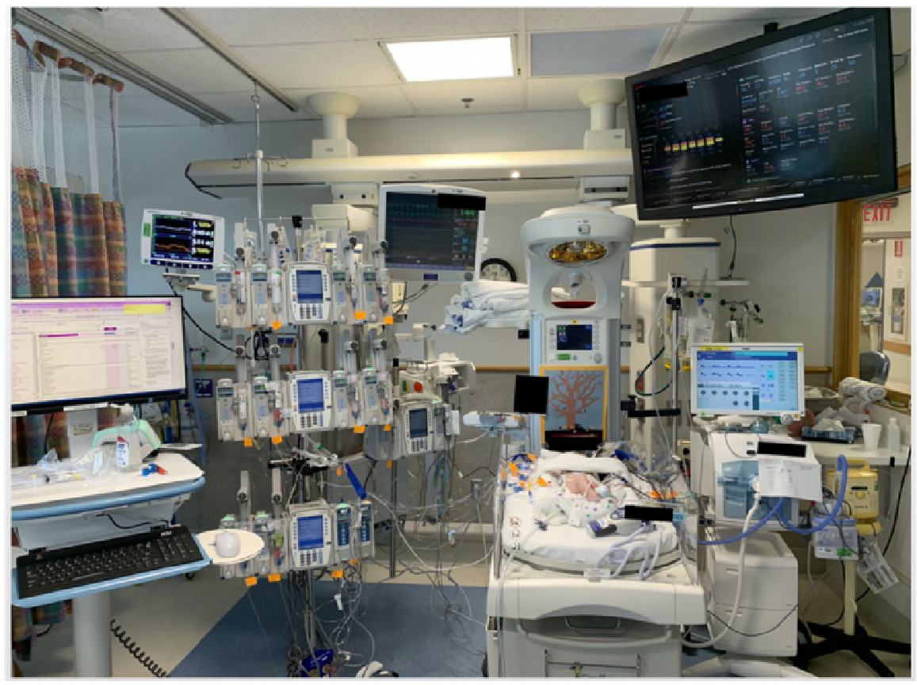
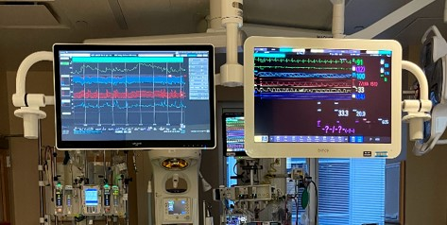
Integrated HFDC Monitor
VS over time
Lab integration
Medication administration
Vent Data
Data visualization
Risk tools
NIRS Monitor
Cerebral NIRS
Somatic NIRS
Ventilator Monitor
Mode of Ventilation
TV / PIP
PEEP
Respiratory Rate
Pressure Support
FiO2
i-Time
Other Buttons
Standard Monitoring Device
Temperature
5-lead EKG
Respiratory Rate
SpO2
EtCO2
S/D/MAP
CVP and Atrial Pressures
Patient
Notes:
Introduce the current “standard of care”… continuing to ask bedside nurse to document hourly vital signs, not just the classic 5, but 10-15 different values, often compiled from multiple bedside monitors
Continuous monitoring of numeric and waveform data streaming in realtime
Overwhelming amount of data/output for any person to comprehend/interpret in addition to other duties of patient care

Slide 7
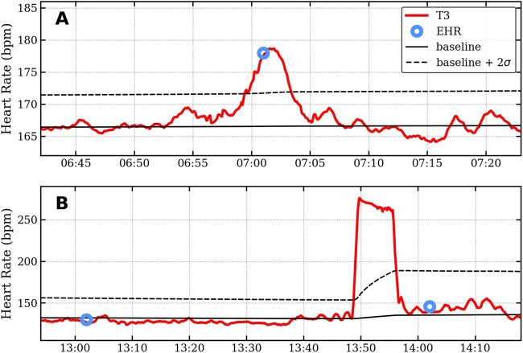
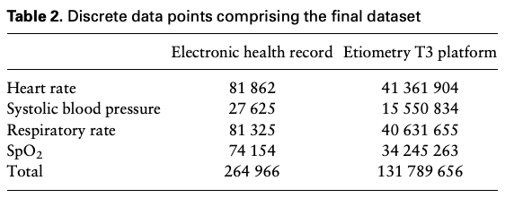
Hourly Vital Sign Monitoring
Lowry et al. 2022
Notes:
Limitations of hourly vital sign reporting which does not always capture acute HD changes as they are happening, and can miss events entirely. (first PIC)
Continuous vital sign monitoring by HFDC allows 100x vital signs to be trended/assessed in realtime (second PIC)

Slide 8
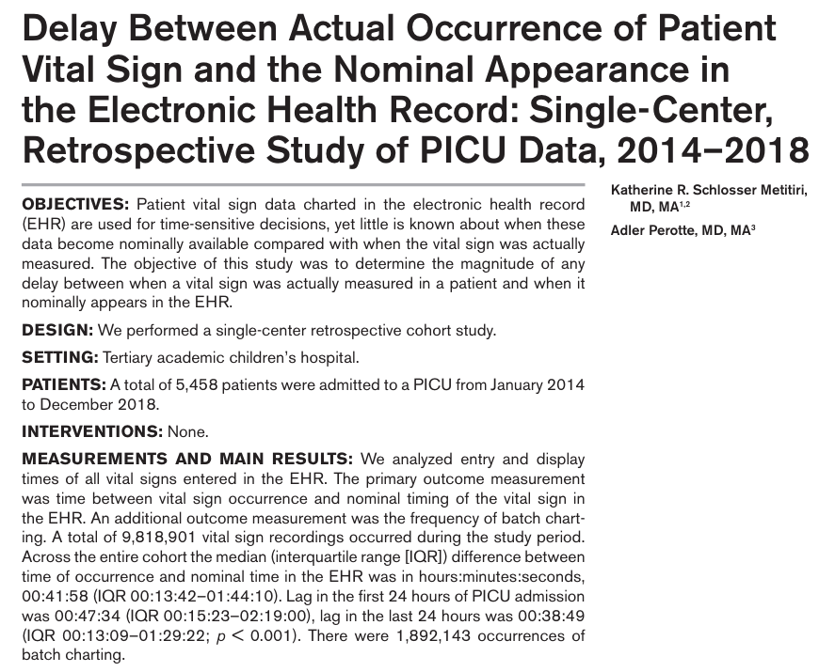
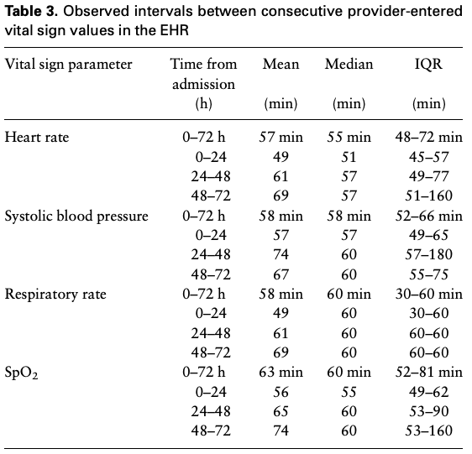
Notes:
Additionally, due to all the things we ask the bedside nurses to do for these patients, there is often a lag b/w the time a vital sign occurs and is charted in the EMR system, by up to an hour especially in the first days of admission when acuity tends to be the highest.

Slide 9
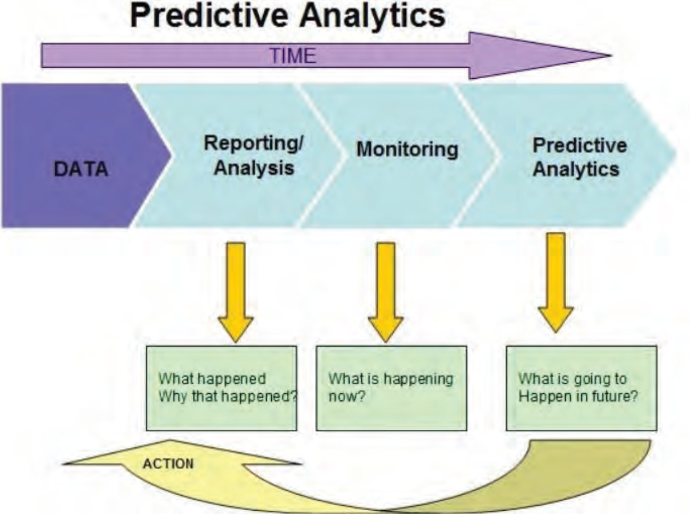
What If….?
We had a tool to provide patient specific, real-time prediction of outcomes?
We could monitor individual patient hemodynamics and predict changes from their own baseline?
We could incorporate physiologic vital signs, hemodynamic waveforms and clinical laboratory data into a HFDC system to guide patient-specific management decisions?
Notes:
Within the Cardiac ICU
The amt of data we have collected, stored and streaming into our consciousness has increased exponentially as more sophisticated invasive and noninvasive monitoring systems develop. However, our CHD population, especially the cyanotic, single ventricle arrhythmogenic patients “normal” conduction systems, pulse pressures, venous pressures, saturations are often read as “abnormal” by our machines, which were developed for patients that have 2 heart ventricles. What this can lead to is the phenomenon of “alarm fatigue” akin to the “crying wolf” of children’s fables, making it hard to differentiate when the patient is truly having changes until they are severe. A PICU study found that clinical response time to potentially critical alarms increased significantly as the frequency of false alarms increased in the preceding 2 hours. Additionally, critical care providers perform an average of 180 actions on or for each individual patient daily, and are also supposed to continuously be monitoring them globally for changes.
We are also trying to provide care to more and more of these high risk patients requiring human bandwidth to do so safely, since they are at the highest risk of inpatient mortality

Slide 10
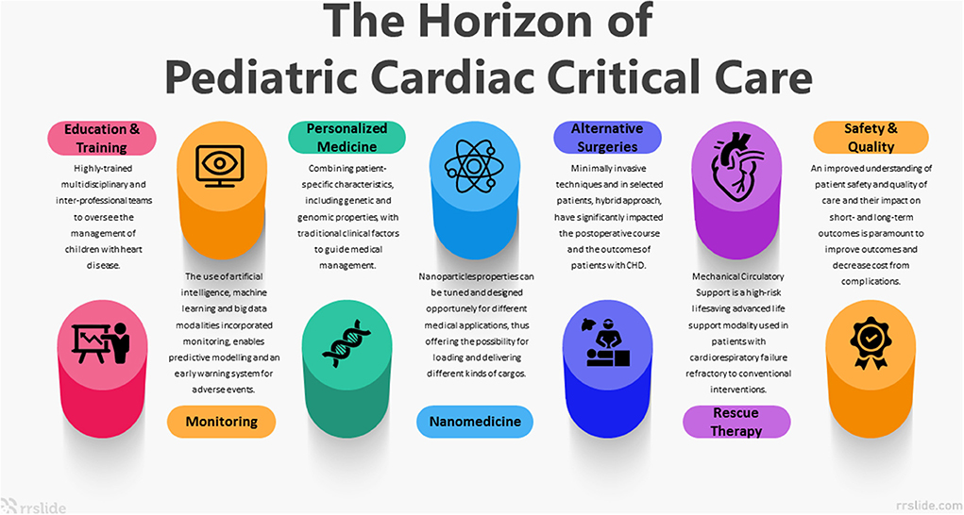
Pollak et al. 2022
Notes:
One of the pillars of the “next generation” of CHD and PCICU care is integration of AI/machine learning/HFDC which can enhance our ability to succeed in the other domains such as personalized medicine, education/training, rescue therapies, and patient safety and care quality.

Slide 11
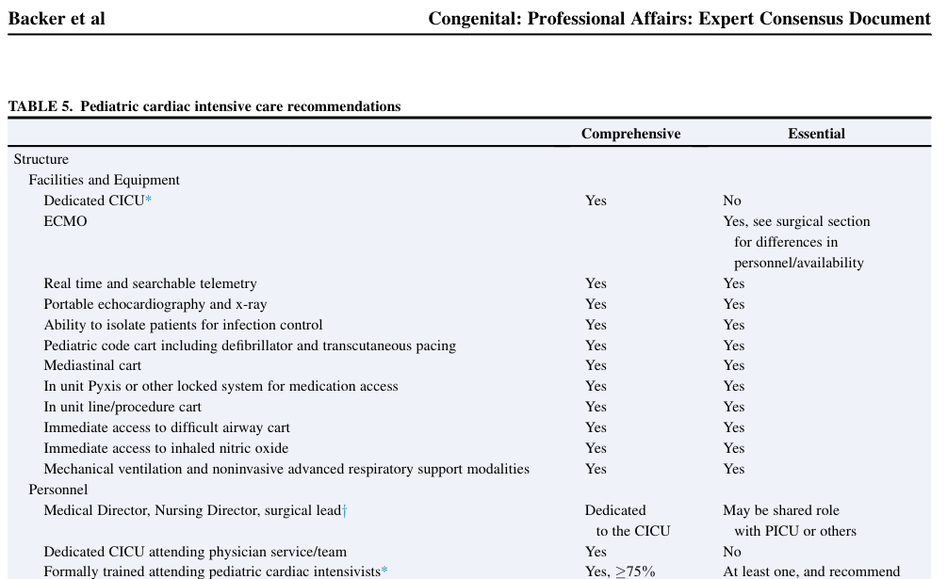
Backer et al. 2023
Notes:
2023 Consensus recommendations for hospitals performing PCS include realtime / searchable telemetry data in both the ICUs and acute care floors

Slide 12
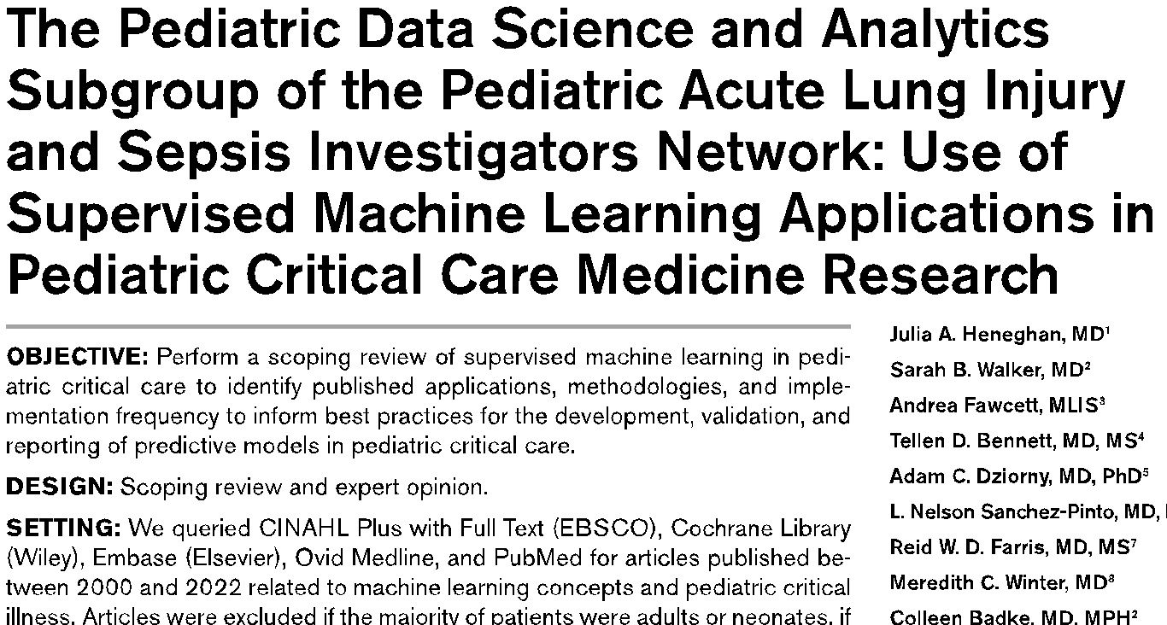
Notes:
And we are starting to see multi-center collaboratives such as PALISI devoting subgroup efforts to leverage AI/machine learning/HFDC… something im hopeful we can develop within PC4/PAC3.

Slide 13
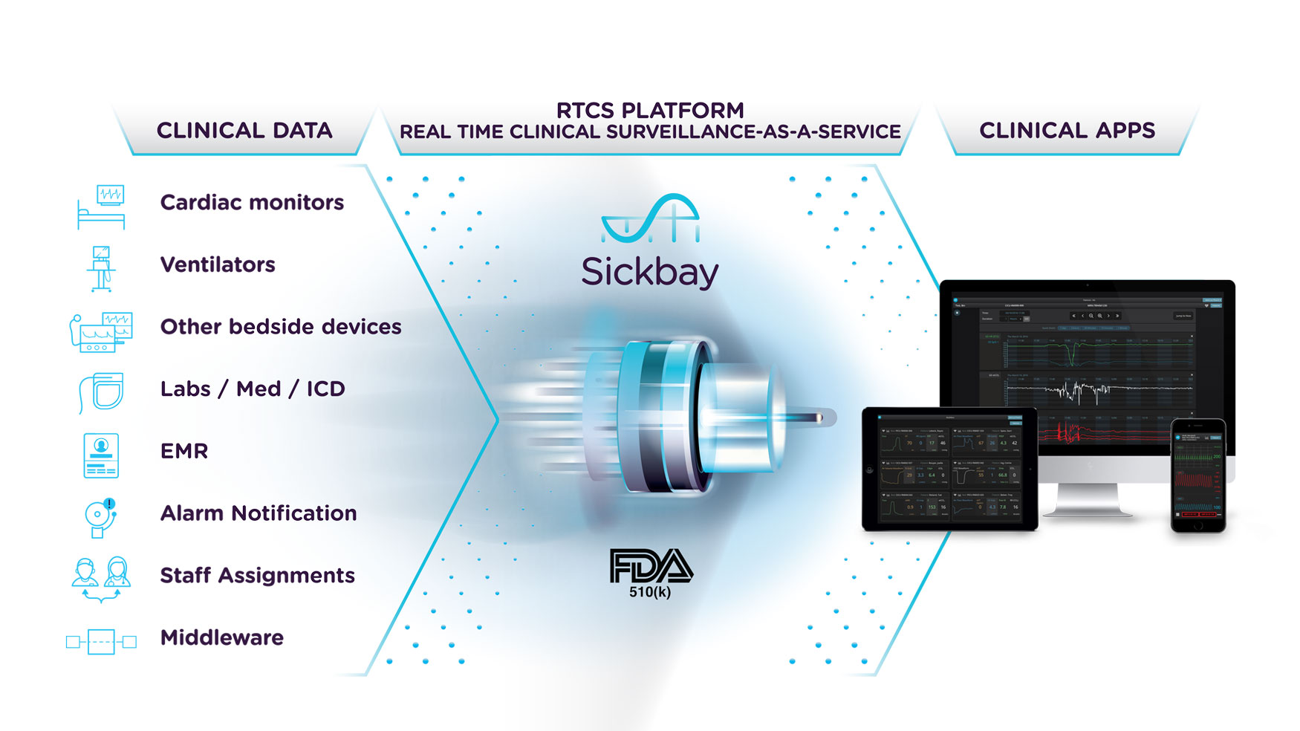

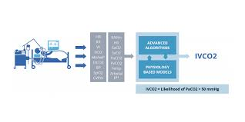
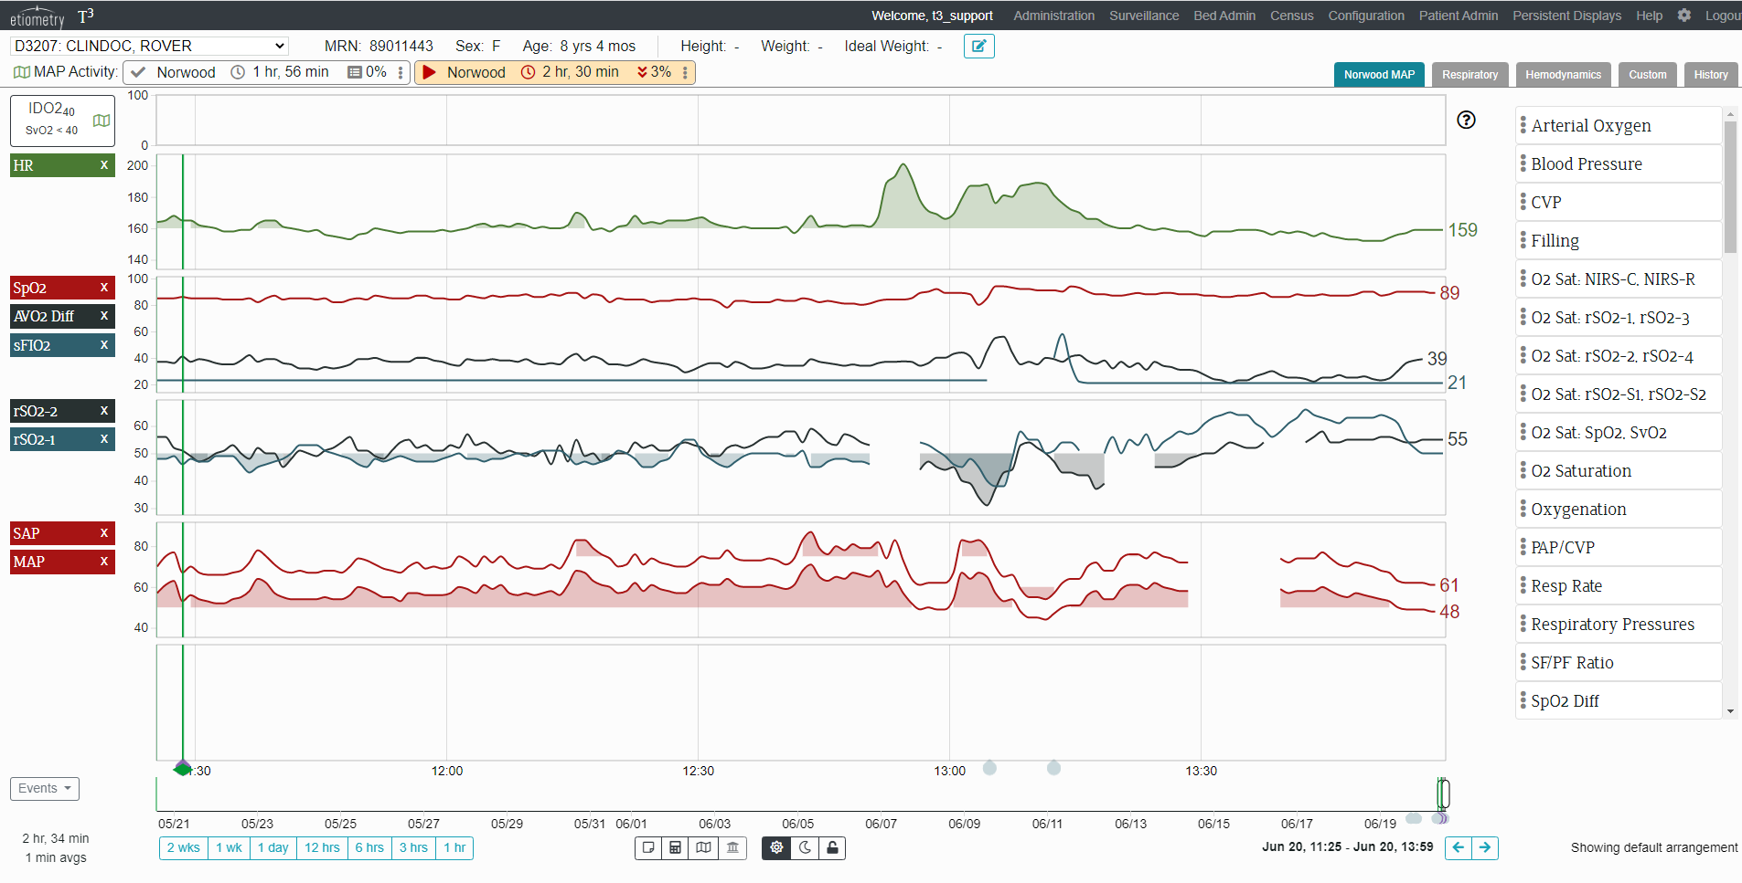
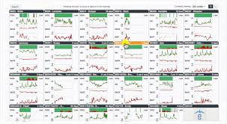
Notes:
To illustrate the purpose of these HFDC platforms being “device/EMR agnostic” in regards to their ability to collect data.

Slide 14
High Frequency Data Capture Systems: How do centers leverage them to improve outcomes?
Jeremy Affolter, MD
University of Texas at Austin
Joshua Salvin, MD
Boston Children’s Hospital
Nate Sznycer Taub, MD
University of Michigan
Notes:
With that 1000 ft overview in mind, Id like to introduce our speakers for the session who are going to share their experience(s) with HFDC system implementation at their institution. The scope will vary from system/hospital-wide integration efforts to daily clinical utilization to research and QI projects surrounding HFDC. I think I can speak for the panel when I say we believe we’ve only scratched the surface of the potential that HFDC has to aid in our ability to provide complex CHD care at the exponential growing rate that our specialty continues to have.

Slide 15
Boston Children’s Etiometry Experience

Slide 16

Boston Children’s Hospital Experience
Joshua W Salvin, MD MPH
Division of Cardiovascular Critical Care Medicine, Boston Children’s Hospital
Associate Professor, Harvard Medical School
Boston, Massachusetts, USA
Notes:
Laura and Daniel

Slide 17
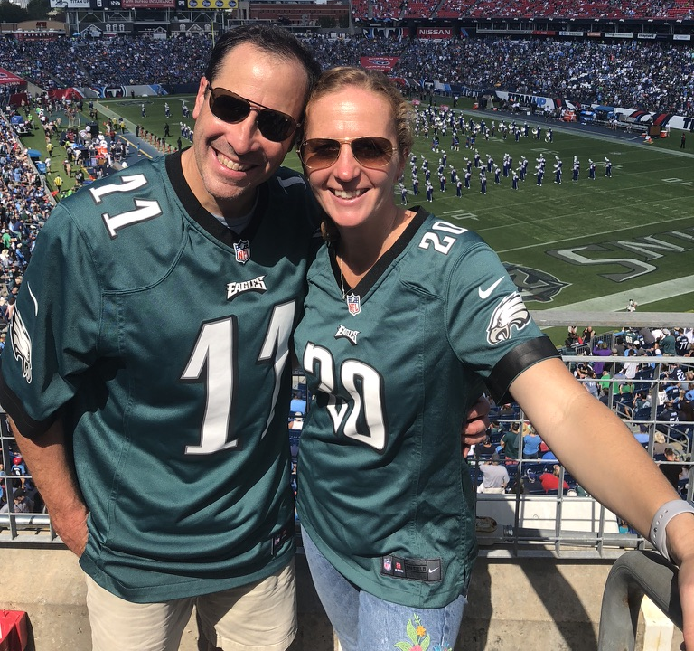

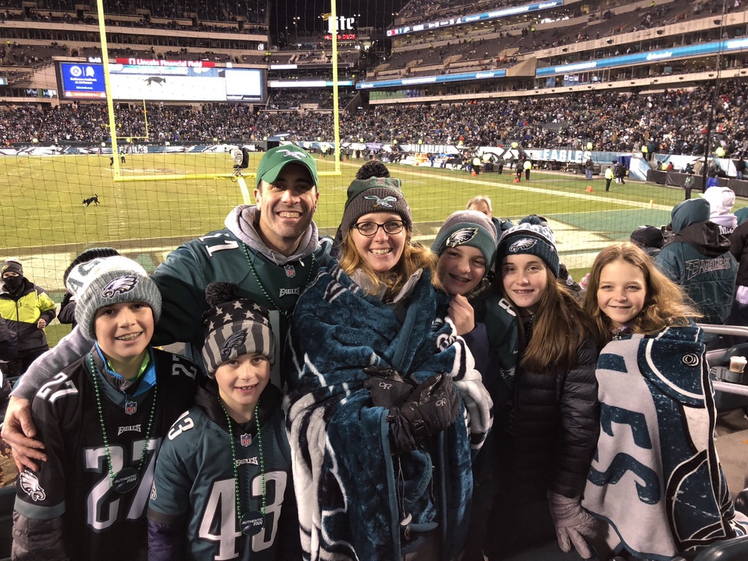
Disclosures
Funding via National Heart, Lung, And Blood Institute of the National Institutes of Health Small Business Innovation Research Grants (SBIR) Phase IIb: Risk Assessment Using Noninvasive Measurements in Postoperative Pediatric Patients. 2R44HL117340-03A1/04/05.

Slide 18
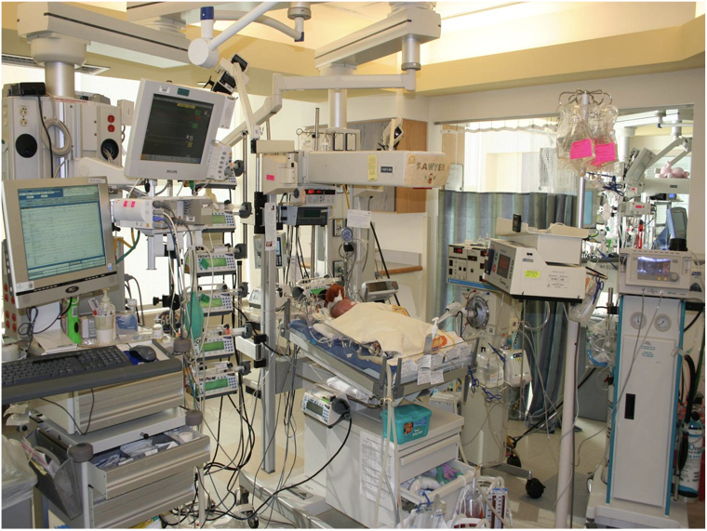
Introduction
Caregivers are challenged by
  high acuity
  low provider-to-patient ratio
  interdisciplinary team experience
  information overload
  subtle physiologic changes
  distractions

Slide 19
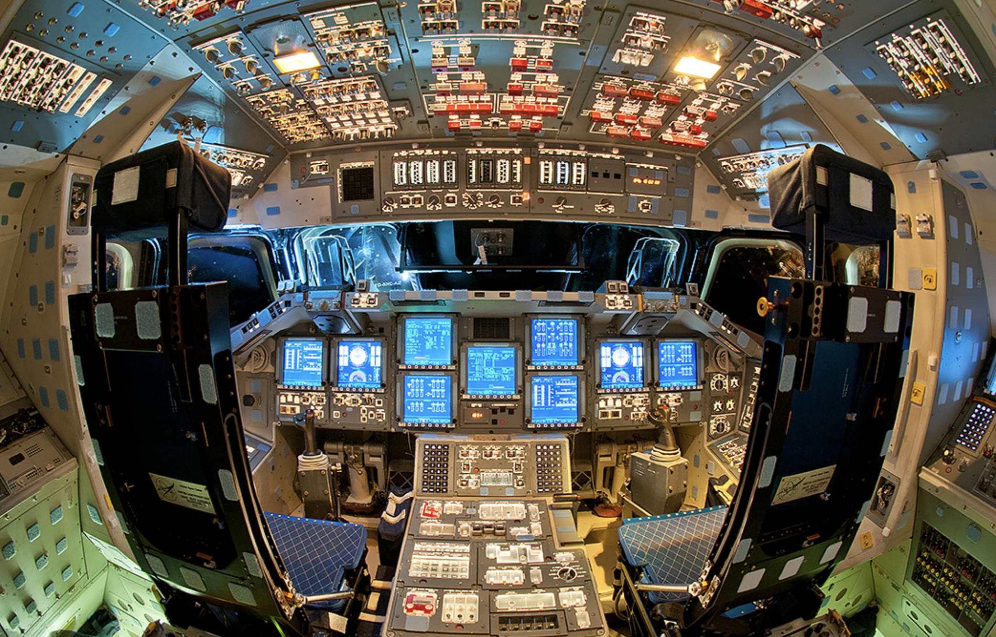
Introduction
Unlike aerospace industry
  most vulnerable periods often with fewest resources
  cost is a factor in delivery models
These factors may contribute to late recognition of clinical deterioration → adverse events

Slide 20
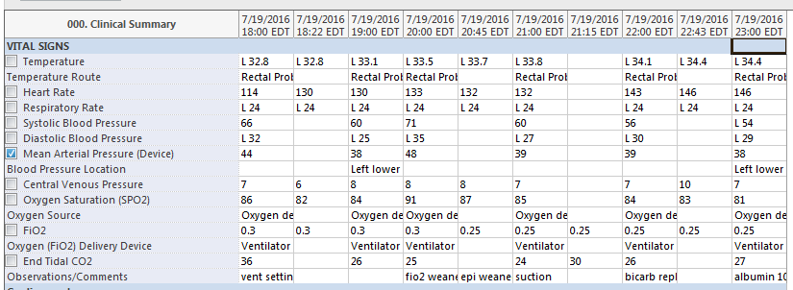
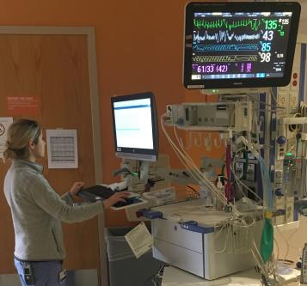
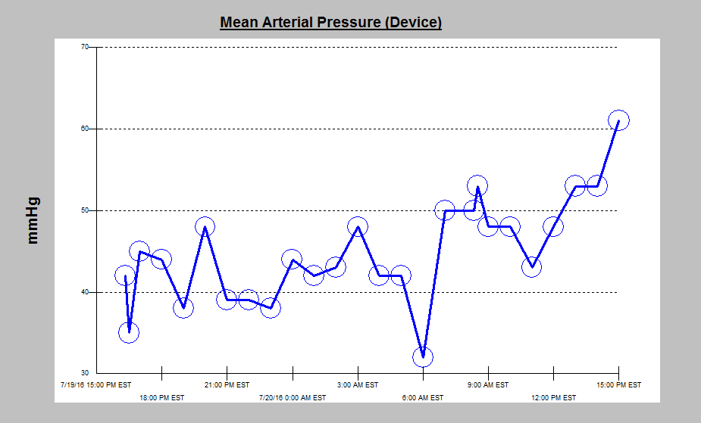
Traditional Monitoring

Slide 21
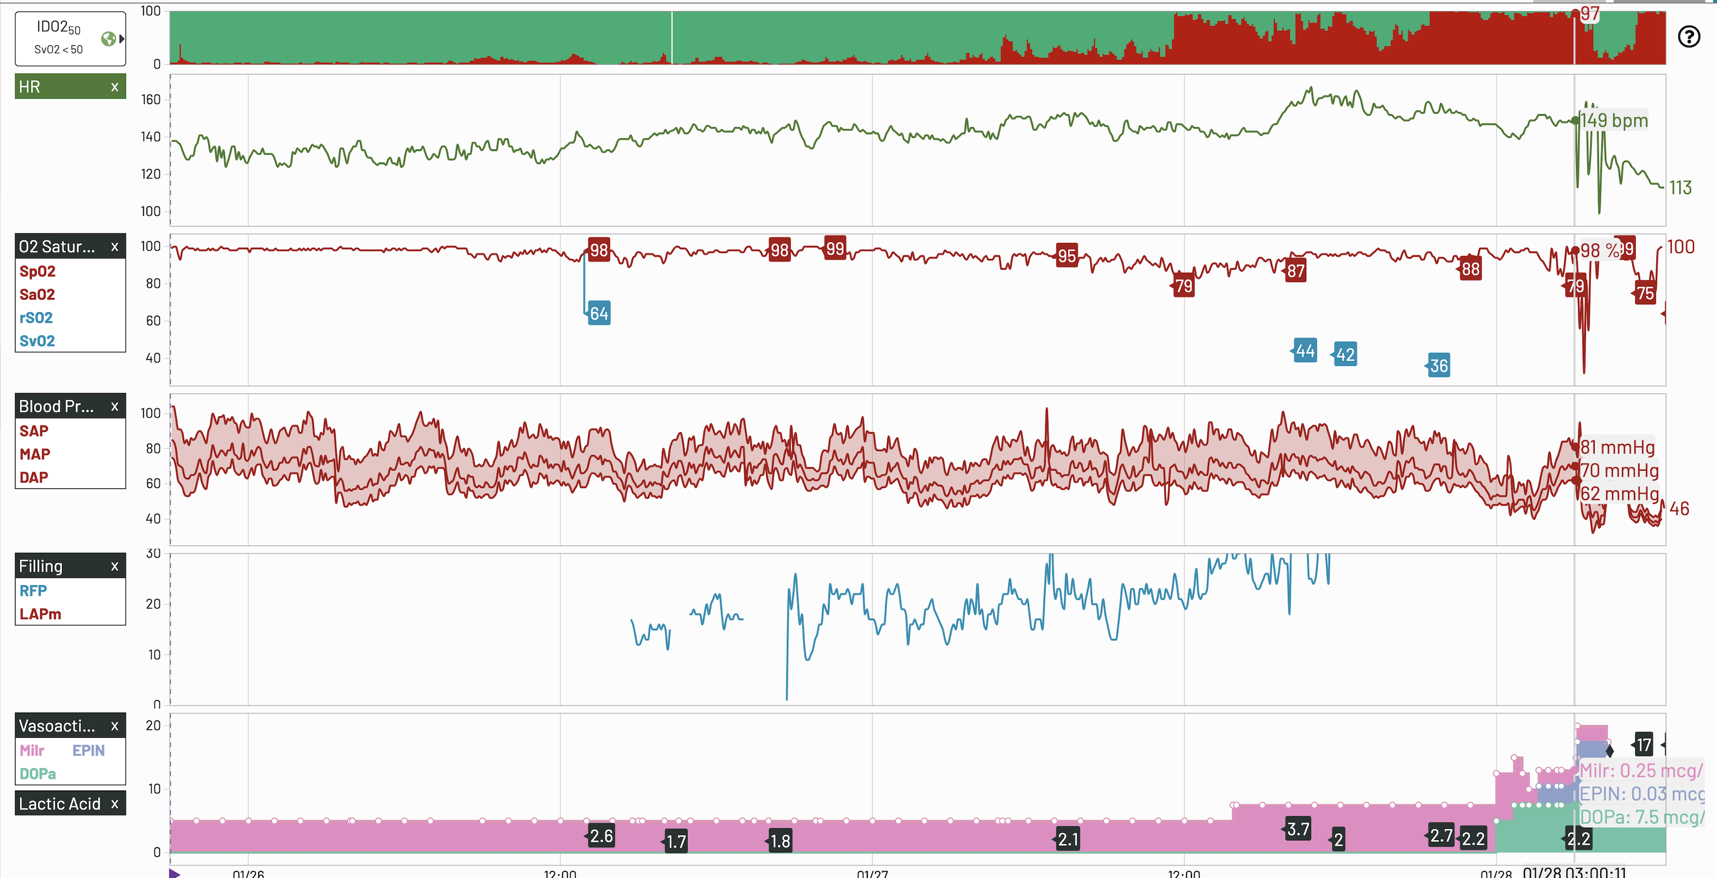
T3 platform

Slide 22
How much data?
Data collection on 515 BCH beds
  MSICU
  CICU
  ACCU
  NICU
  MICU
  ICP
From November 2010-March 2030
  183,921 patients
  663,956 patient days
  15,934,953 hours of data collected and stored

Slide 23
Data streaming and predictive analytics
Predictive analytics algorithms are informed by high-fidelity physiologic data streams and laboratory data
Inadequate Delivery of Oxygen (IDO2) and Inadequate Ventilation of CO₂ (IVCO2)
  Real time analytic models for the probability of mixed venous saturation <40% and pCO₂ >50mmHg, respectively
  Utilize up to 19 continuous and intermittent data inputs
May lead to early recognition of evolving clinical deterioration or allow early de-escalation

Slide 24
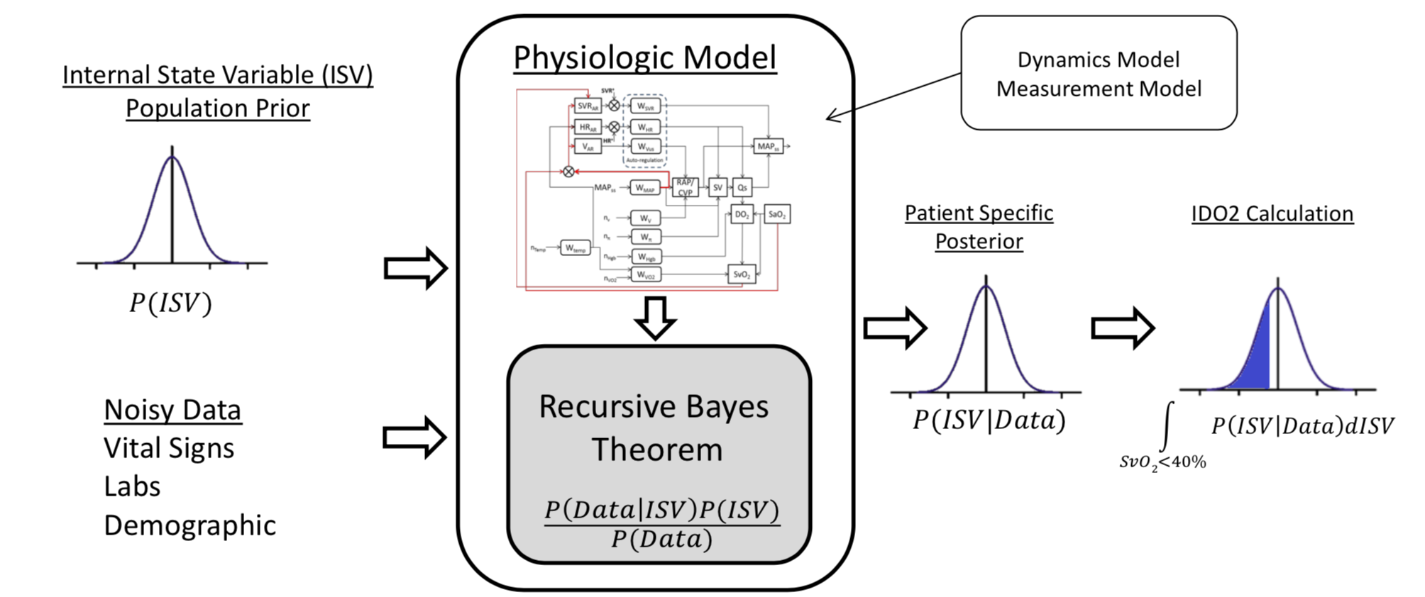
Predictive analytics - IDO2 Index

Slide 25
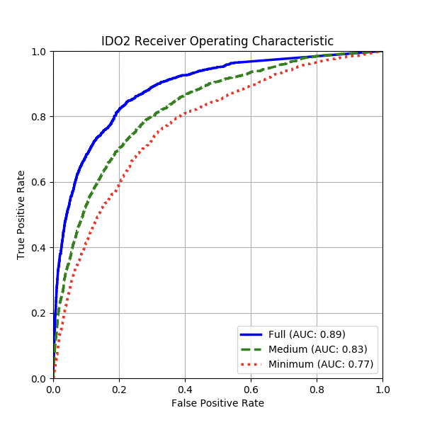
Predictive analytics – IDO2 Index
Predictive analytics to demonstrate odds of low SvO2
Power of model dependent upon the number of inputs

Slide 26
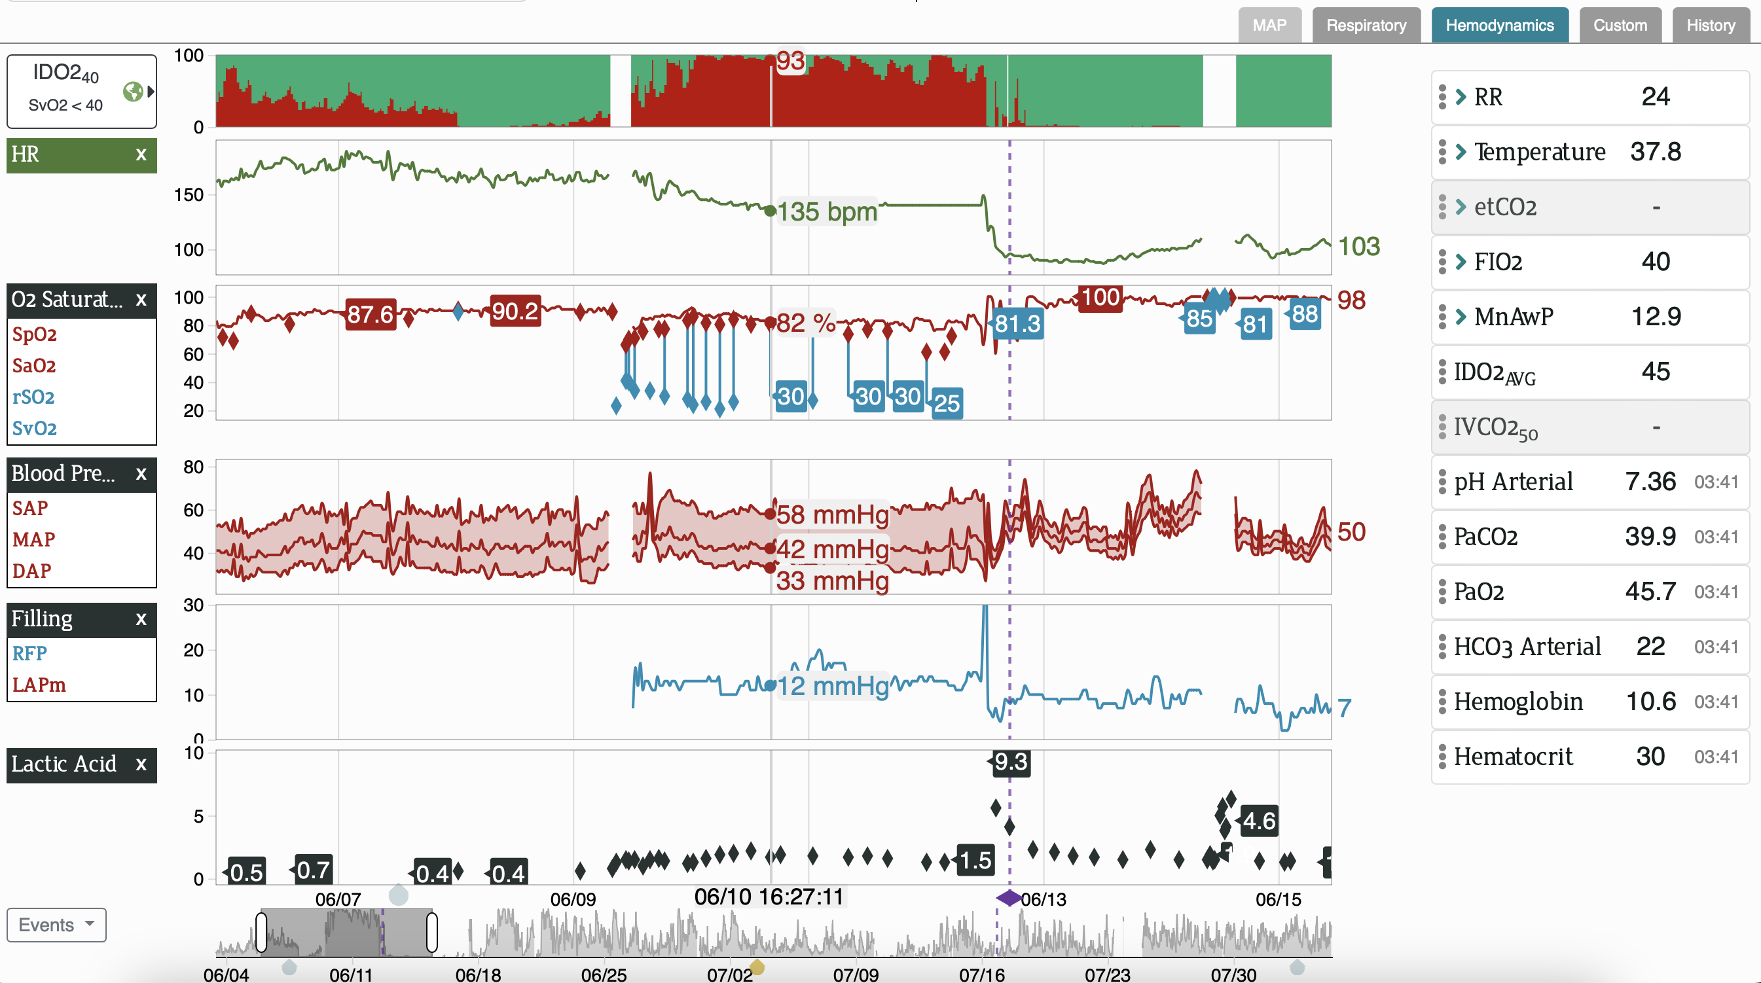
Predictive analytics - IDO2 Index

Slide 27
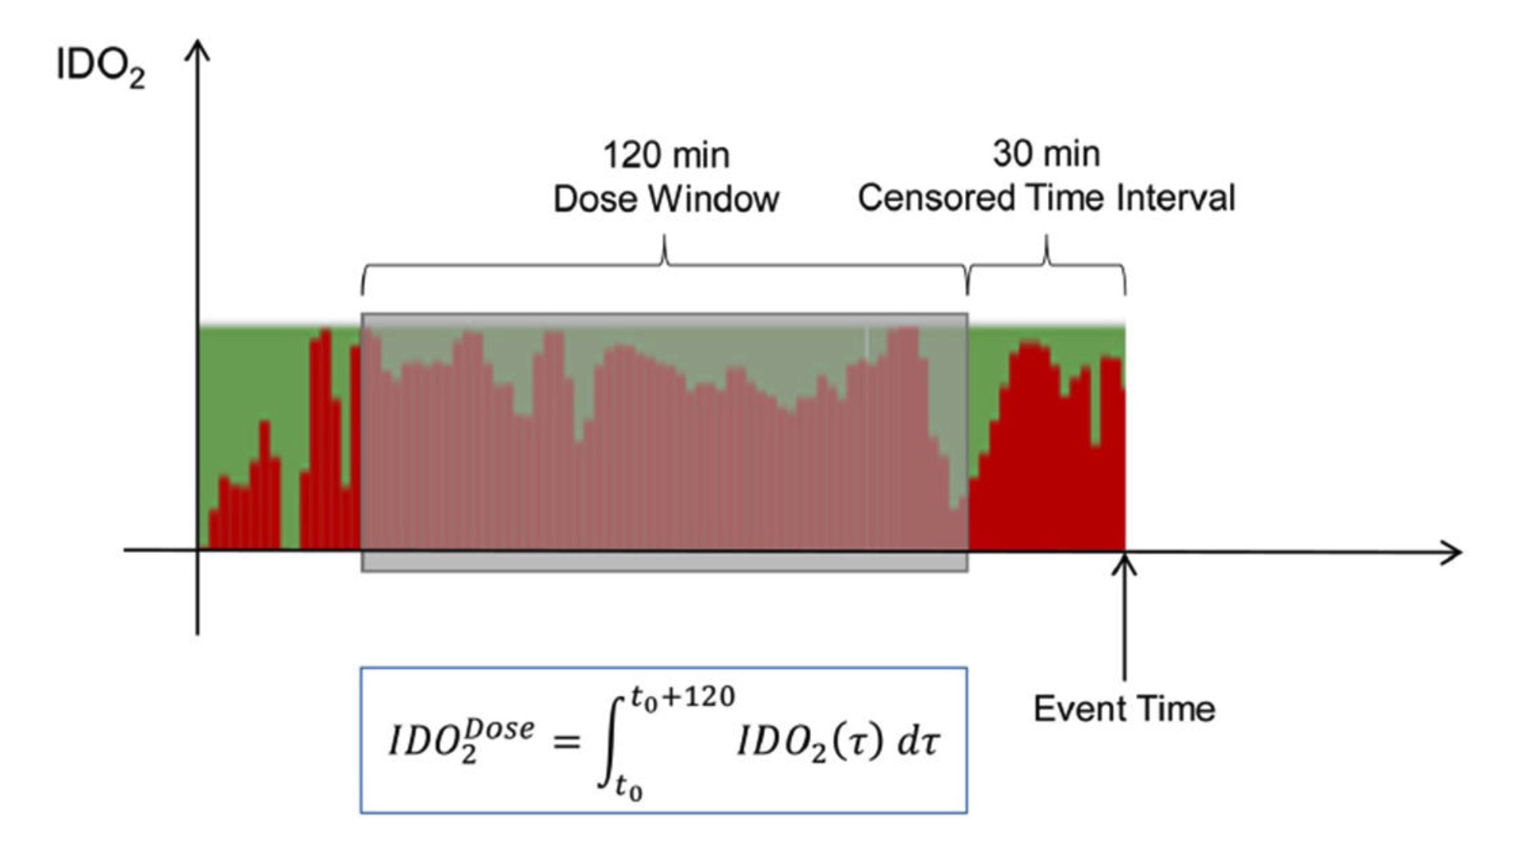
Inadequate Oxygen Delivery Index Dose is Associated with Cardiac Arrest Risk
Prospectively calculated the exposure or “dose” of IDO2 for patients with and without cardiac arrest
  defined as the area under the IDO2 curve computed over a 120- minute window that preceded the CA and “control” event by a censored pre-event window of 30 minutes
  Secondary/sensitivity analyses assessed alternative definitions of “dose of IDO2” with 20 minute and 10-minute censored pre-event windows substituted for 30 minutes.
Futterman C, Salvin JW, McManus M, Lowry AW, Baronov D, Almodovar MC, Pineda JA, Nadkarni VM, Laussen PC, Gazit AZ. Inadequate oxygen delivery index dose is associated with cardiac arrest risk in neonates following cardiopulmonary bypass surgery. Resuscitation. 2019 Sep;142:74-80.

Slide 28
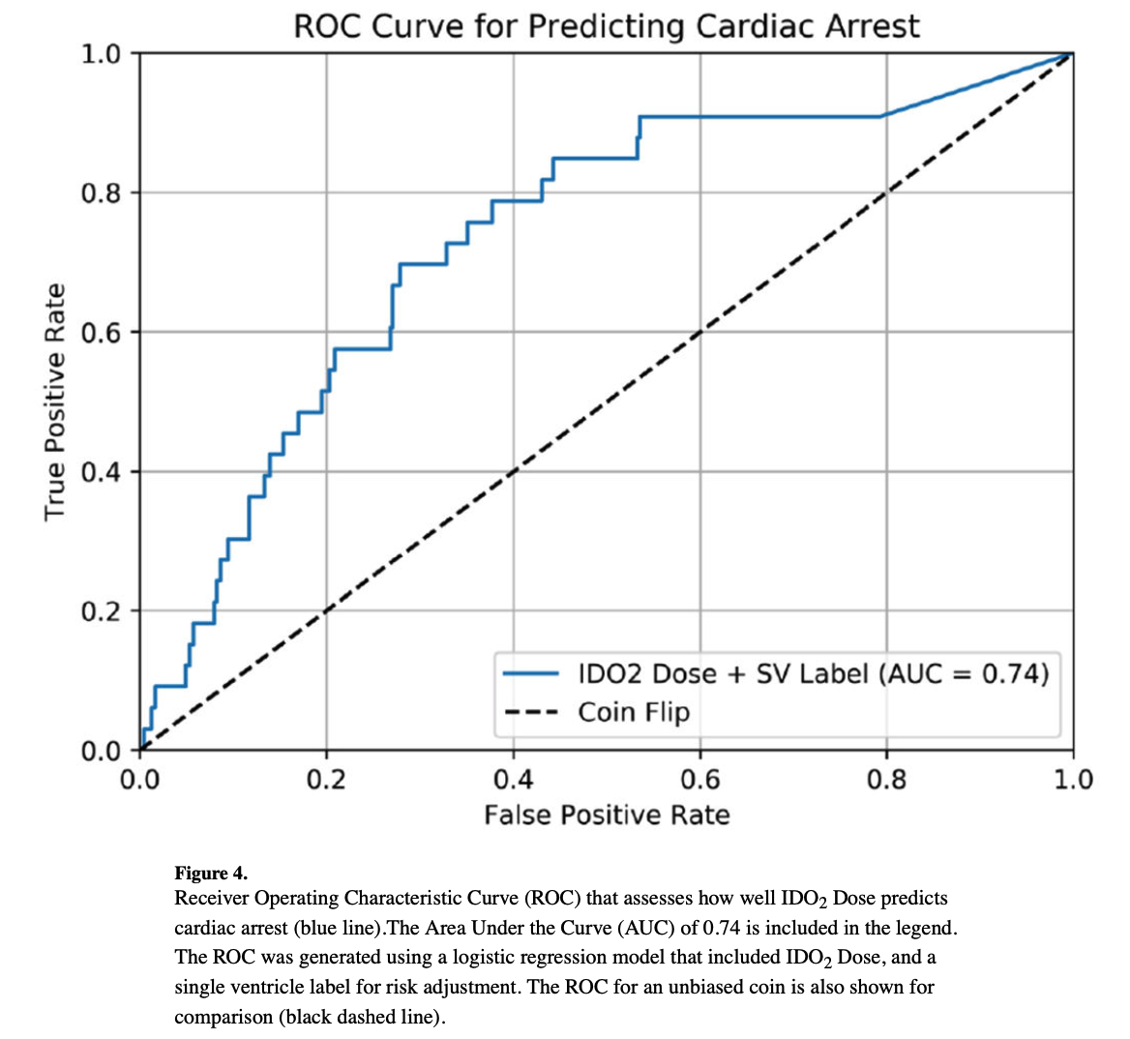
IDO2 as early warning

Slide 29
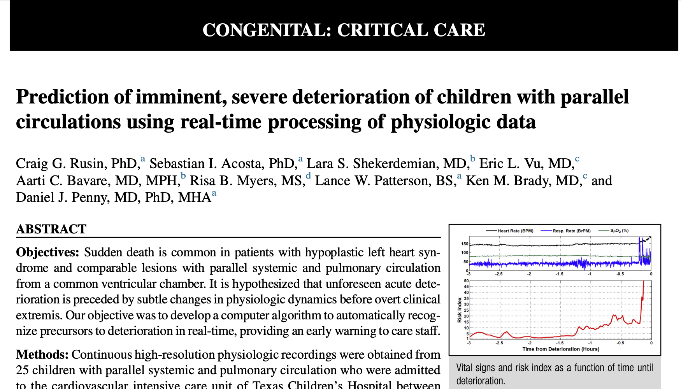
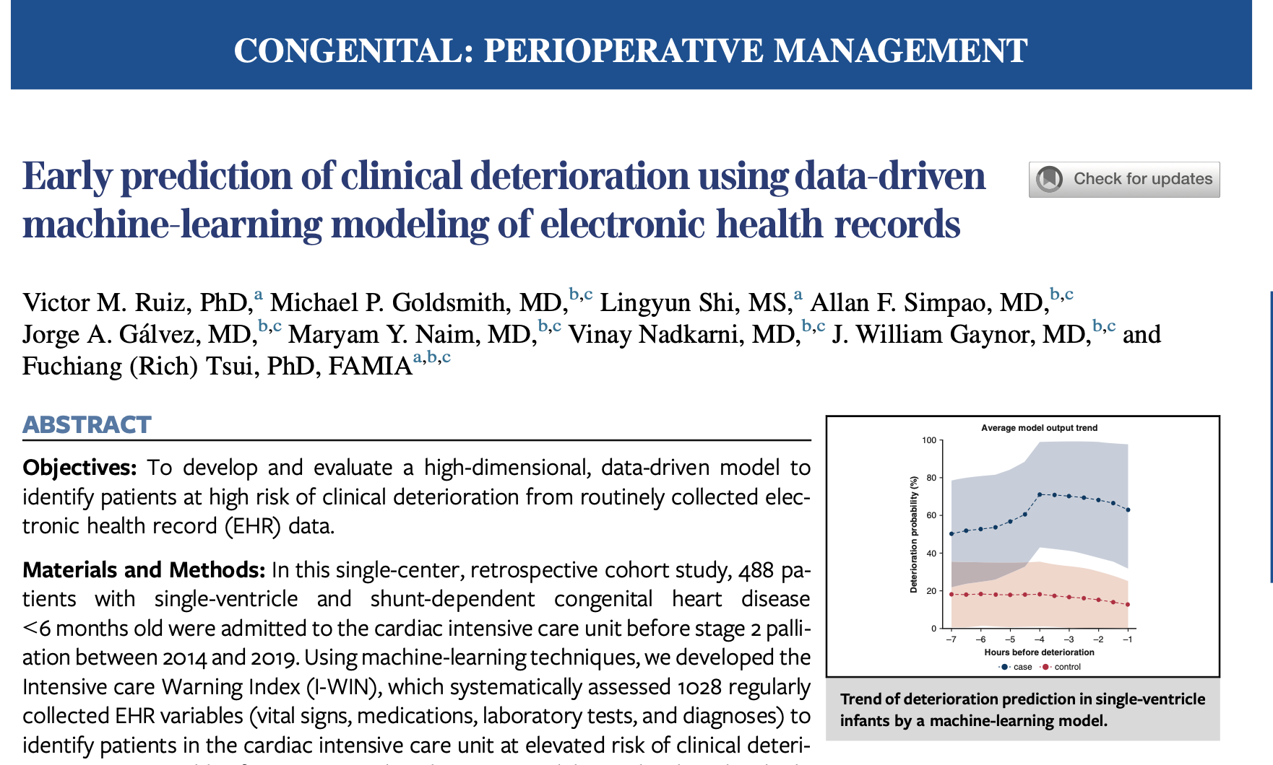
J Thorac Cardiovasc Surg. 2016 Jul;152(1):171-7.
J Thorac Cardiovasc Surg. 2022 Jul;164(1):211-222.e3.

Slide 30
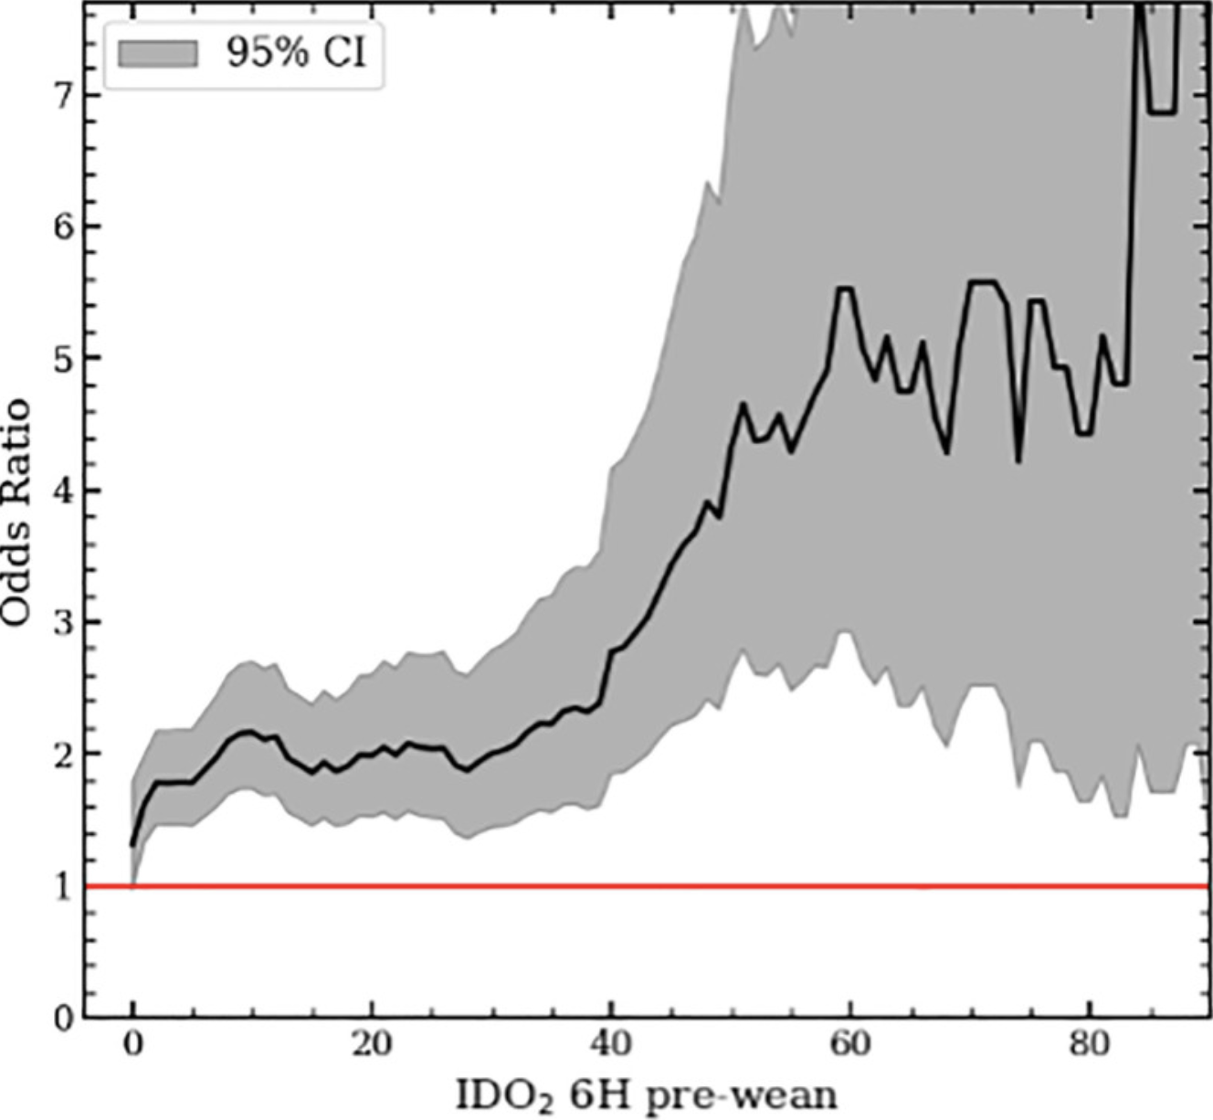
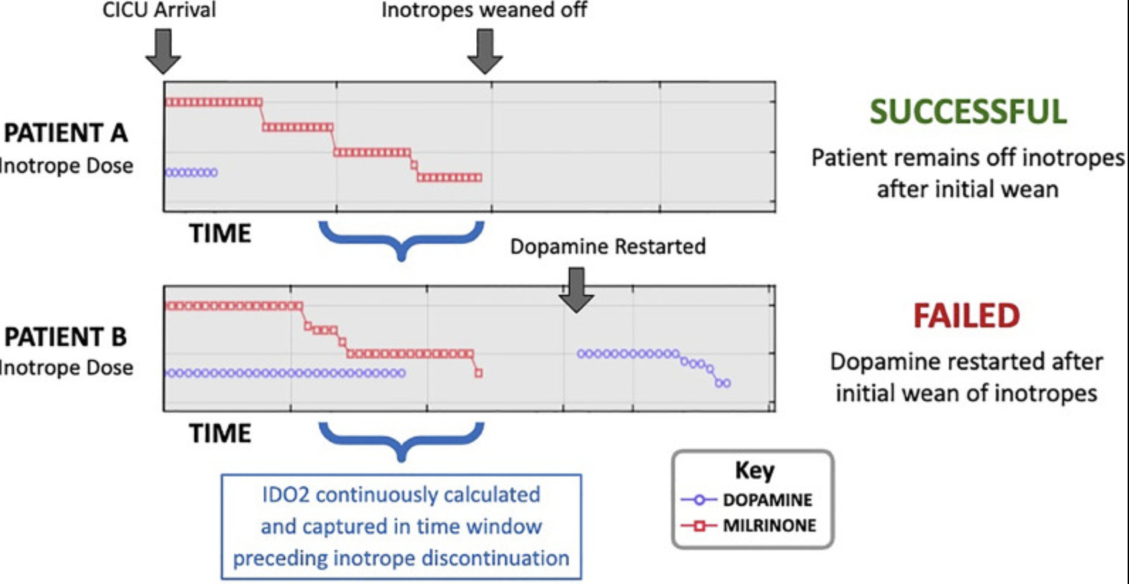
Use of a Risk Analytic Algorithm to Inform Weaning From Vasoactive Medication in Patients Following Pediatric Cardiac Surgery
Goldsmith et al 2021

Slide 31
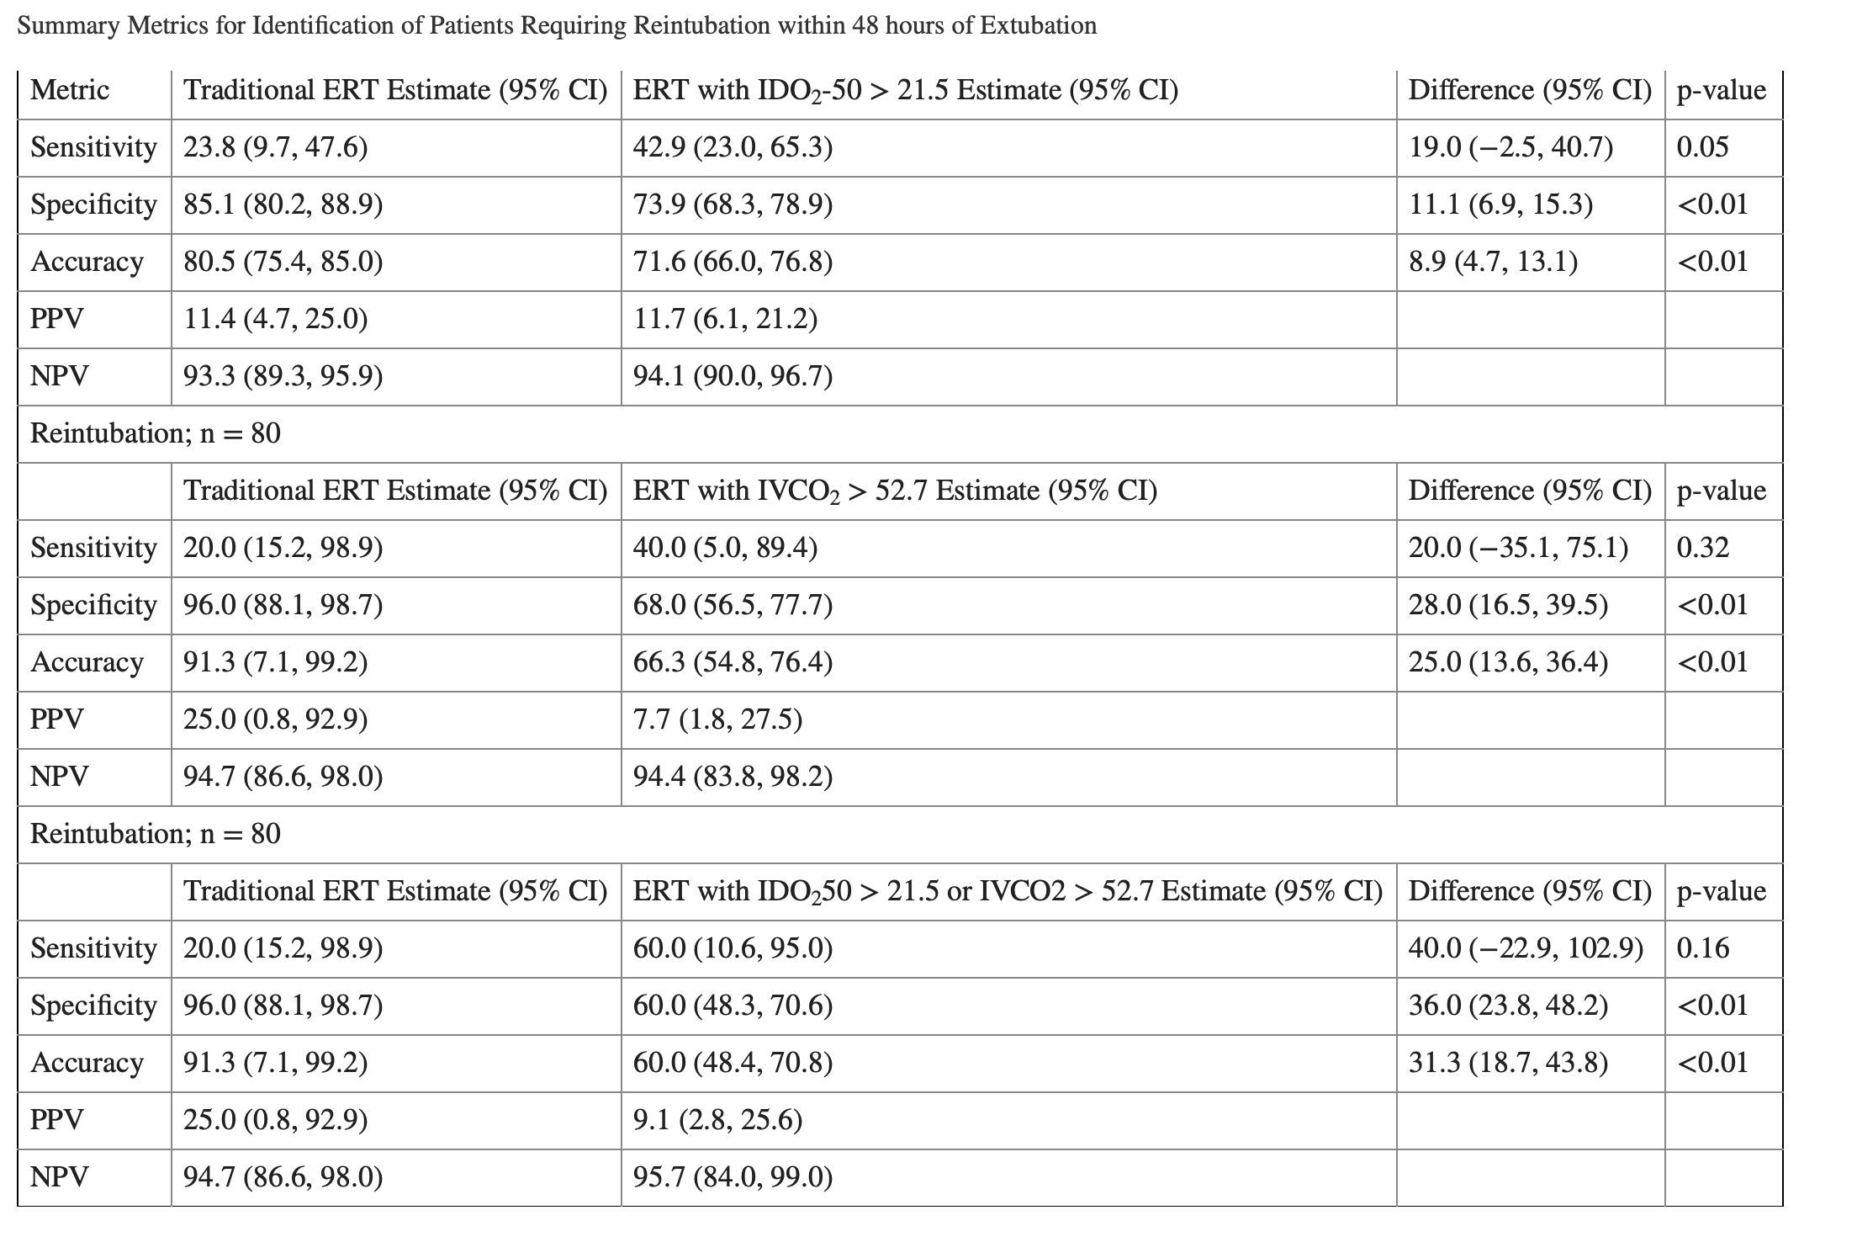
Associations with Extubation Failure and Predictive Value of Risk Analytics Algorithms with Extubation Readiness Tests following Congenital Cardiac Surgery
Hames et al 2022

Slide 32
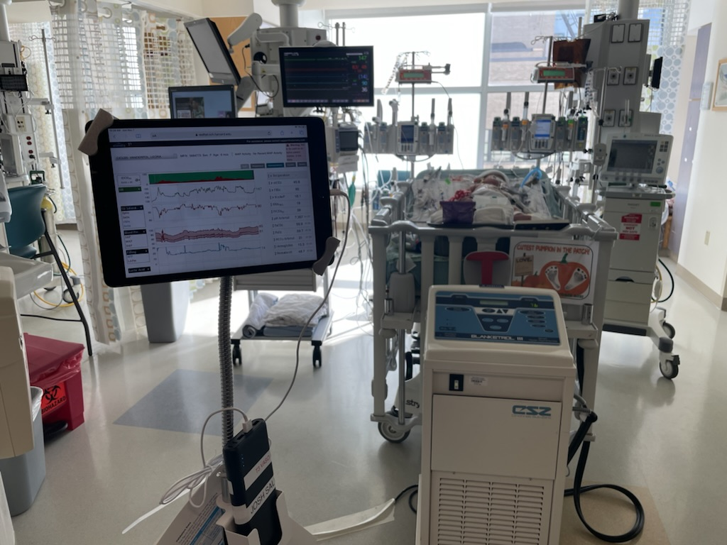

Slide 33
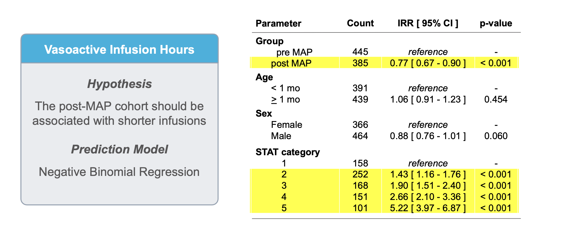
Vasoactive wean clinical trial
BCH, St. Louis, Children’s National
Negative binomial regression risk adjusted model showed that IVAI duration was 18% shorter (95% CI: 5 - 29%) in the intervention group, with the largest effect size in STAT 5. There was no change in ICU LOS or cardiac arrest.
Use of a Risk Analytic Algorithm to Inform Weaning from Vasoactive Medication in Patients Following Pediatric Cardiac Surgery, Futterman C, Gazit A, Salvin JW et al., World Congress abstract 2023

Slide 34
Can predictive analytics improve outcomes?
To gauge impact of these tools:
  Need to understand how and why decisions are made
  Implementation is key – clinical decision support system?
  An understanding of the workflow and environment
  Capture human factors

Slide 35
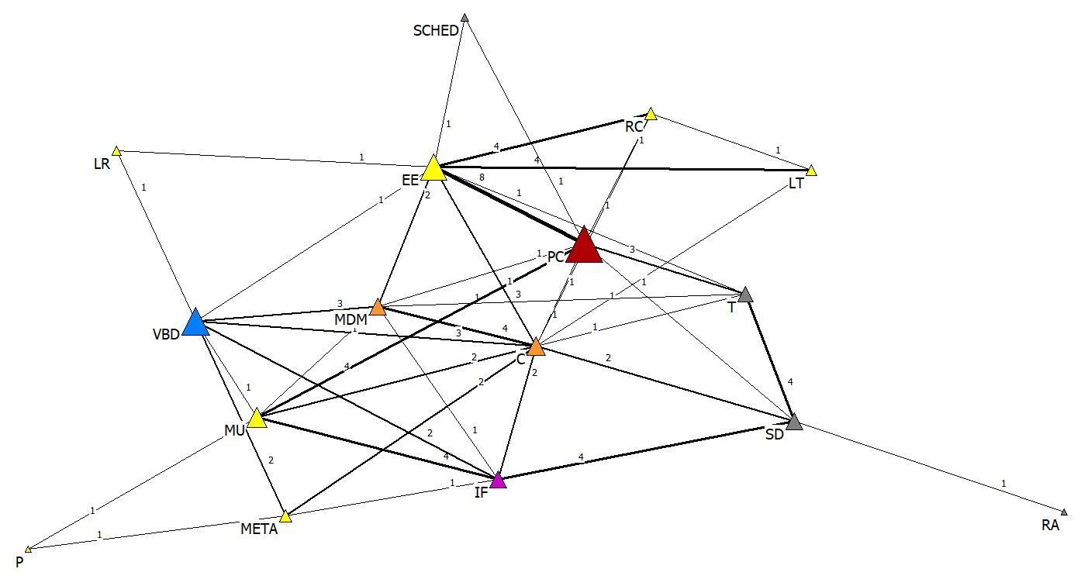
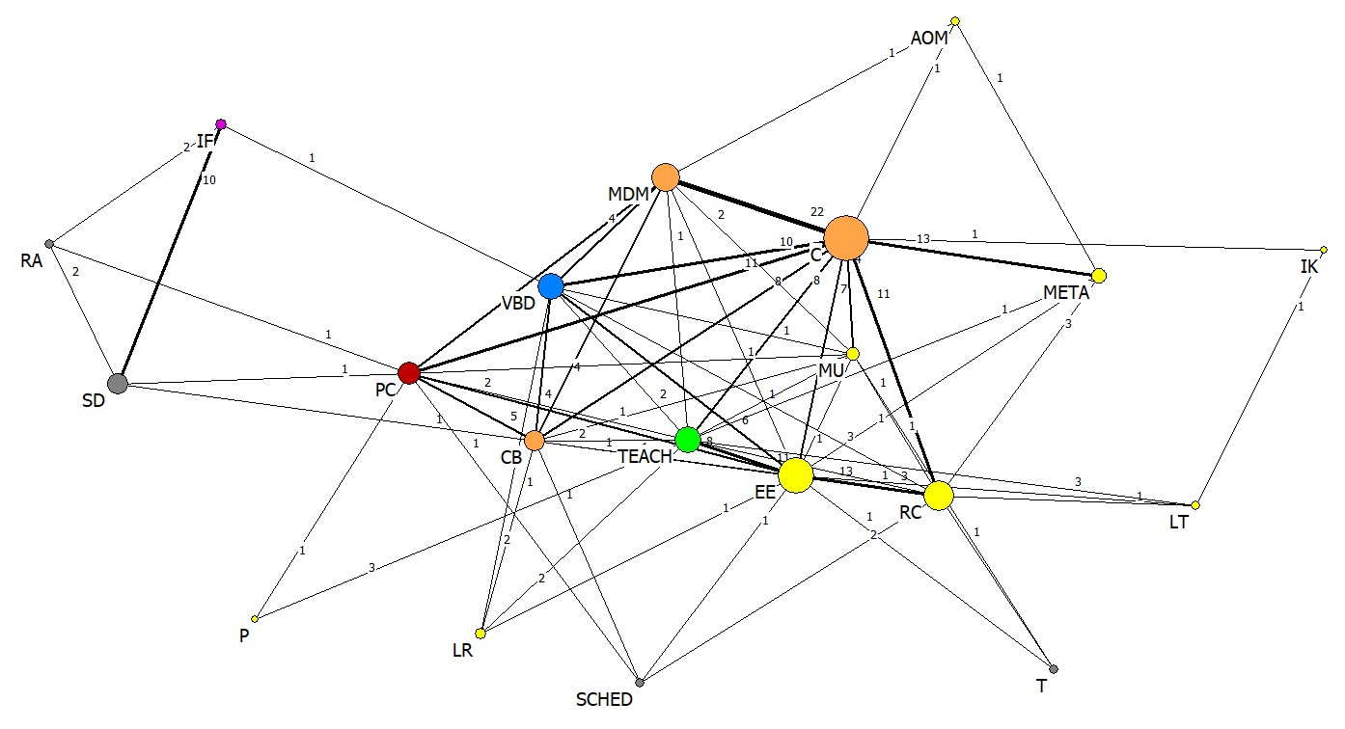
Human factors
Semi-structured Interviews
Interviews vs. Observations
  How we say we make decisions is quite discrepant from how we make decisions
    Patient characteristics (what we say) vs. team expertise and value based (stakeholder) characteristics (what we do)
  Technology is directly connected to patient characteristics in what we say
  Technology is very peripheral from patient characteristics in what we do
Ethnographic Observations
Complex decision making in an intensive care environment: Perceived practice versus observed reality; Teele SA et al. Journal of Evaluation in Clinical Practice; 2024, 30(2), 337-345. https://doi.org/10.1111/jep.13930

Slide 36
Why is this important?
Modification of human factors is an essential component of incorporating technology aimed at optimizing patient care, improving the workplace environment, strengthening systems-based practice, and improving our approach to trainee education
Without a more sophisticated understanding of human factors, implementation of any CDSS tool is unlikely to have an impact in outcome

Slide 37
Conclusions
High frequency data collection systems may serve as a both early warning indicator of adverse events and an indicator for de-escalation of care
Must derive a better framework for utilization of such tools in order to maximize potential
Understanding of human factors are essential prior to the implementation of any analytics tool

Slide 38
UT Austin Sickbay Experience

Slide 39
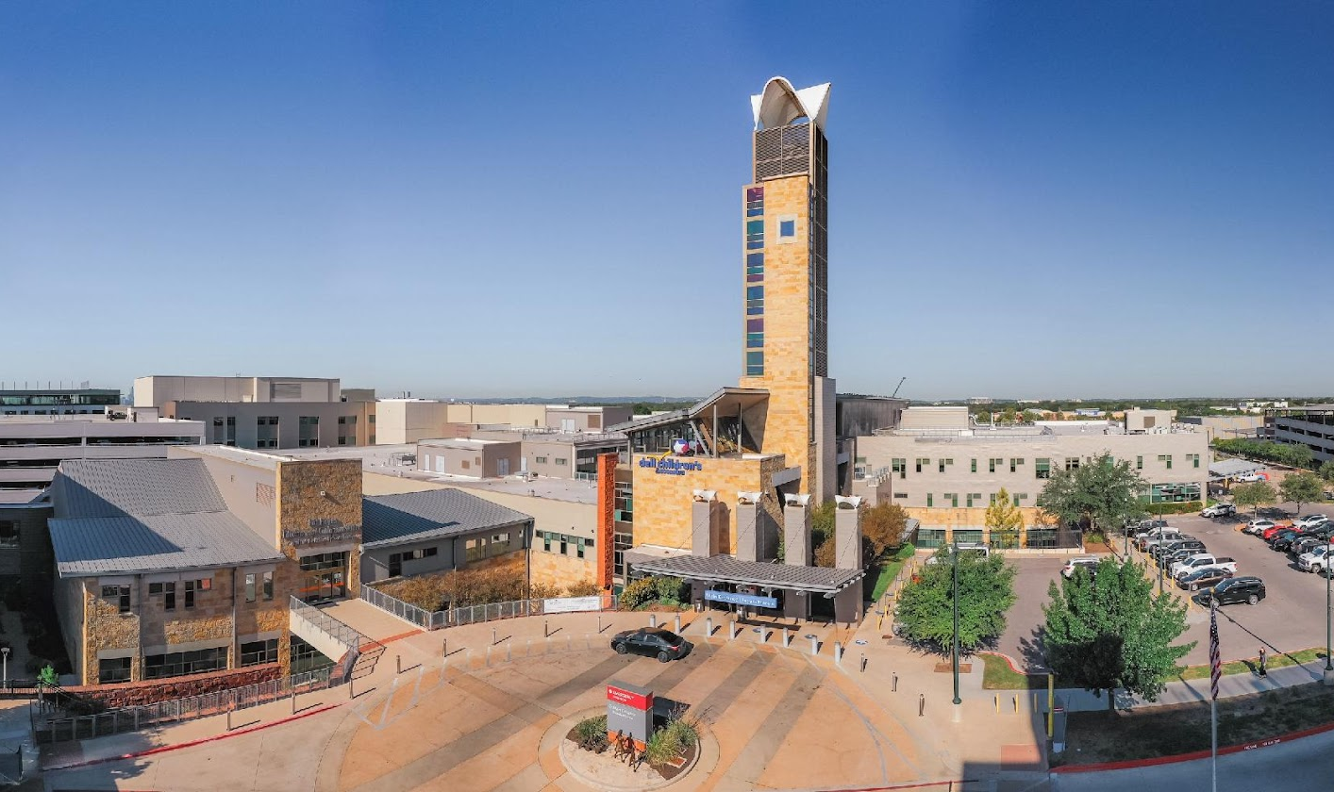
2018 Sickbay integration vision
  Research platform
  Quality improvement
  Clinical outcomes

Slide 40
DCMC Sickbay Integration
PHASE 1
PHASE 2
Phillips device integration
CCU and PICU first
  Extended to NICU
  ….CVOR and Cath lab…then ED
Barriers
  Corporate
  Technical aspects (components, jacks, etc.)
Non-Phillips device integration
  CCU
    Complete bed monitoring
    Trend monitor
    NIRS
    Ventilator
    Labs and medications
  CVOR and Cath lab
    Draeger anesthesia machines
    NIRS
    Perfusion pump

Slide 41
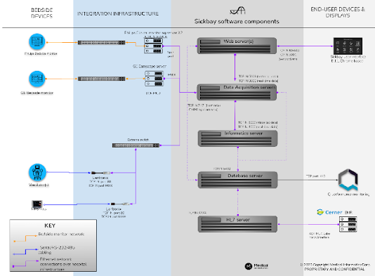
Phase 1
Phase 2

Slide 42
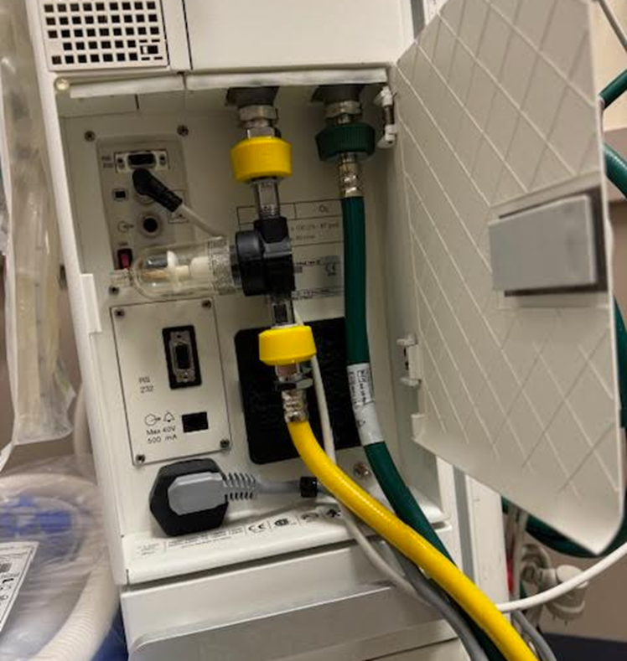
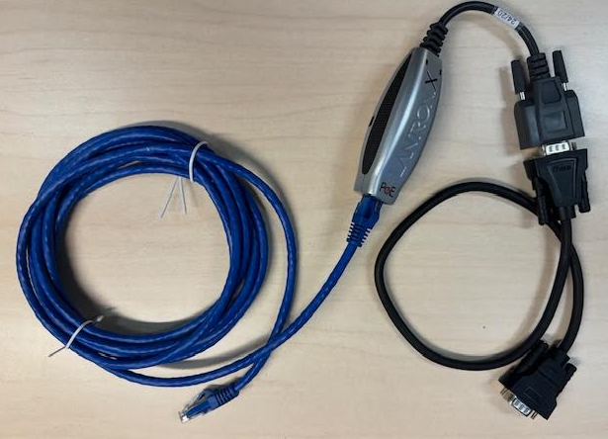
For Each Ventilator:
Lantronix dongle
Serial cable
Ethernet cable
Into wall jack
Right here

Slide 43
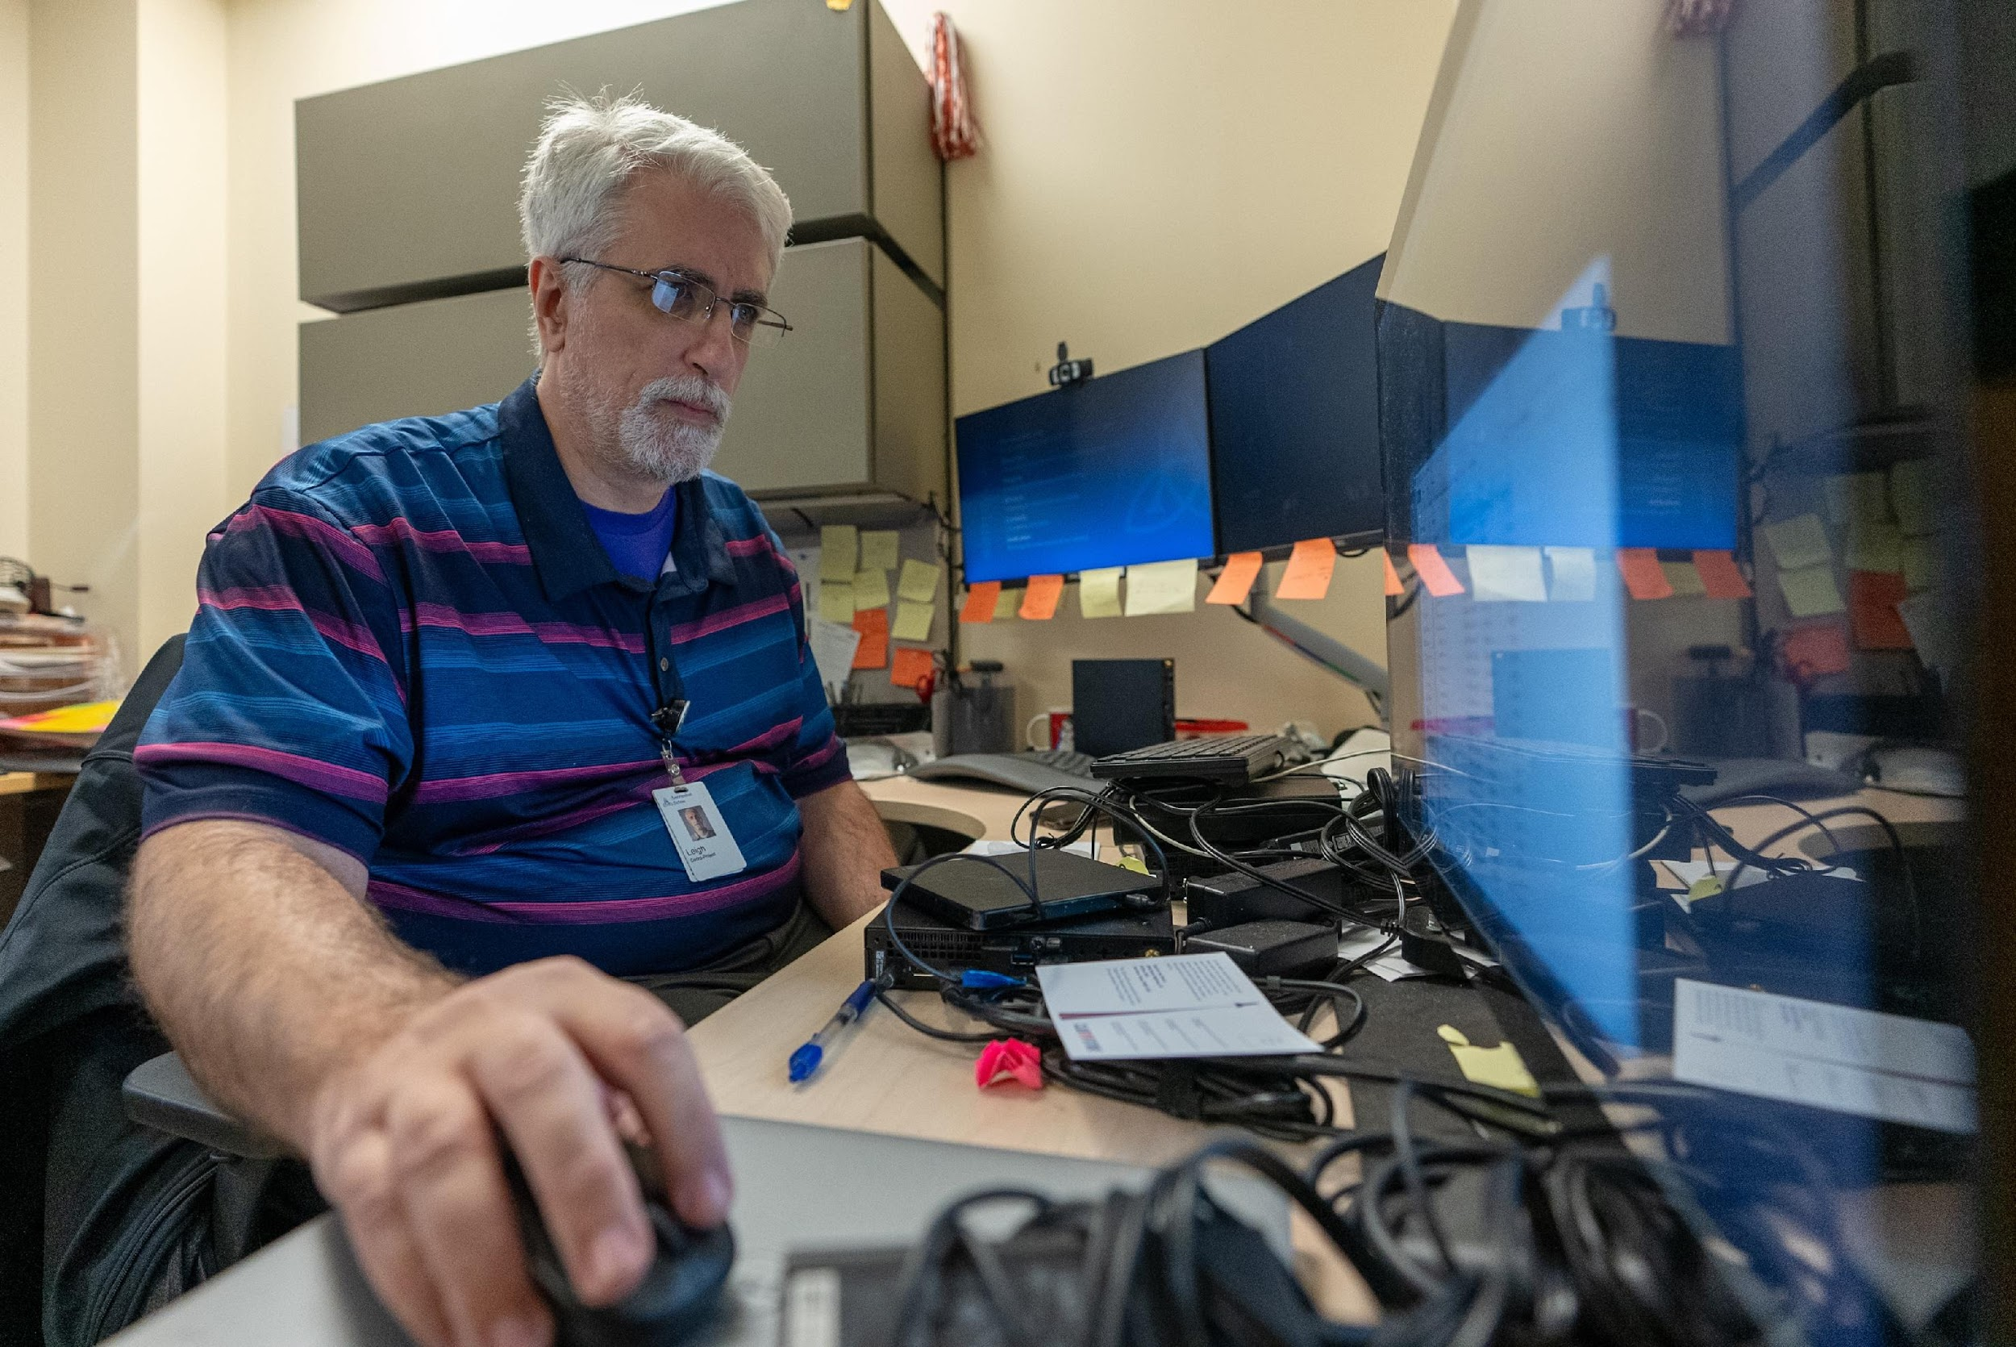
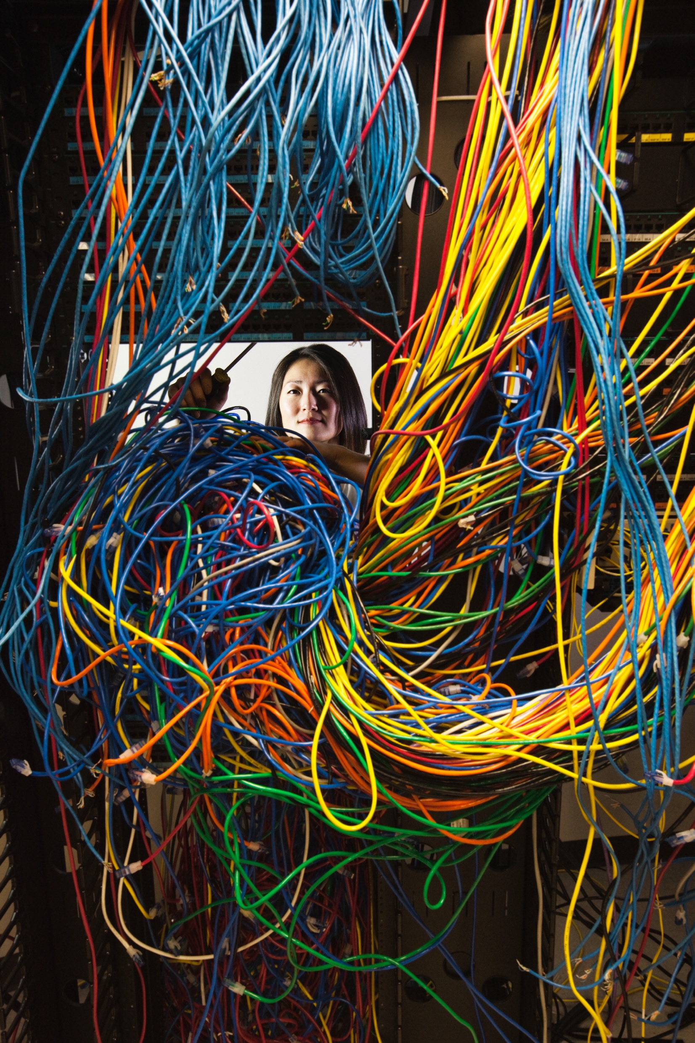
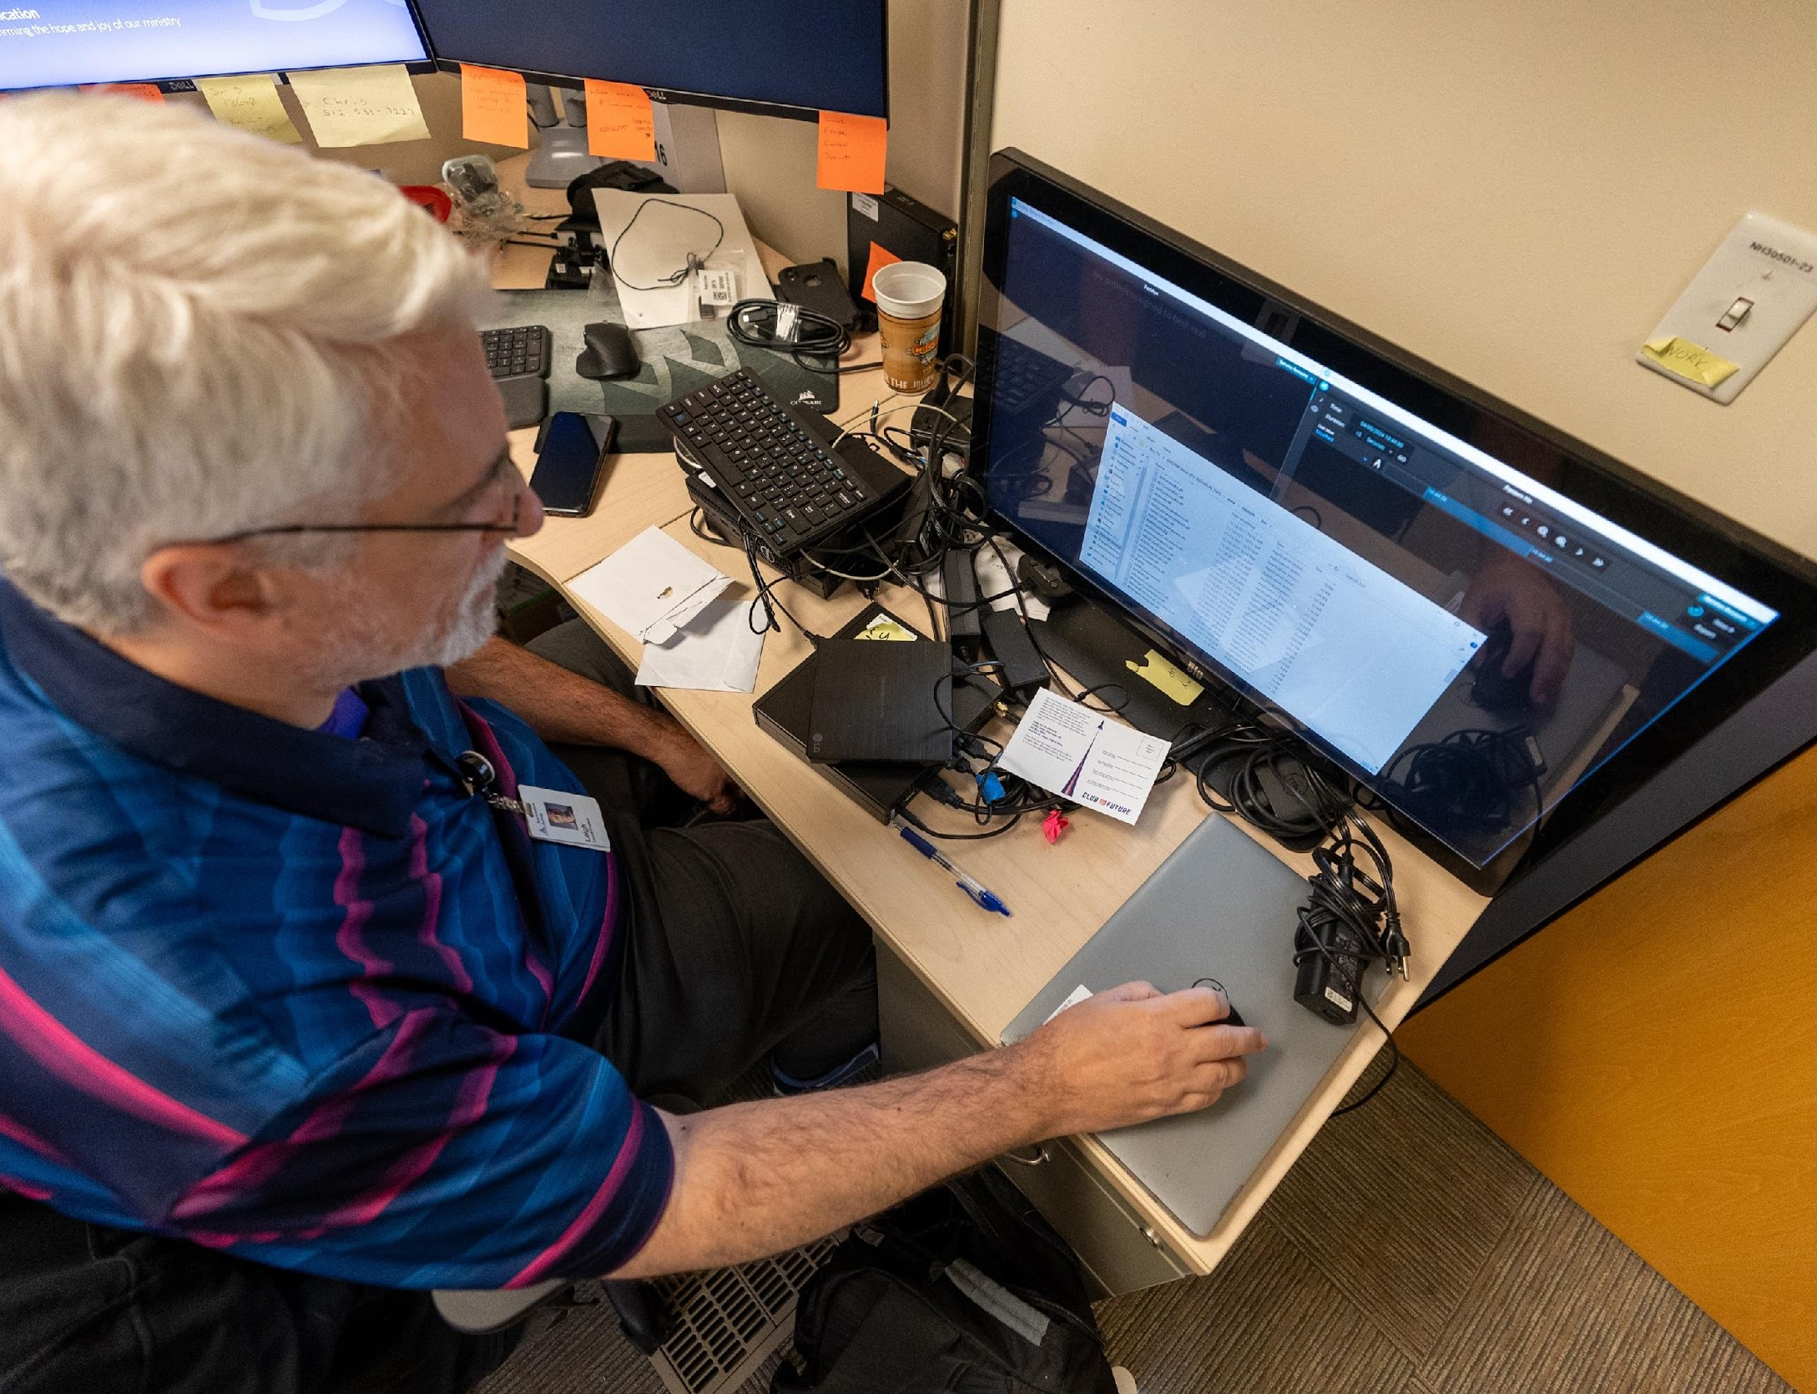

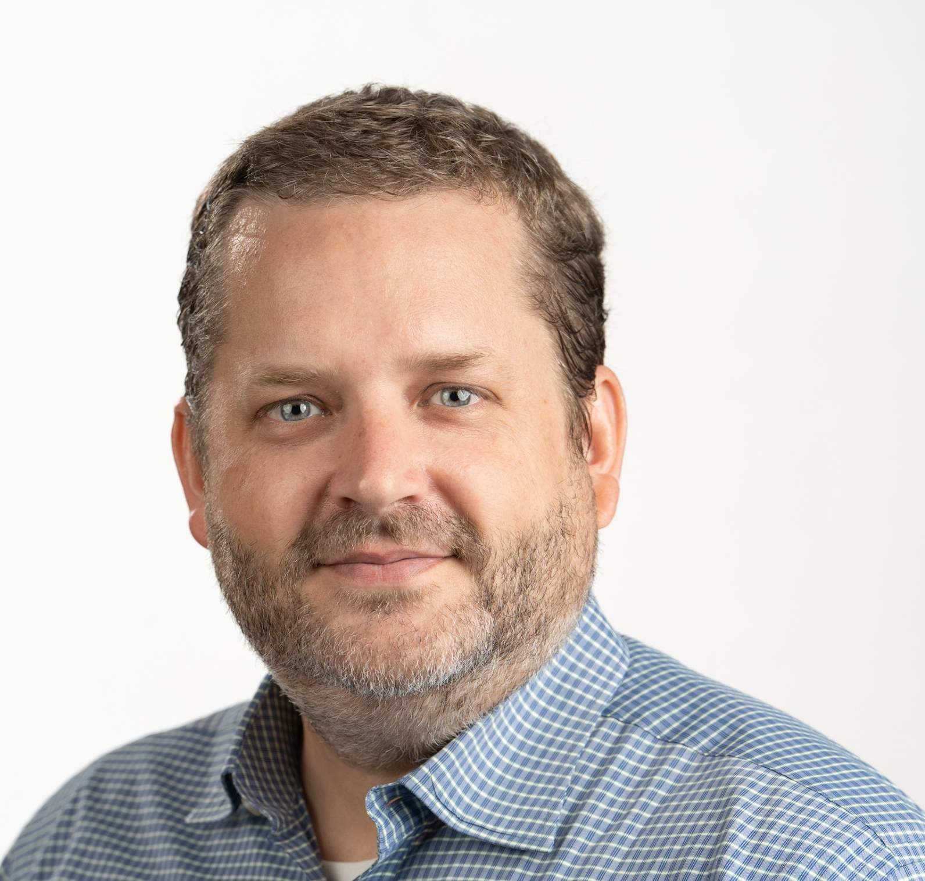
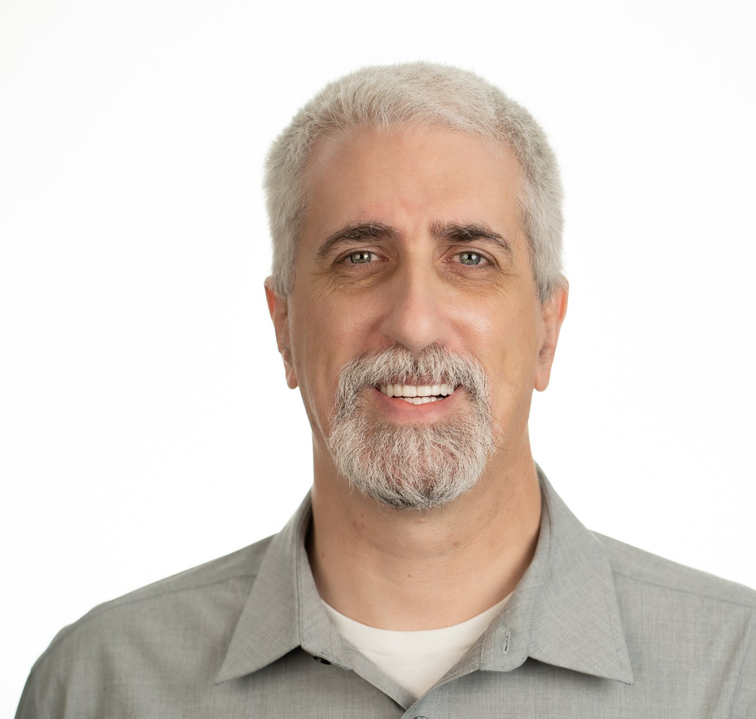
What this set-up really looks like…

Slide 44
Clinical Utility

Slide 45
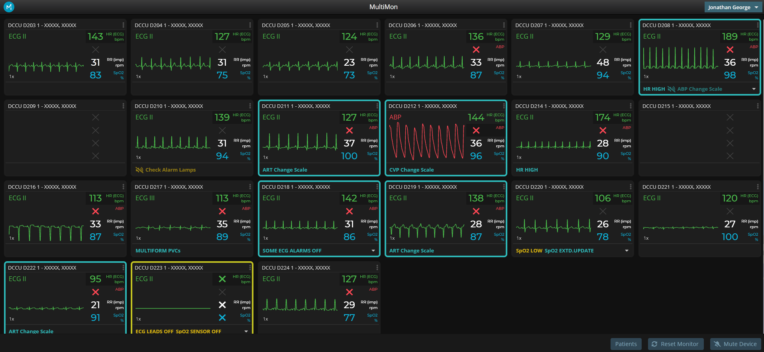
Workroom Monitoring

Slide 46


Slide 47

Monitor with dual display (6h trend)

Slide 48
Quality Improvement

Slide 49

CPR Debrief

Slide 50

Medication Administration Inputs

Slide 51

Mechanical Ventilator Inputs

Slide 52
Research Activities

Slide 53


Hemodynamic Response to Blood Transfusion
6 babies underwent ASO
  Evaluation of 10 blood transfusions
  Median 36h after surgery
  [IQR:10-40]
Systolic and mean BP for increase for 3 hours after transfusion
  5-12.5% increase above baseline
Up to 57,600 vital sign data points per transfusion…
MF Mikulski, Cardiology in the Young, 2024

Slide 54

Post-Operative Trajectory Mapping
14 babies underwent ASO
  Median day of life 7 [IQR: 4-14]
  6 (43%) had VSD
  No perioperative mortalities
Blood pressures decrease and recover over the first 1.5-2 days post surgery
DP Howsmon, 2024

Slide 55

Peritoneal Dialysis
Initiation
Inadequate
Analgesia / Sedation
Notes:
Light and dark blue are the CI and SD for all 14 ASO patients…
The dark grey is patient 1 and patient 6 respectively deviating from expected trajectory (leave one out, cross validation stats)…. Proof of concept that TMs of postoperative hemodynamics can be built after as few as 10-15 cases. Pilot study performed on relatively homogenous cohort of d-TGA patients undergoing ASO.
Patient 1 has deviation below baseline due to peritoneal dialysis initiation. Patient 6 has deviations above baseline due to inadequate pain control (per independent, retrospective chart review)
(4 CLICKS TO SUPERIMPOSE CIRCLES AND TEXT BOXES

Slide 56


PediRES-Q IAC-CPR
data extraction
SICKBAY DATA
D Stromberg, 2024

Slide 57

CVP Waveform Analysis for VTE
20 patients with US diagnosed CVL associated VTE
  Median age, 33 days
  Predictive signature of VTE formation
D Stromberg, 2024

Slide 58

Alternative Vital Sign Integration
Quality improvement opportunity
Association with usual vital signs
Association with medications and other stimuli
Improved inpatient environment and
Improved neurodevelopmental growth

Slide 59
Leveraging HFDC systems to improve outcomes
Clinical utility and quality improvement = Prevention
Research analysis = Predictive analytics
Starting it all up
Analysis challenges
Overabundance of data for each item
Overabundance of data elements
Collaboration opportunities

Slide 60
University of Michigan Experience

Slide 61
Timeline of HFDC at Michigan
Sickbay
Etiometry
2016 2017 2018 2019 2020 2021 2022 2023 2024
2018 Hospital IT assumed cost/maintenance of Etiometry
November 2022 Sickbay Activation
September 2016 Etiometry Activation
August 2023 Etiometry deactivated

Slide 62
Implementation of Etiometry
How did it get implemented?
Originally brought in as a research endeavor with philanthropic funding for the pediatric cardiac ICU
  *** was eventually expanded in Children’s Hospital to cover PICU, NICU, and other clinical wards during height of COVID pandemic

Slide 63

How did it get implemented?
Technology brought on without guidelines or planned use
Evolution into practice was “natural” and guided by providers
Almost exclusively used as a clinical tool in our center
Became “ingrained” in our clinical workflow (pre-rounding, rounding, surveillance, handoff, night rounding, etc)
No persistent displays at bedside

Slide 64

User Logins for Etiometry

Slide 65
Evidence that Etiometry
Influenced Outcomes?
PC4 Data
Manuscript (Difference in differences)

Slide 66


PC4 Data (Adjusted Mortality and CAs)
September 2016 Etiometry Activation
September 2016 Etiometry Activation
***2017: Cardiac Arrest Prevention Bundle Rollout

Slide 67


PC4 Data: Adjusted CICU LOS and Ventilation Times
September 2016 Etiometry Activation
September 2016 Etiometry Activation
***2015: Core PHN Site for Early Extubation in OR Collaborative Learning Project

Slide 68

CICU Readmission Rates
September 2016 Etiometry Activation

Slide 69

Difference in difference (DID) analysis to determine if outcomes observed at Michigan were statistically different from secular trends at control hospitals within PC4
-DID is method for evaluating the impact of major organizational changes or implementation of health policies and is more robust than a time-series analysis due to inclusion of control (unexposed) hospitals
Pre-implementation era; 8/1/2014 to 9/21/2016
Post-implementation era: 9/22/2016 – 1/31/2018
Control PC4 hospitals (N=21)
-Had at least 6 months of data prior to post-implementation era
-Hospital that used data visualization software were included

Slide 70


No statistical differences at U of M between pre- and post-implementation period:
DID analysis:

Slide 71


Example of Etiometry used for Research
Retrospective analysis of PC4 registry data and streamed data from Etiometry during patient’s last extubation readiness trial
Time: (2016-2018)
Data was analyzed using machine learning methods
178 encounters (11% extubation failure rate)

Slide 72
Implementation of Sickbay
How did it get implemented?
Hospital system was looking for a new vendor for telemetry across the hospital. Sickbay was awarded the bid in 2022.
Launched across adult and children’s hospital to provide live remote monitoring of nearly all beds
Our team noted that data visualization of patient trends (Patient history app) was “basic” and required multiple “upgrades” on the part of team

Slide 73


How Sickbay is Used
Live Remote Monitoring of Multiple Patients
Trends of Individual Patient Data

Slide 74
Current usage in Pediatric Cardiac ICU:
User Logins to Sickbay over 4 months
Variability in usage across provider group
Not reflective of time spent in ICU

Slide 75


Evidence for Sickbay Affecting Outcomes?
August 2023 Etiometry deactivated
November 2022 Sickbay Activation
November 2022 Sickbay Activation
August 2023 Etiometry deactivated

Slide 76


Evidence for Sickbay
Affecting Outcomes?
August 2023 Etiometry deactivated
November 2022 Sickbay Activation
August 2023 Etiometry deactivated
November 2022 Sickbay Activation

Slide 77
Comparison (Our Opinions and Usage***)
Etiometry:
  Visualization of data trends
    Very user friendly and customizable
    Most common use by CICU team
  Able to review multiple patients quickly and efficiently on rounds or on a as needed basis
    Extubation readiness
    Readiness for transfer out of ICU
    Picking up on trends where interventions may be needed
  Code or M&M reviews (drill-downs or teaching)
Sickbay:
Able to view realtime monitors of individual or multiple patients
  Good for keeping ”watch” over troublemakers
  Most common use by CICU team
Visualization of data trends is possible not as user friendly
Code or M&M reviews (drill-downs or teaching)

Slide 78
Comparison (Our Opinions and Usage***)
Importance of a “culture of comfort/awareness” of a patient’s clinical trajectory
Which system provides this may depend on individual provider:
  User friendly data visualization of patient trajectory (Etiometry)
  Real-time remote monitoring of patient condition (Sickbay)

Slide 79
Clinical and Research Utilities of HFDC
FDA cleared for remote monitoring
FDA cleared for bedside use
FDA cleared algorithms (4 risk indices)
Ability to embed ICU-specific care guidelines
Automated reporting on QI metrics for guidelines
Demonstrated outcomes improvement from multiple hospitals and applications
Calculation and display of calculated parameters
Usage reporting for ICU leadership
Self service permanent data storage (web interface or API)
Algorithm software development kit
Tools for 3rd party rapid algorithm computation and FDA validation
Community of researchers with 150+ ongoing research projects
Normalization of data across all hospitals to facilitate multicenter research
Additional services and support available
Notes:
LAST SLIDE TO REVIEW HFDC UTILIZATION UP TO THIS POINT AND FOR FUTURE DIRECTIONS… CAN KEEP UP ON SCREEN DURING Q&A??

Slide 80
Literature References
Mikulski, Linero, Stromberg, Affolter, Fraser, Mery, Lion. Analysis of haemodynamics surrounding blood transfusions after the arterial switch operation: a pilot study utilizing real-time telemetry high-frequency data capture. 2024
Howsmon, Mikulski, Kabra, Northrup, Stromberg, Fraser, Mery, Lion. Statistical process monitoring creates a hemodynamic trajectory map after pediatric cardiac surgery: A case study of the arterial switch operation. 2024.
Olive, Owens. Current monitoring and innovative predictive modeling to improve care in the pediatric cardiac intensive care unit. 2018
***other references provided on individual slides***

Slide 81
Acknowledgements
Evan Butler (Etiometry)
Leigh Busch and Matthew Hooker (UT)
Gabe Owens (UM)
Craig Futterman MD
Avihu Gazit MD
Michael Goldsmith MD
Danny Hames MD
Peter Laussen MBBS
Sarah Teele, MD MSHPEd
Our multidisciplinary colleagues in the PCICU, without whom, we would be useless…
PC4 Program Planning Committee for granting us this forum
Children’s Health for hosting the PC4/PAC3 conference

Slide 82
Thank you!
Q & A

