Slide 1




we welcome you to
Nicolas L. Madsen
Co-Director, PAC³ (outgoing)
Co-Director, Cardiac Networks United
PROPRIETARY AND CONFIDENTIAL

Slide 2



PC⁴/PAC³ Conferences
2017: Ann Arbor, MI
2018: Cincinnati, OH
2019: Ann Arbor, MI
2020/21: We don’t talk about 2020/21
2022: Atlanta, GA
2023: Toronto, Canada
2024: Dallas, TX

Slide 3

2024 Shenanigans

Slide 4
Thank You
Kim Gonzalez
Sarah Tabbutt
Cortney Higbee
Jen del Muro

Slide 5
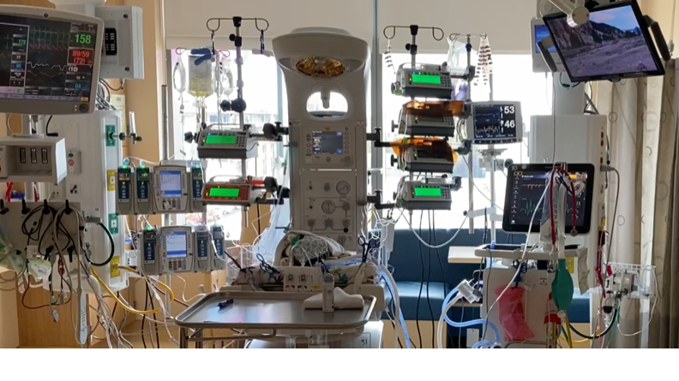


PC⁴/PAC³ Annual Meeting

Slide 6

To the team at Children’s Health for hosting the meeting
To Kim Gonzalez for organizing the PC⁴ meeting
To session moderators and speakers

Slide 7
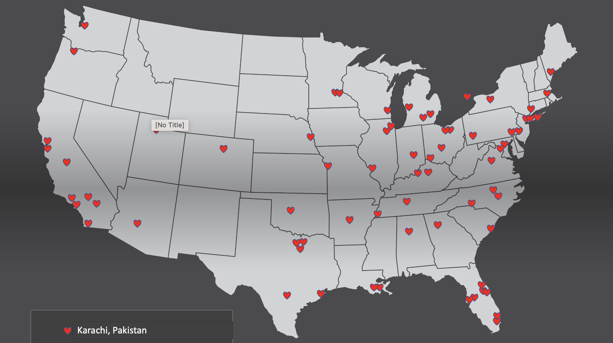
72 sites submitting data
Currently 73 participating centers

Slide 8
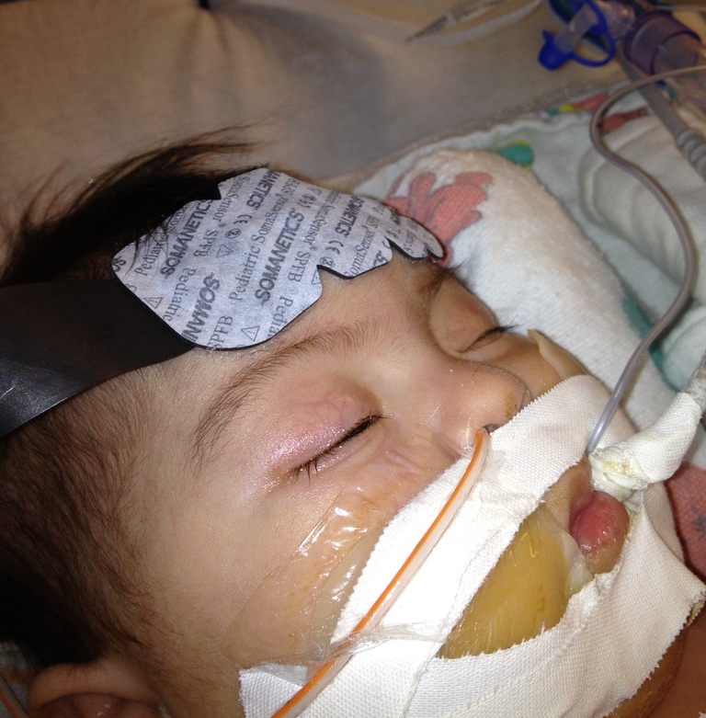
Over 200,000 PC⁴ encounters

Slide 9
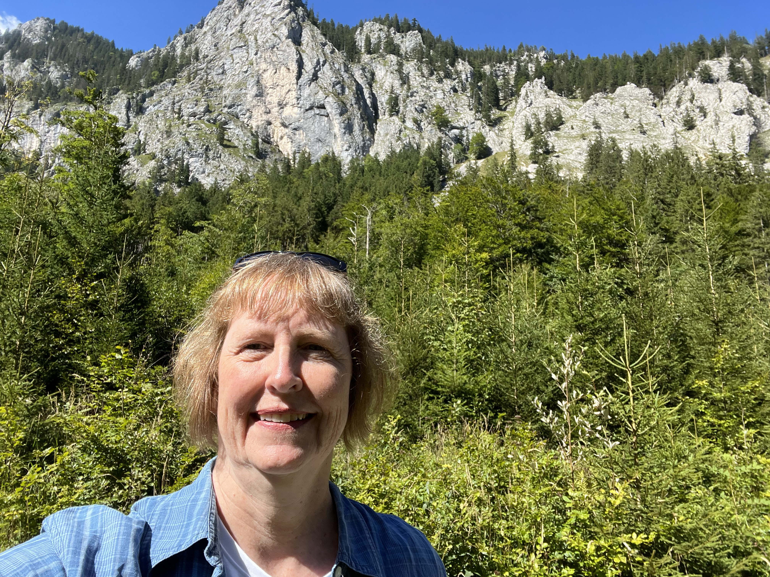
PC⁴ management: University of Michigan
Kim Gonzalez, Project Manager
Amanda Martinez, Administrative Coordinator
Suzanne Viers, Administrative Coordinator
Andrea Les, CNU Project Manager
Sara Pasquali, UM Faculty Lead
Germany

Slide 10
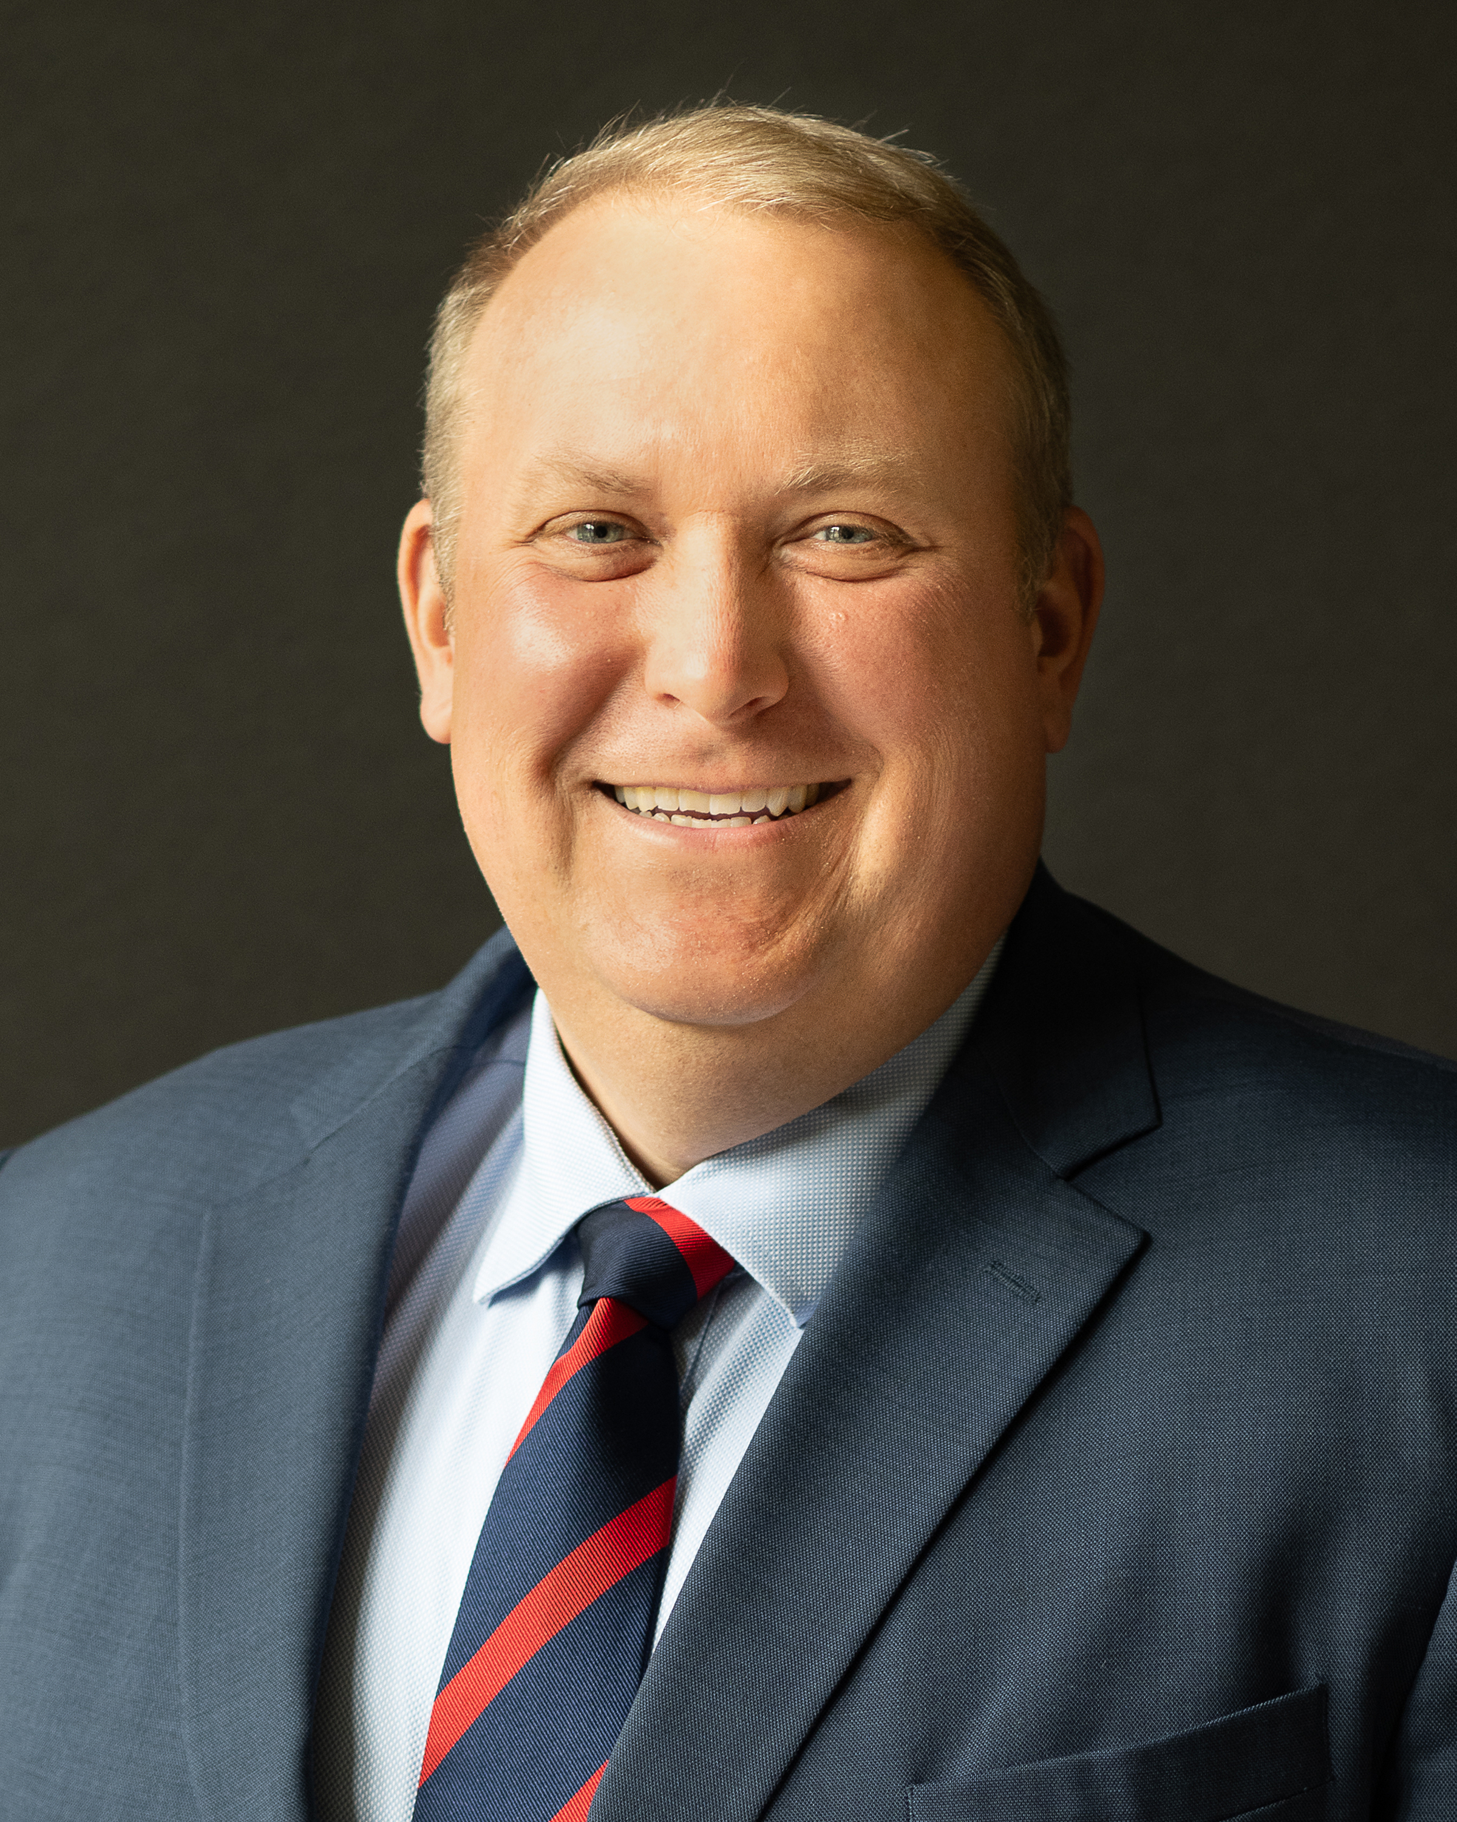
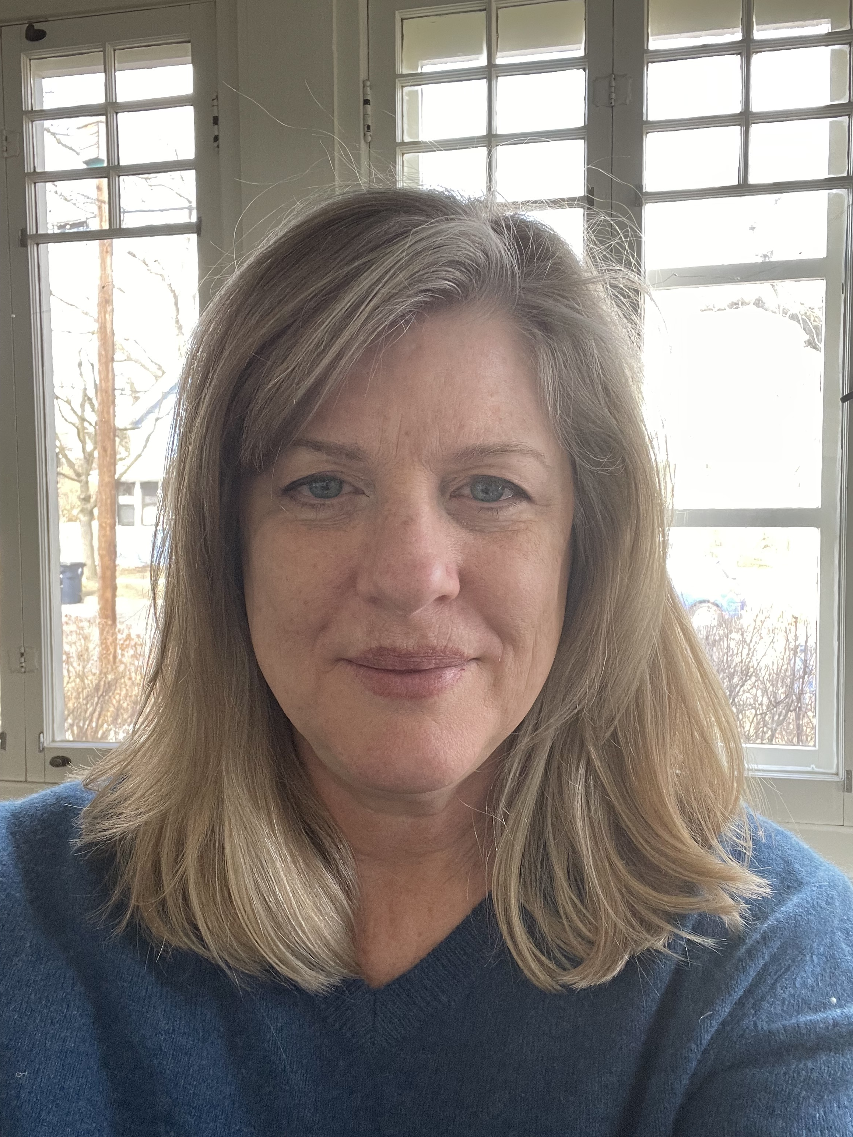
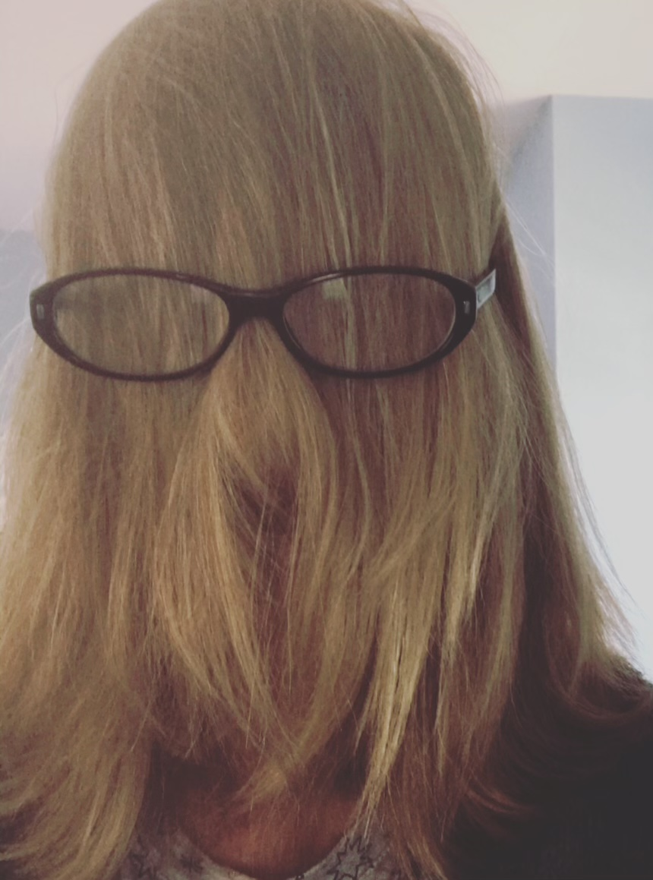
PC⁴ data coordinating center
Kurt Schumacher, Director, UM
Kate Mikesell, PC⁴ lead analyst, UM
Lauren Bush, CNU lead analyst, UM
Garrett Reichle, part time analyst, UM
Mousumi Banerjee, part time PhD statistician, UM
Wenying Zhang, MS statistician, UM
Martina Steurer, UCSF
Sarah Tabbutt, UCSF
Michael Gaies, CCHMC
Trainees, UM

Slide 11
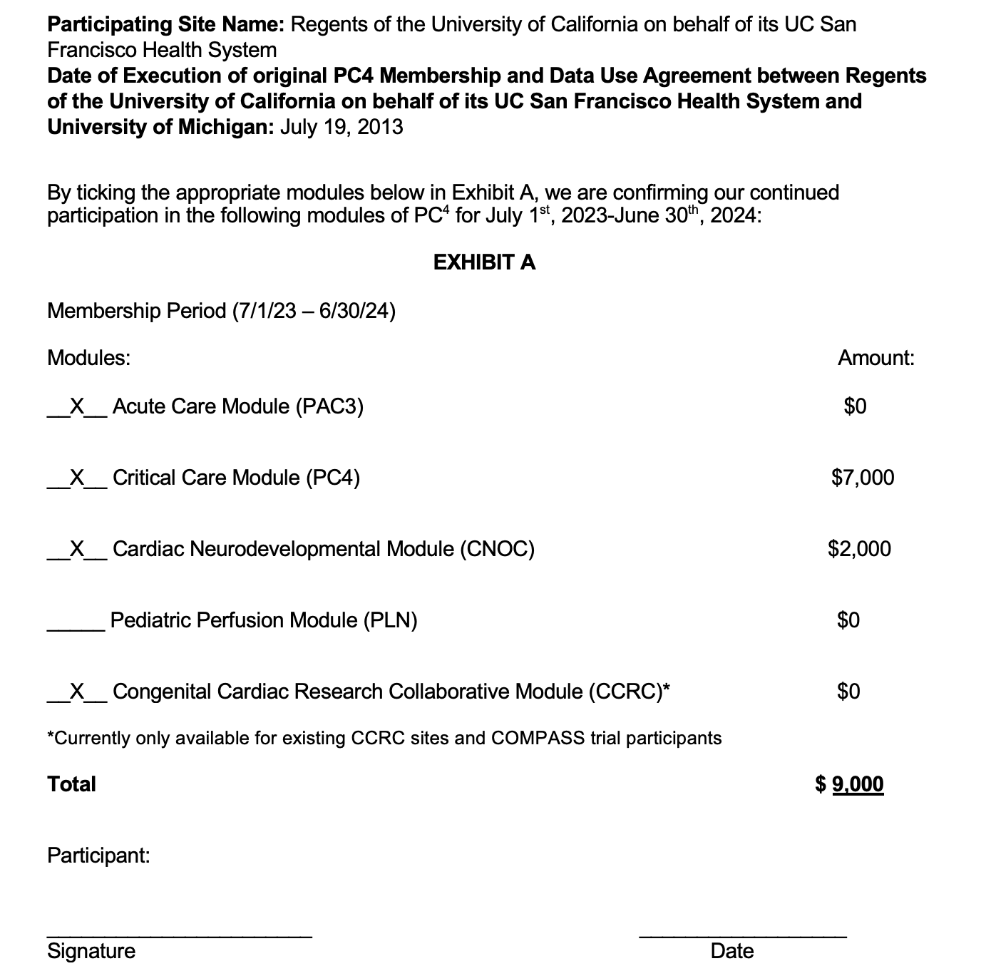
DUA updates
Moving forward annual UM CNU DUAs no longer require legal review.
Exhibit A can be signed by site’s appropriate administrative contact
Will off load a significant time burden for UM team AND for local sites
More detail today 10:30 am to noon

Slide 12
PC⁴ Committees
Committee Update Session today 10:30 to noon
Committee Expo today during lunch noon to 1 pm
SRC, Nancy Ghanayem chair
Equity Diversity Inclusion, Titus Chan and Lie Tjoeng, co-chairs
Database, Javi Lasa and Nikhil Chanani, co-chairs
Quality, David Bailly and Dana Mueller, co-chairs
Public Relations, David Werho, chair
Audit, Jen Schuette and Mary Lukacs, co-chairs
Program, Sarah Tabbutt chair
Finance, Kay Stewart-Huey, chair

Slide 13
Executive Committee Voting Positions
1-2 positions open per year
5 year term
Eligible
  2 years at a site submitting data
  2 years on a PC⁴ committee
  Recommendation from Committee Chair of active participation
  Recommendations from other Executive Committee members
Request for nominations for those eligible sent to PC⁴ community near end of year

Slide 14
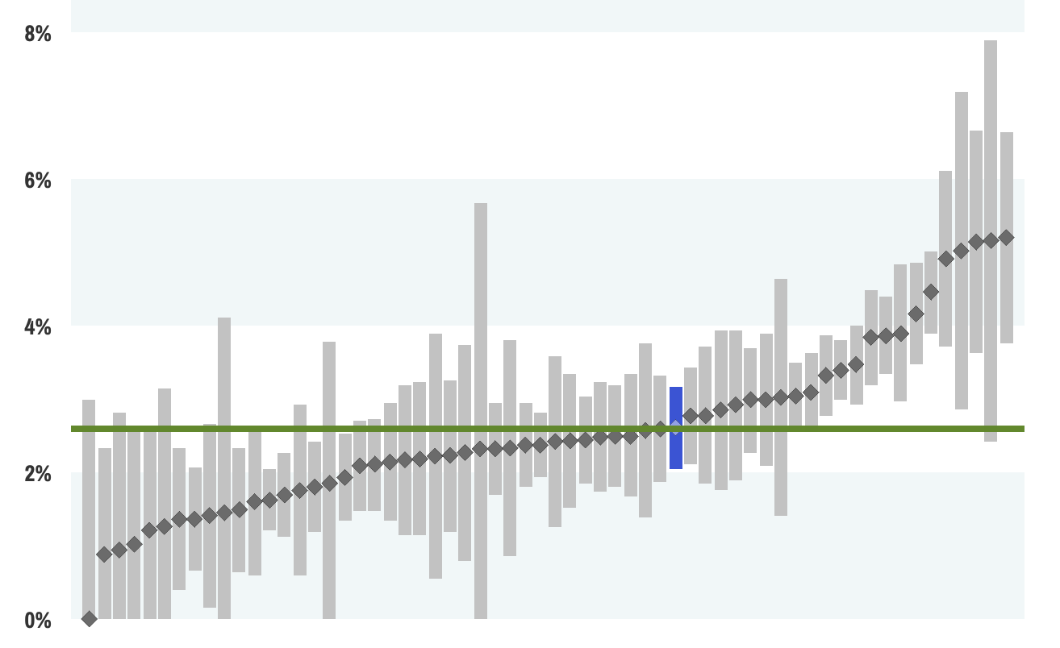
Data Quality is the Critical Backbone of PC⁴
Accuracy of data on reporting platform
Partnering with clinical trials
Scholarly publications
Accuracy of risk models on reporting platform
Supporting QI projects
Risk adjusted surgical mortality

Slide 15
Data Quality is the Critical Backbone of PC⁴
Weekly user feedback calls, twice monthly join with PAC³
Audits
Email queries
Training sessions quarterly, 9 hours in one week
Minutes taken of feedback calls
Biannual update to Data Definitions manual

Slide 16

Audits
Highest Volume Auditors | Number of Audits past year
Mary Lukacs (CHOA) | 9
Jen Schuette (Maryland) | 6
Geoff Bird (CHOP) | 4
Viki Haro (UCSF) | 4
Kim Parrigin-Symes (DeVos) | 4
Jocelyn Furr (Oregon) | 3
Josh Koch (Phoenix) | 3
Melissa Wiggins (CHOP) | 3
Jenny Root (Michigan) | 3
Auditor time commitment 1-3 full days
Sites must pass one year audit to have access to unblinded reporting platform
Privilege revoked if subsequent failed audit
Data from sites who have not passed audit are not used in analytics or risk adjusted models
More detail today 10:30 am to noon

Slide 17

Scientific Update
59 manuscripts to date
14 manuscripts in the past year
More detail today 10:30 am to noon

Slide 18

CNU Quality Update
Cincinnati Children’s Quality Core
  Supports CNU multicenter QI projects
Cardiac Arrest Preventions sustainability
  Manuscript under review
Target Based Care
  Completed December 2022
  Final data analysis pending
Upcoming Chylothorax Project
  More detail today at 10:30 am to noon

Slide 19
ArborMetrix Updates
Complete overturn in management and front facing team over the past two years
  Limited transition of mental model
Simultaneous with developing CCRC and PediPERForm CNU registries
Weekly meetings
  Twice monthly with Database representatives
  Twice monthly with PC⁴ leadership and Lauren Bush
New team is engaged
Pace of projects is a work in progress
More detail on reporting platform today at 10:30 am to noon

Slide 20
Launched this past year
URiM Mentorship Program
First project submitted to SRC for the May meeting
Clinical Outcomes Support Team (COST)
Update at 2 to 2:15 pm today, Nancy Ghanayem
Partnership with CHD CORD clinical trial
NIH trial randomizing to early versus delayed cord clamping for fetuses with CHD
6 year contract $120,000 with $27,000 as indirects to UM
Contracts complete, first patients enrolled this month
New ArborMetrix modules
PREM, start 5/1/24
Transfusion
Annual meeting
Significant uptick in participation
New front facing website
Update at 10:30 am to noon today

Slide 21

PC⁴ Volunteers
  Committee participation
  Reviewing manuscripts
  Performing audits
  Working with Arbor Metrix
  User Feedback calls
  Entering Data
  Site survey
  Analyzing data and supporting research
  QI projects
  Social Media
  Website Development

Slide 22


Sponsors
Please visit their tables at the Expos
Scholarships for two URiM trainees to attend the conference
Tonight’s PC⁴ Social Event at Miller Tavern

Slide 23



Social Activities: no need to walk far
Tuesday, April 30
5 to 7 pm: Miller Tavern and Beer Garden
PC⁴ Social Event sponsored by NuWellis

