Slide 1
Navigating the PC⁴ Reporting Platform
PC⁴ Database Committee
Javier J. Lasa, MD
Nikhil Chanani, MD
Andrew Smith, MD MSCI MMHC

Slide 2
Disclosures
No disclosures

Slide 3
Objectives
Leverage reporting platform layout and filters to enhance understanding of unadjusted site-specific and aggregate measures
Access risk-adjusted metrics to understand local and national practice patterns and benchmarks
Understand newer platform user interfaces to help drive local quality improvement efforts
Clinical Champion views
Future directions

Slide 4

What is a Reporting Platform?
INPUTS
DATA STORAGE
ANALYTICS
Abstracted
encounter data
PC⁴ Data Coordinating Center

Slide 5
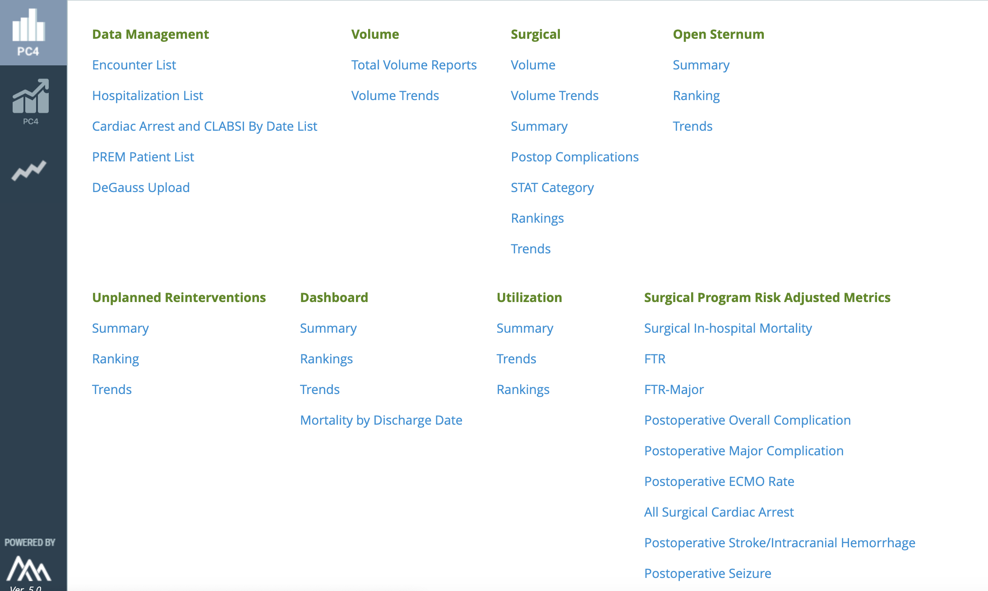
Starting Point
Notes:
Starting point here provides access to counts (surgical volumes raw unadjusted rates) as well as risk-adjusted measures

Slide 6
Encounter Level Lists

Slide 7
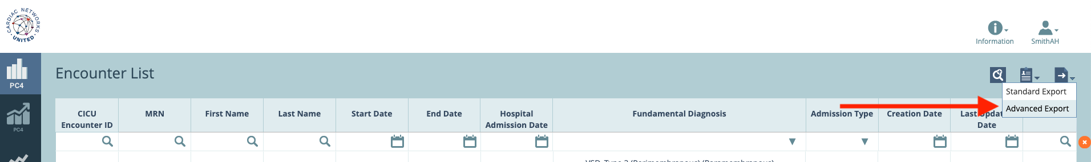
Encounter Level Lists

Slide 8
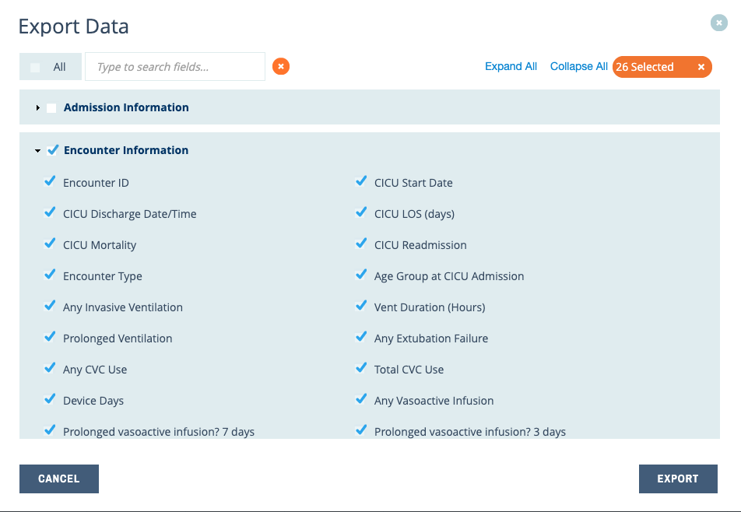
Encounter Level Lists

Slide 9
Raw Counts/Unadjusted Rates
Notes:
Starting point here provides access to counts (surgical volumes raw unadjusted rates

Slide 10
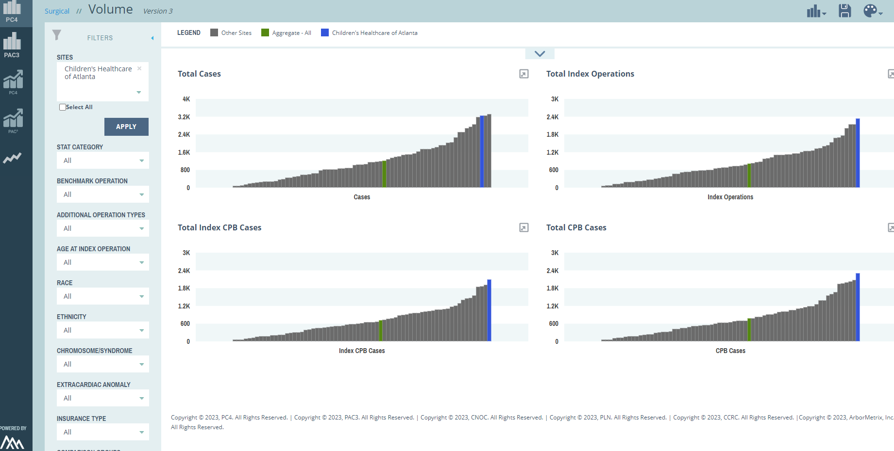
Filtering
Filters
STAT
Benchmark
Age category
Race/Ethnicity
Insurance type
Notes:
Filters applied to raw aggregate data for a 10k foot view of a population,
In this case in the volume tab relative to other participating centers
STAT category
Benchmark operation
Age categories etc.

Slide 11
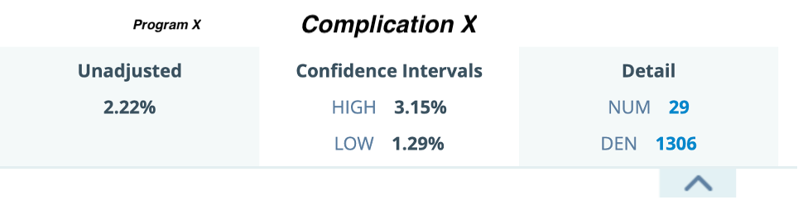
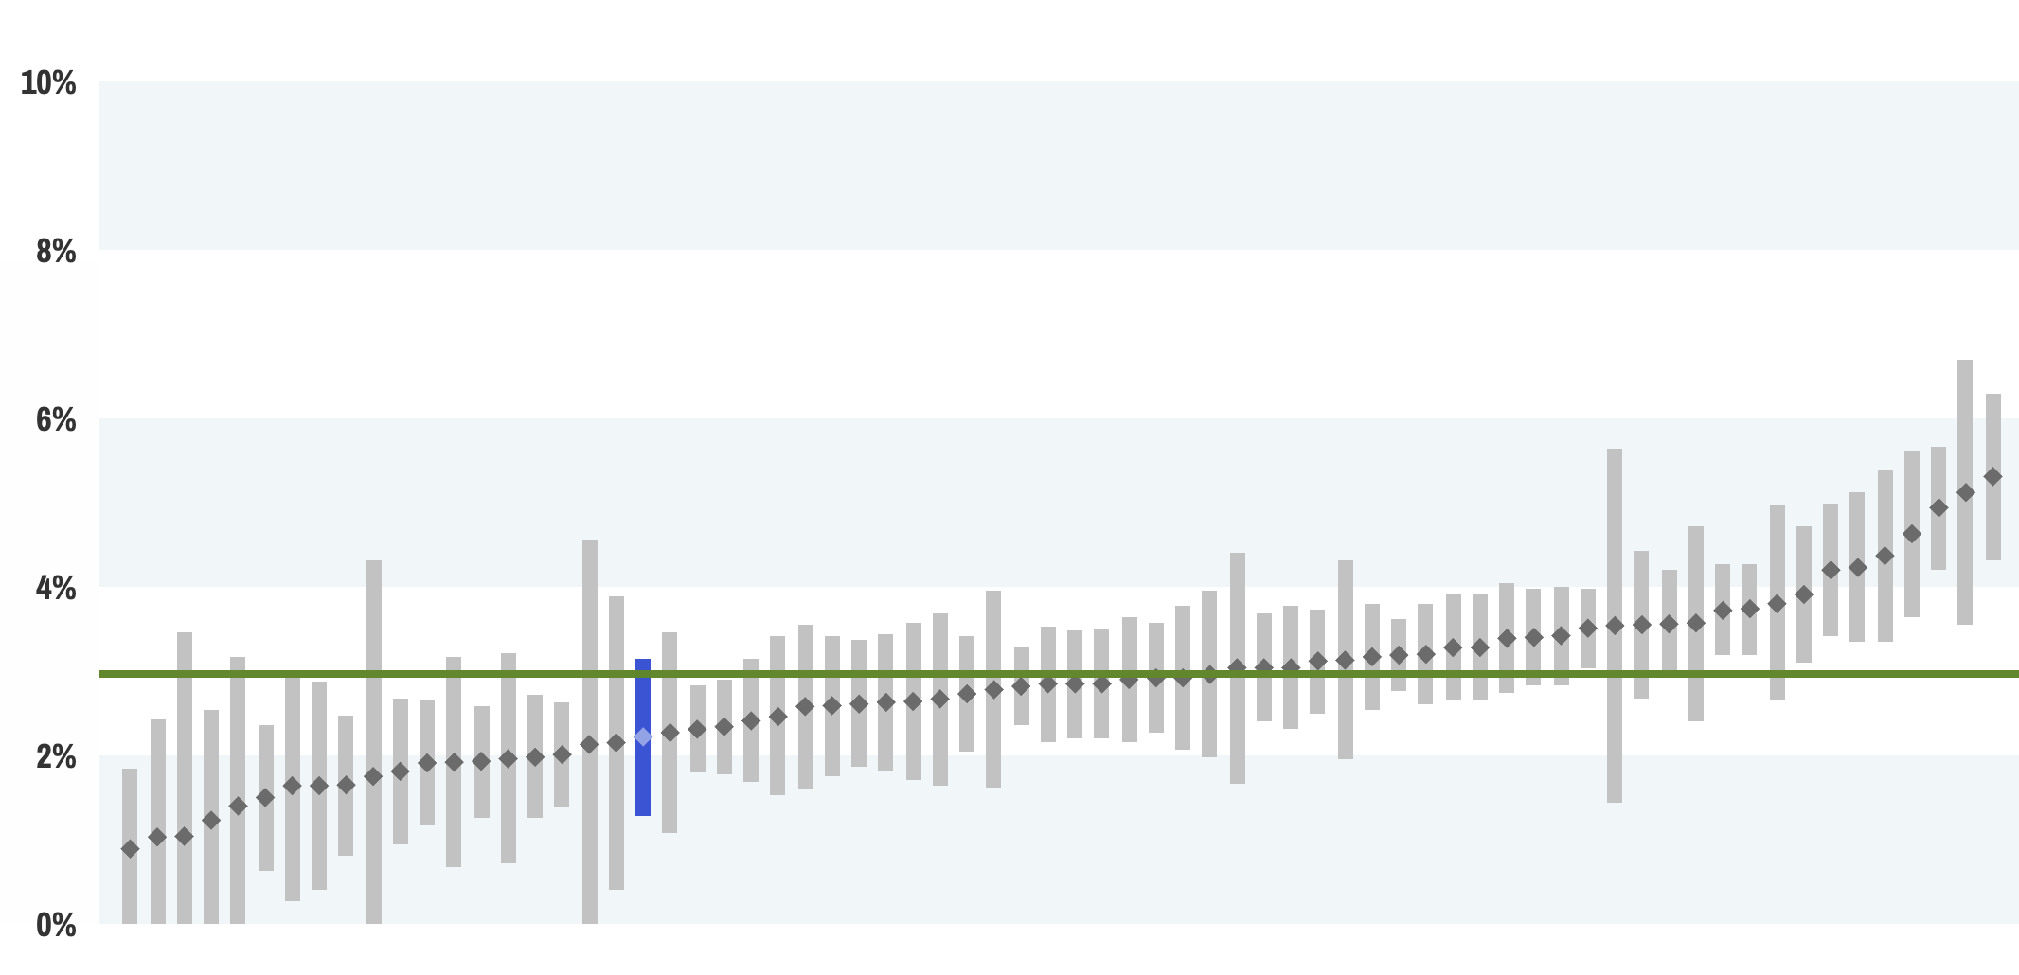
Unadjusted Rate Comparisons

Slide 12
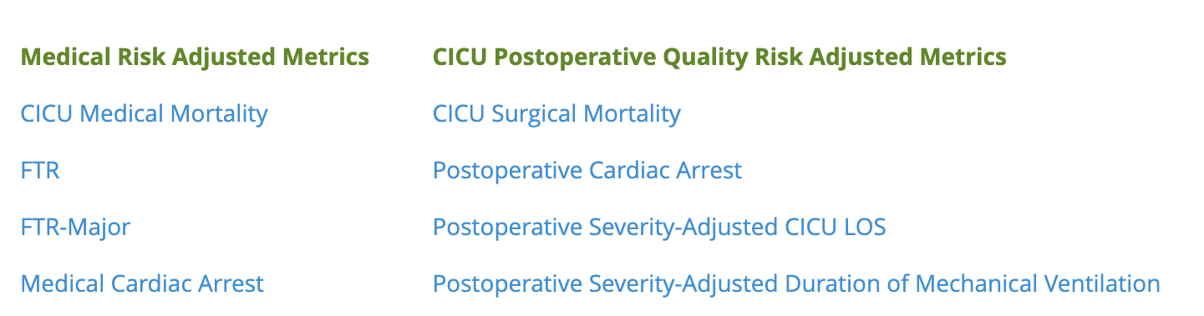
Risk Adjusted Rates

Slide 13
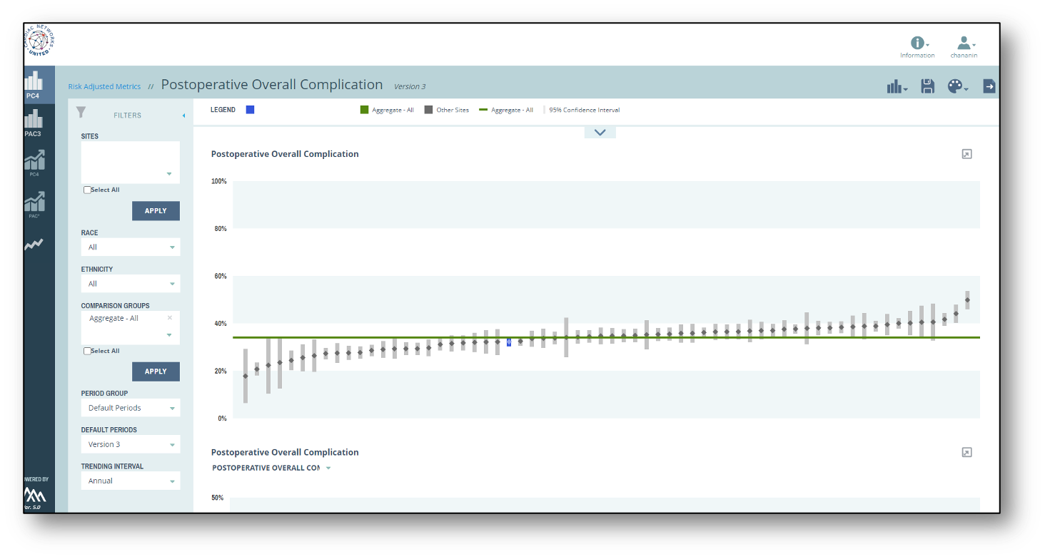
Risk-Adjusted Reports

Slide 14
Risk-Adjusted Reports

Slide 15
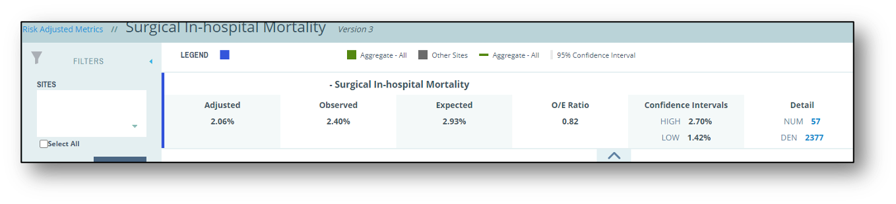
Reports

Slide 16
Reports
Notes:
Reports instead apply analysis… in this case raw complication rates
Can again employ Race/Ethnicity filters

Slide 17
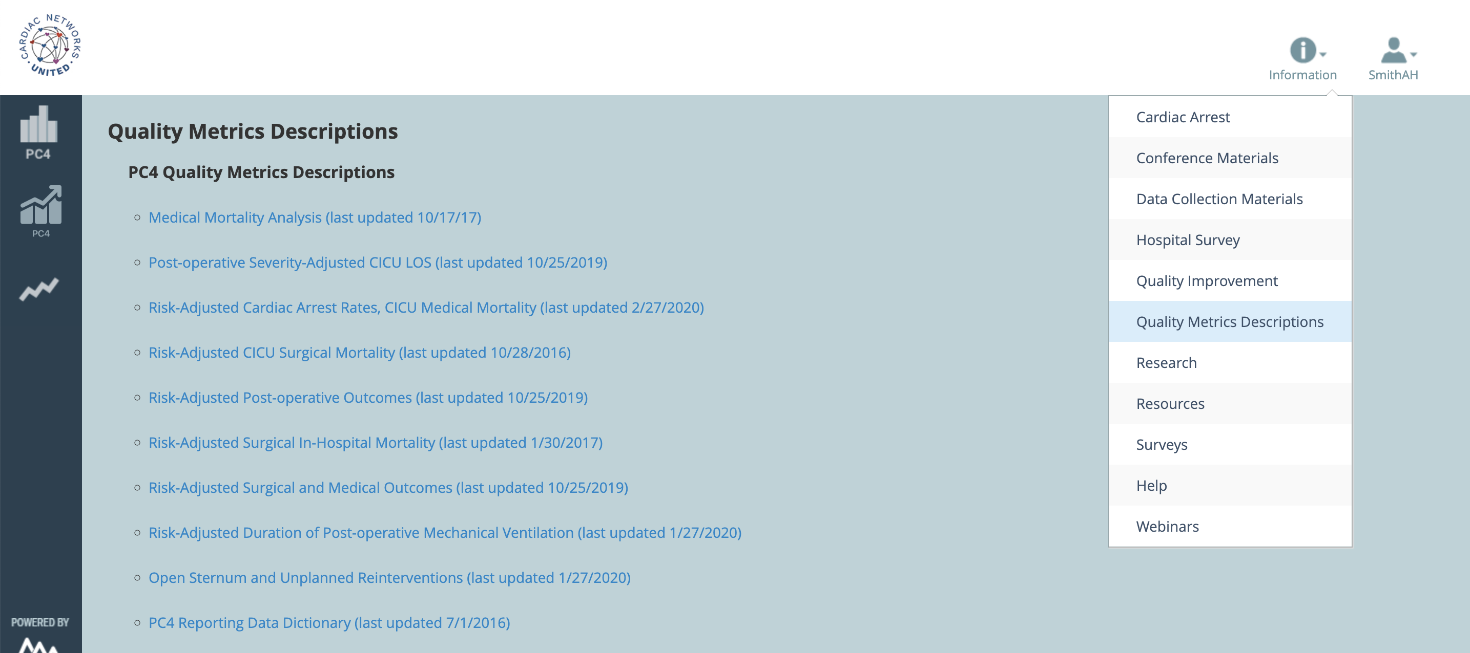
Risk Adjustment Model Description

Slide 18
Standard View vs Clinical Champion
Clinical Champion View
  Available to individual site clinical champions
  Allows direct site to site comparison, identification
    Pick certain hospitals
    No need for key
Notes:
What the CC sees is different…

Slide 19
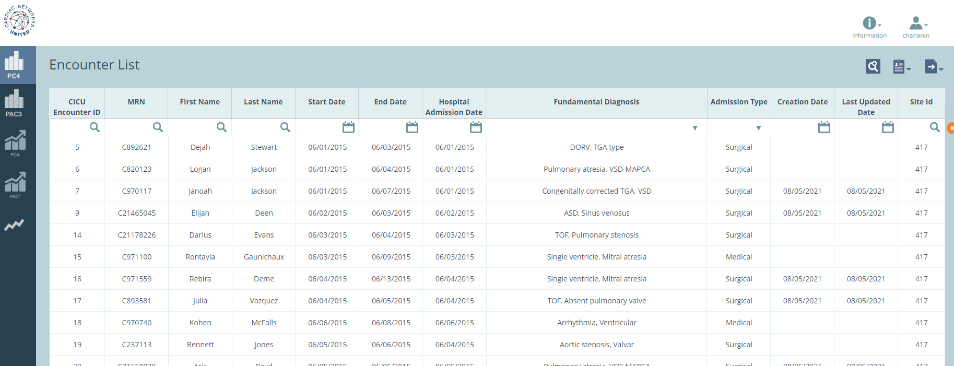
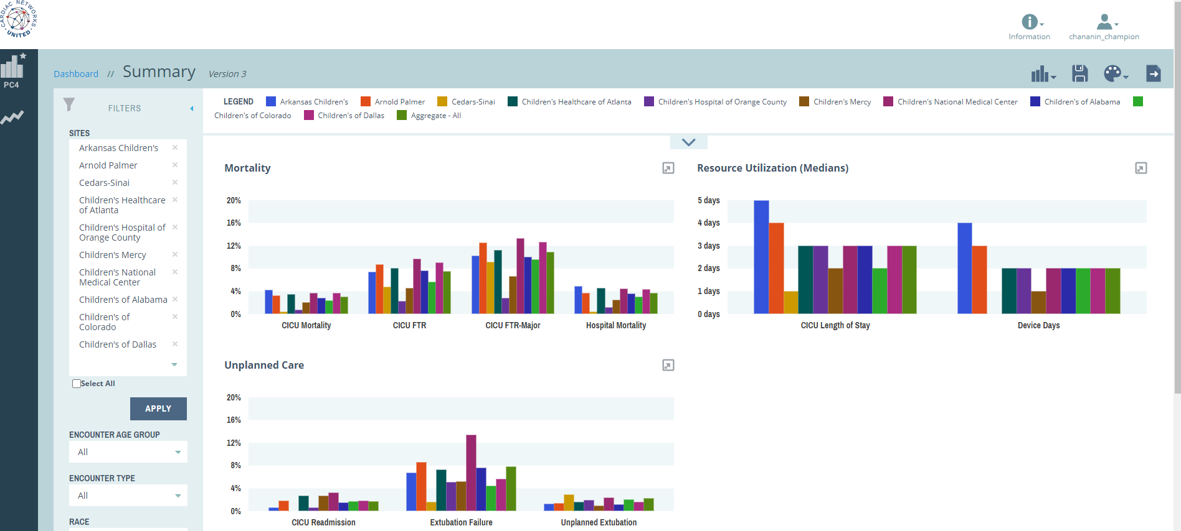
Standard View vs Clinical Champion
Landing Pages

Slide 20
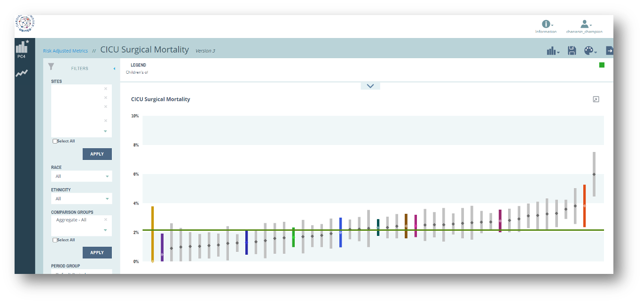
Standard View vs Clinical Champion

Slide 21
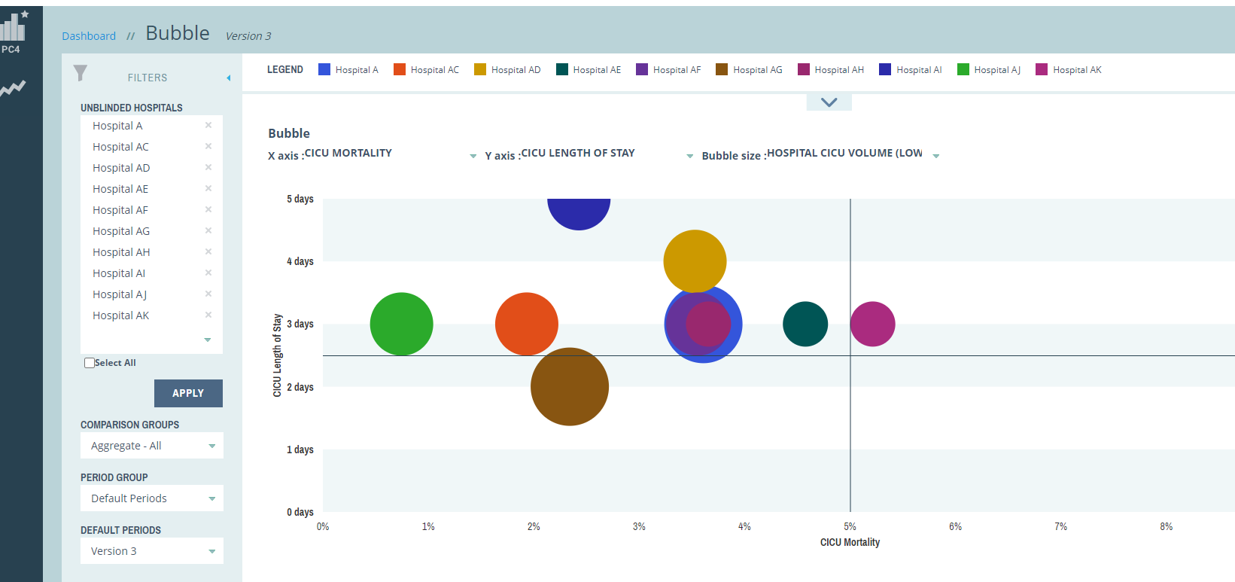
Standard View vs Clinical Champion
Three-dimensional comparisons
  LOS v. Mortality WRT Program volume

Slide 22
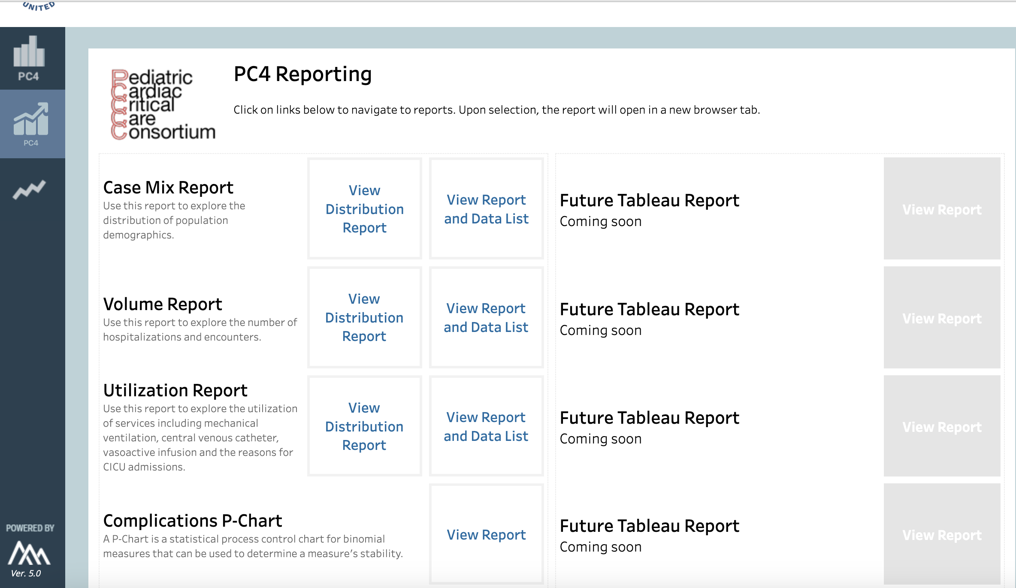
Reporting Platform Developments

Slide 23

Reporting Platform Developments

Slide 24
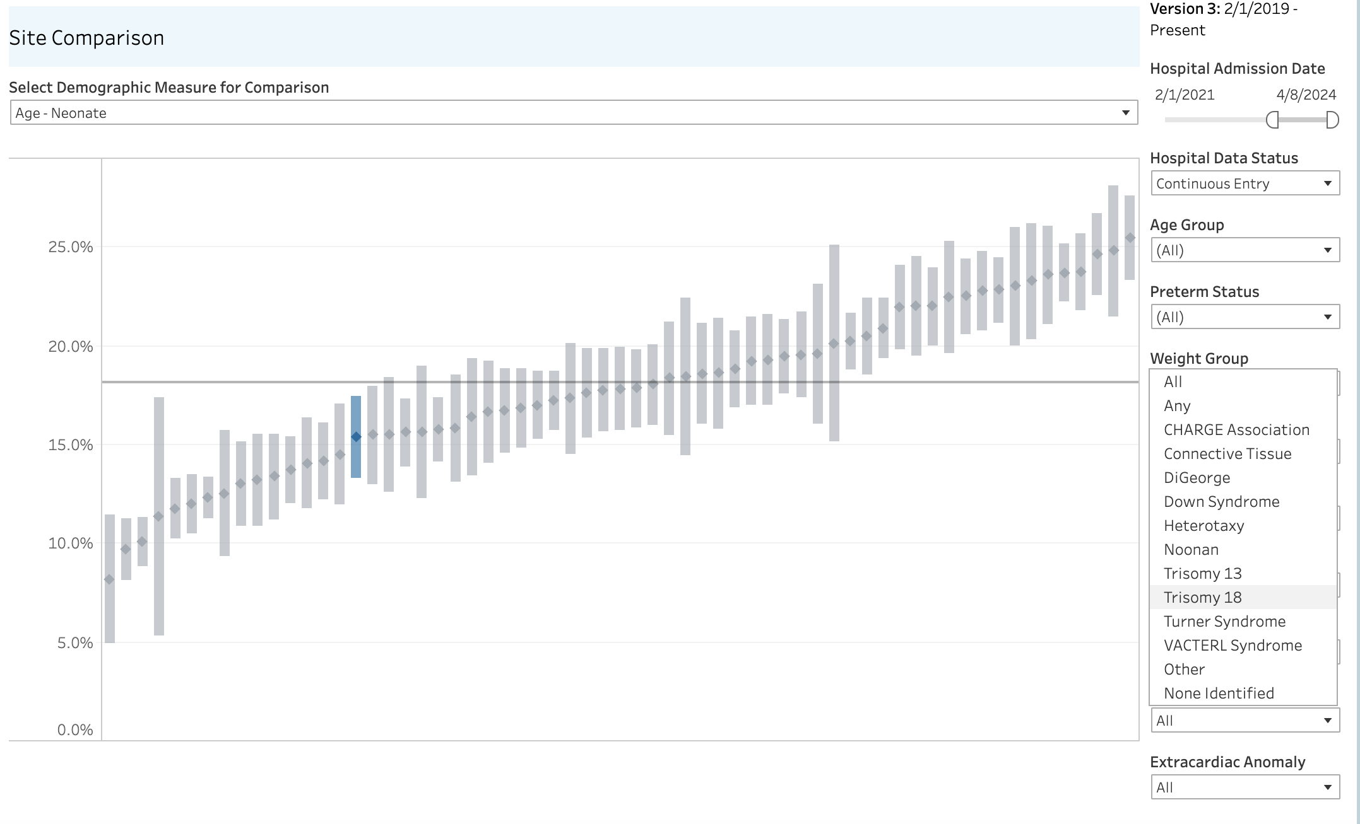
Reporting Platform Developments

Slide 25
Reporting Platform Developments

Slide 26
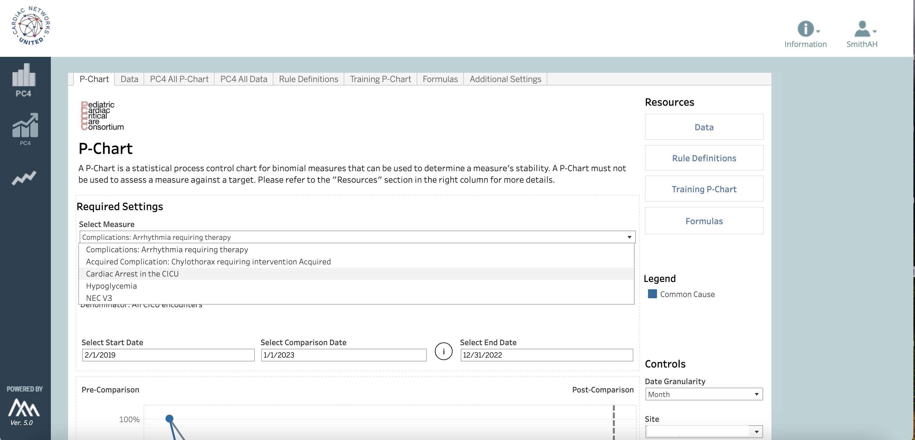
Complication P-Charts

Slide 27
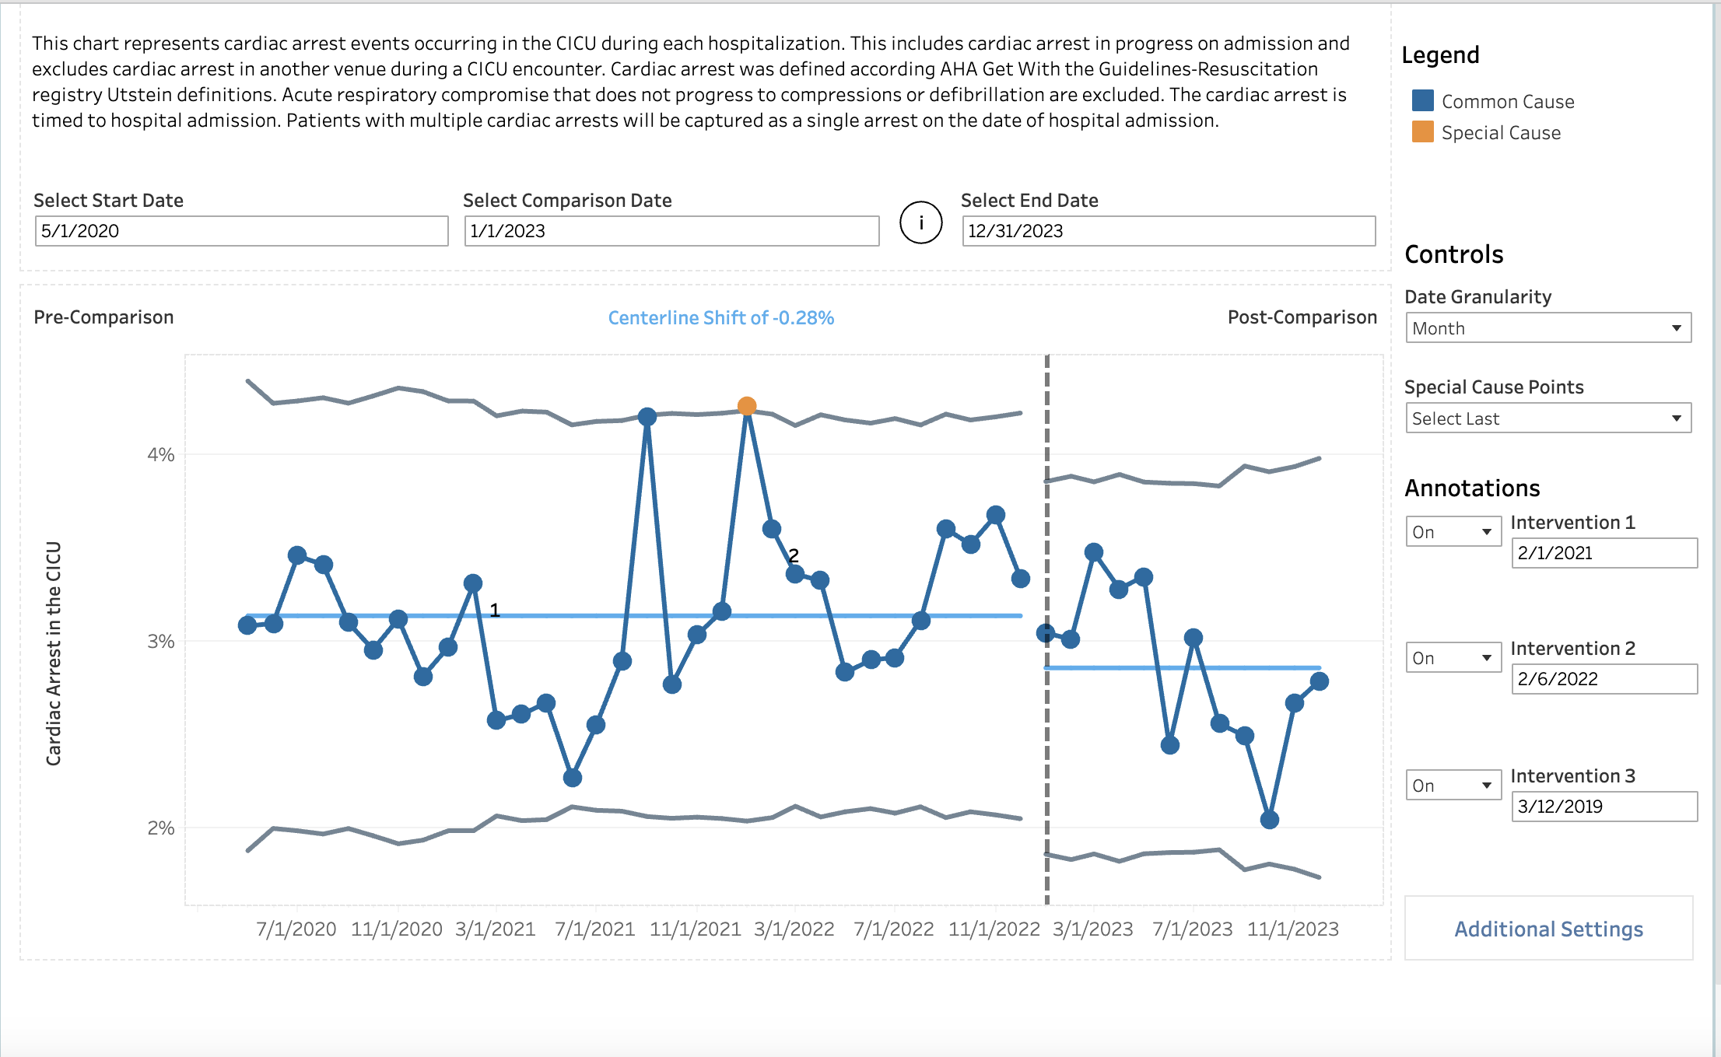
Complication P-Charts

Slide 28
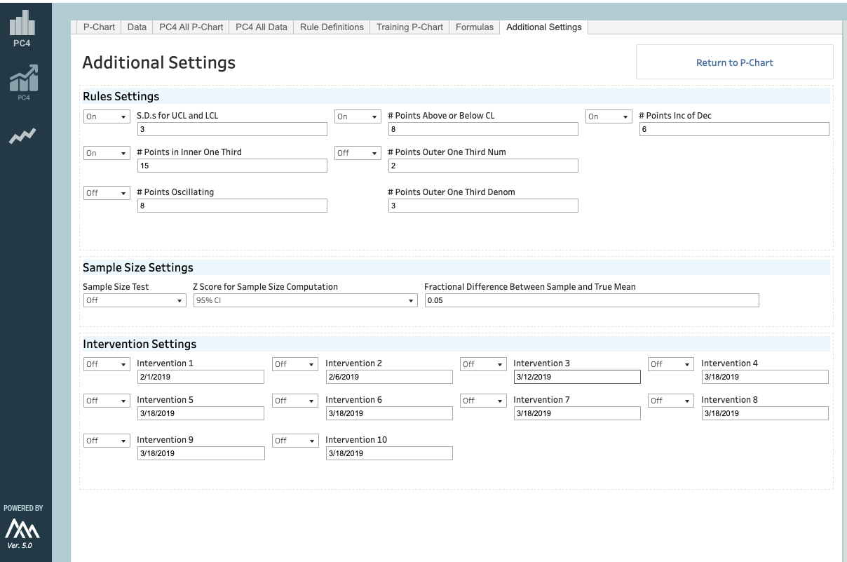
Complication P-Charts

Slide 29
Alternative Measures
Notes:
Starting point here provides access to counts (surgical volumes raw unadjusted rates) as well as risk-adjusted measures

Slide 30
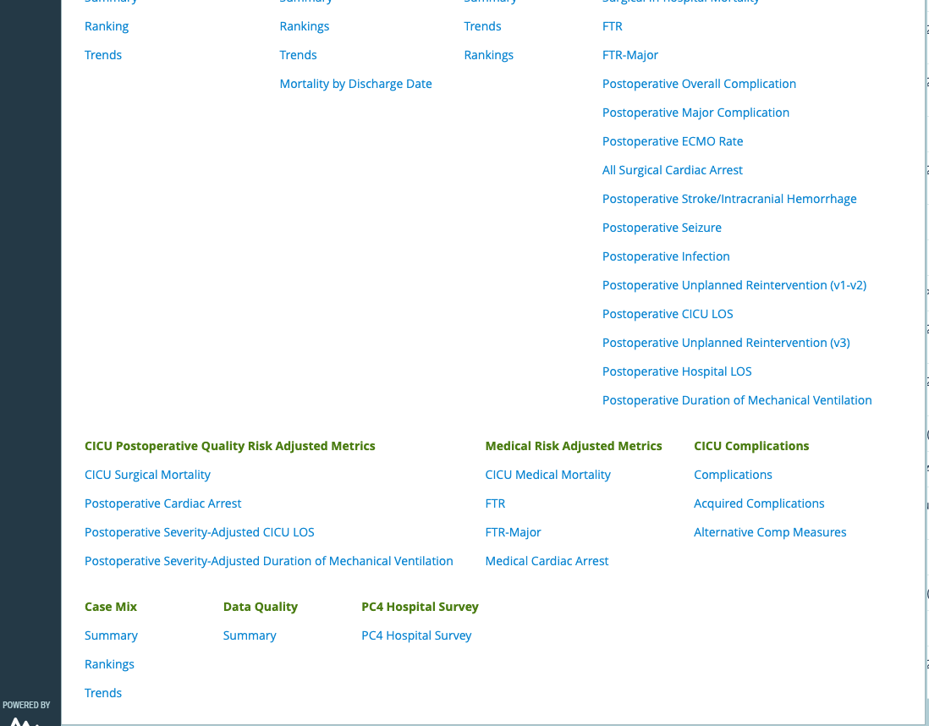
Alternative Measures
Notes:
Starting point here provides access to counts (surgical volumes raw unadjusted rates) as well as risk-adjusted measures

Slide 31
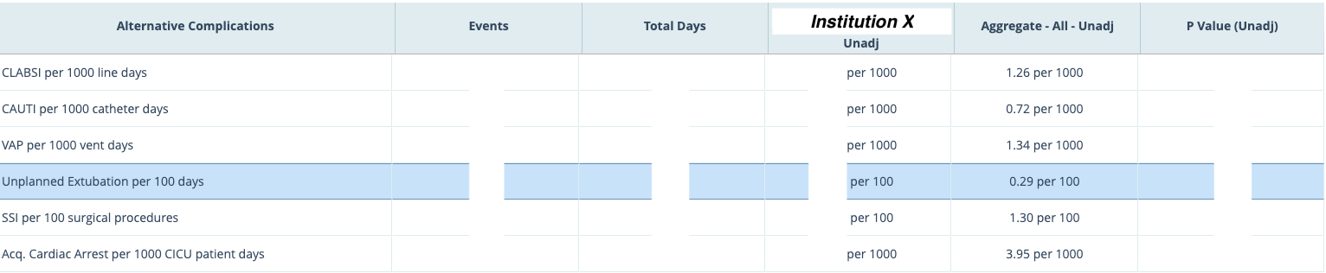
Alternative Measures
Notes:
Starting point here provides access to counts (surgical volumes raw unadjusted rates) as well as risk-adjusted measures

Slide 32
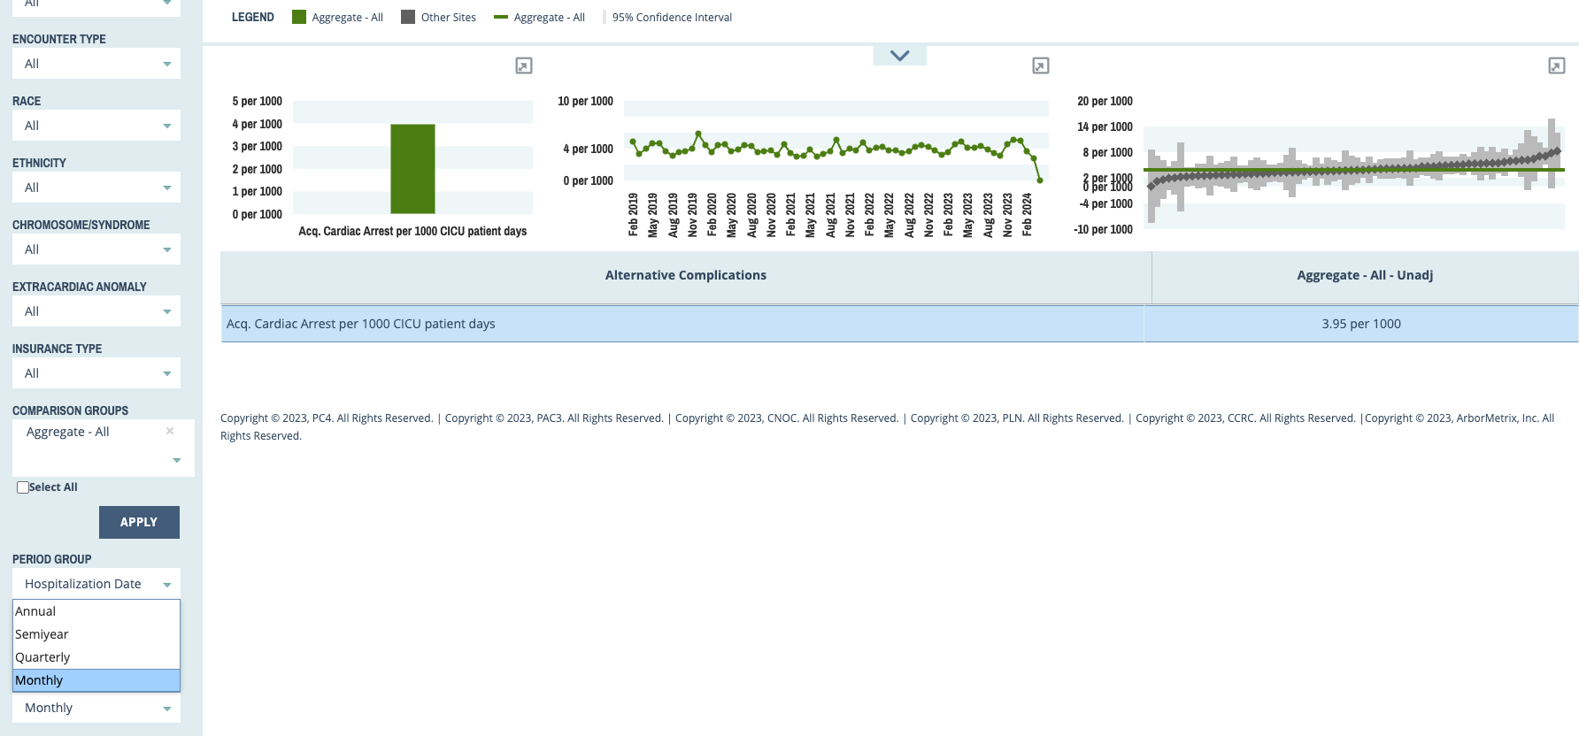
Use Case
Cardiac Arrest Rate By Month (Per 1000 Patient Days)
Notes:
Starting point here provides access to counts (surgical volumes raw unadjusted rates) as well as risk-adjusted measures

Slide 33
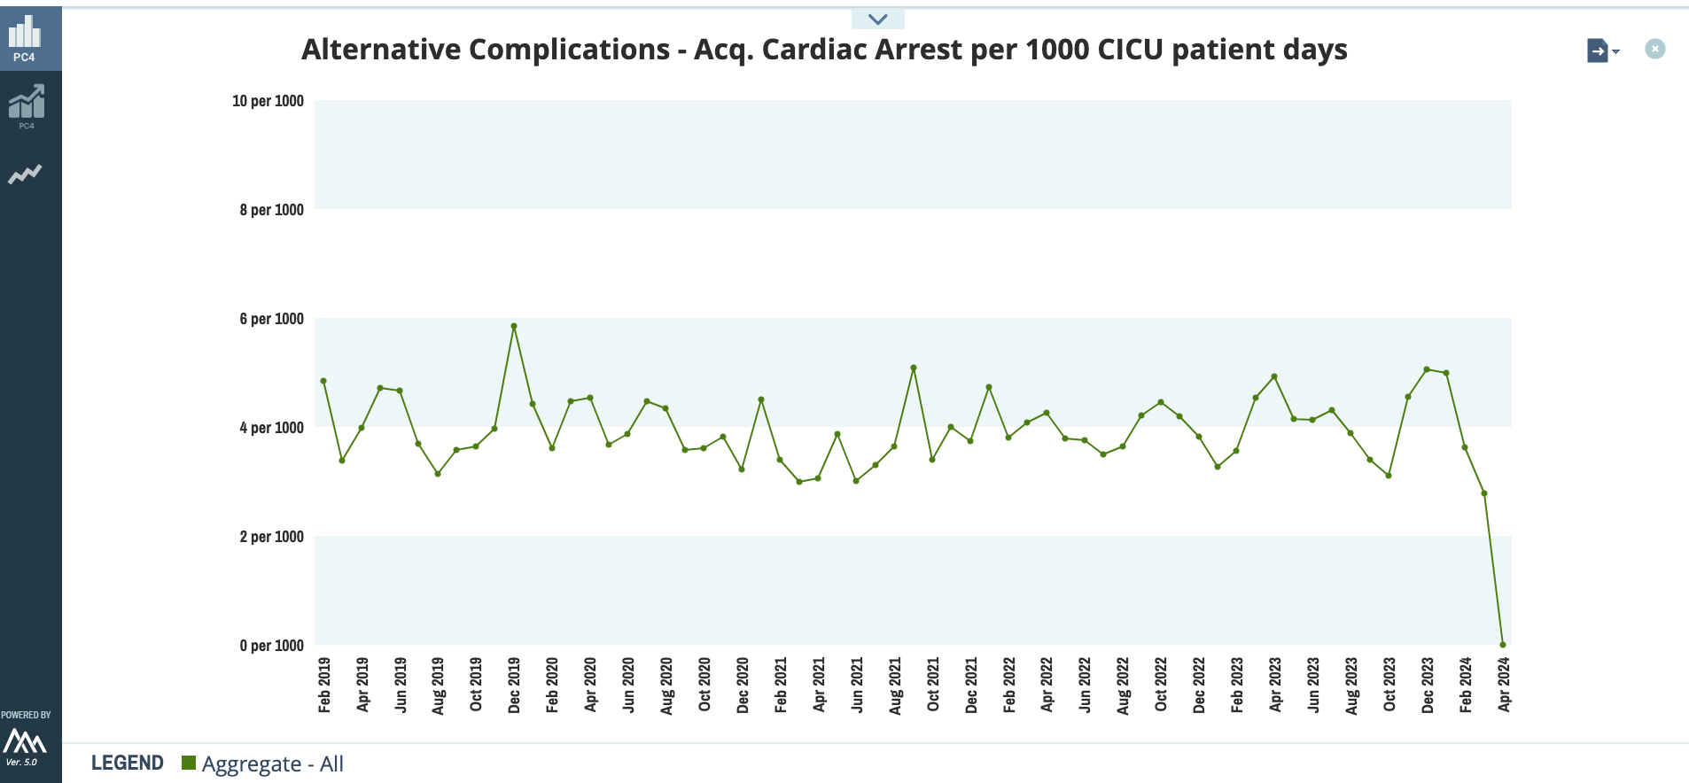
Use Case
Cardiac Arrest Rate By Month (Per 1000 Patient Days)
Also generates raw data to use with your own institutional software for alternate SPCs…
Notes:
Starting point here provides access to counts (surgical volumes raw unadjusted rates) as well as risk-adjusted measures

Slide 34
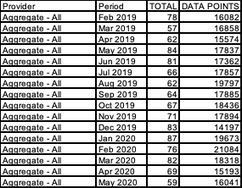
Use Case
Cardiac Arrest Rate By Month (Per 1000 Patient Days)
Raw data to use with your own institutional software for alternate SPCs…
Notes:
Starting point here provides access to counts (surgical volumes raw unadjusted rates) as well as risk-adjusted measures

Slide 35
Use Case
Cardiac Arrest Rate By Month (Per 1000 Patient Days)
Notes:
Starting point here provides access to counts (surgical volumes raw unadjusted rates) as well as risk-adjusted measures

Slide 36
Platform Utilization

Slide 37
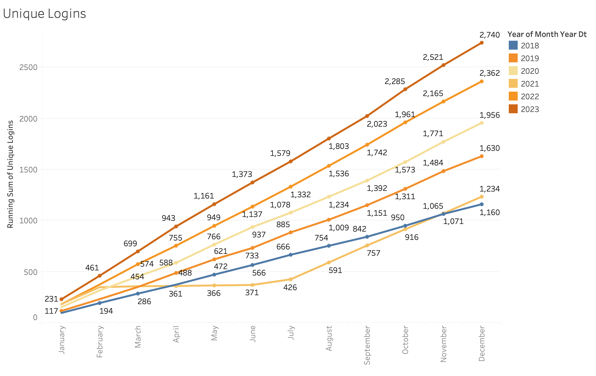
Platform Utilization
Unique Logins

Slide 38
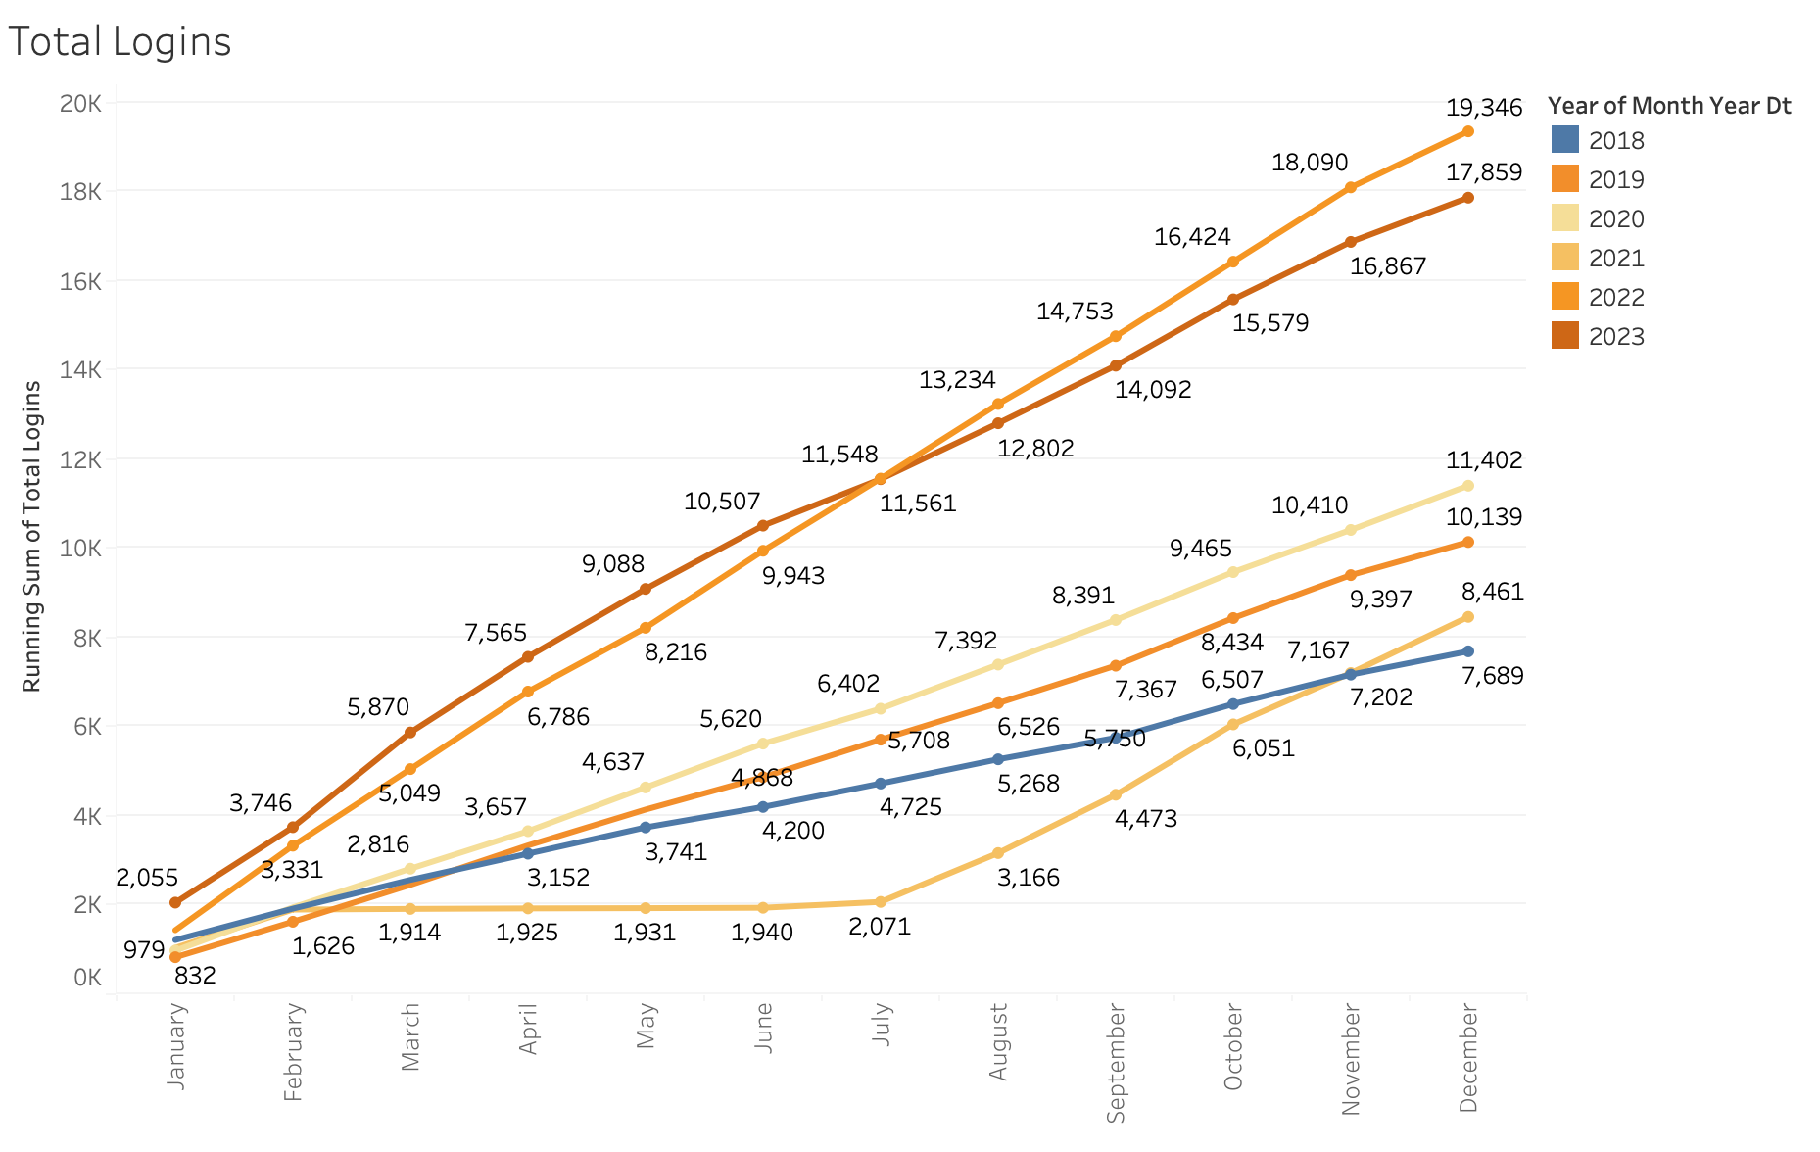
Platform Utilization
Total Logins

Slide 39
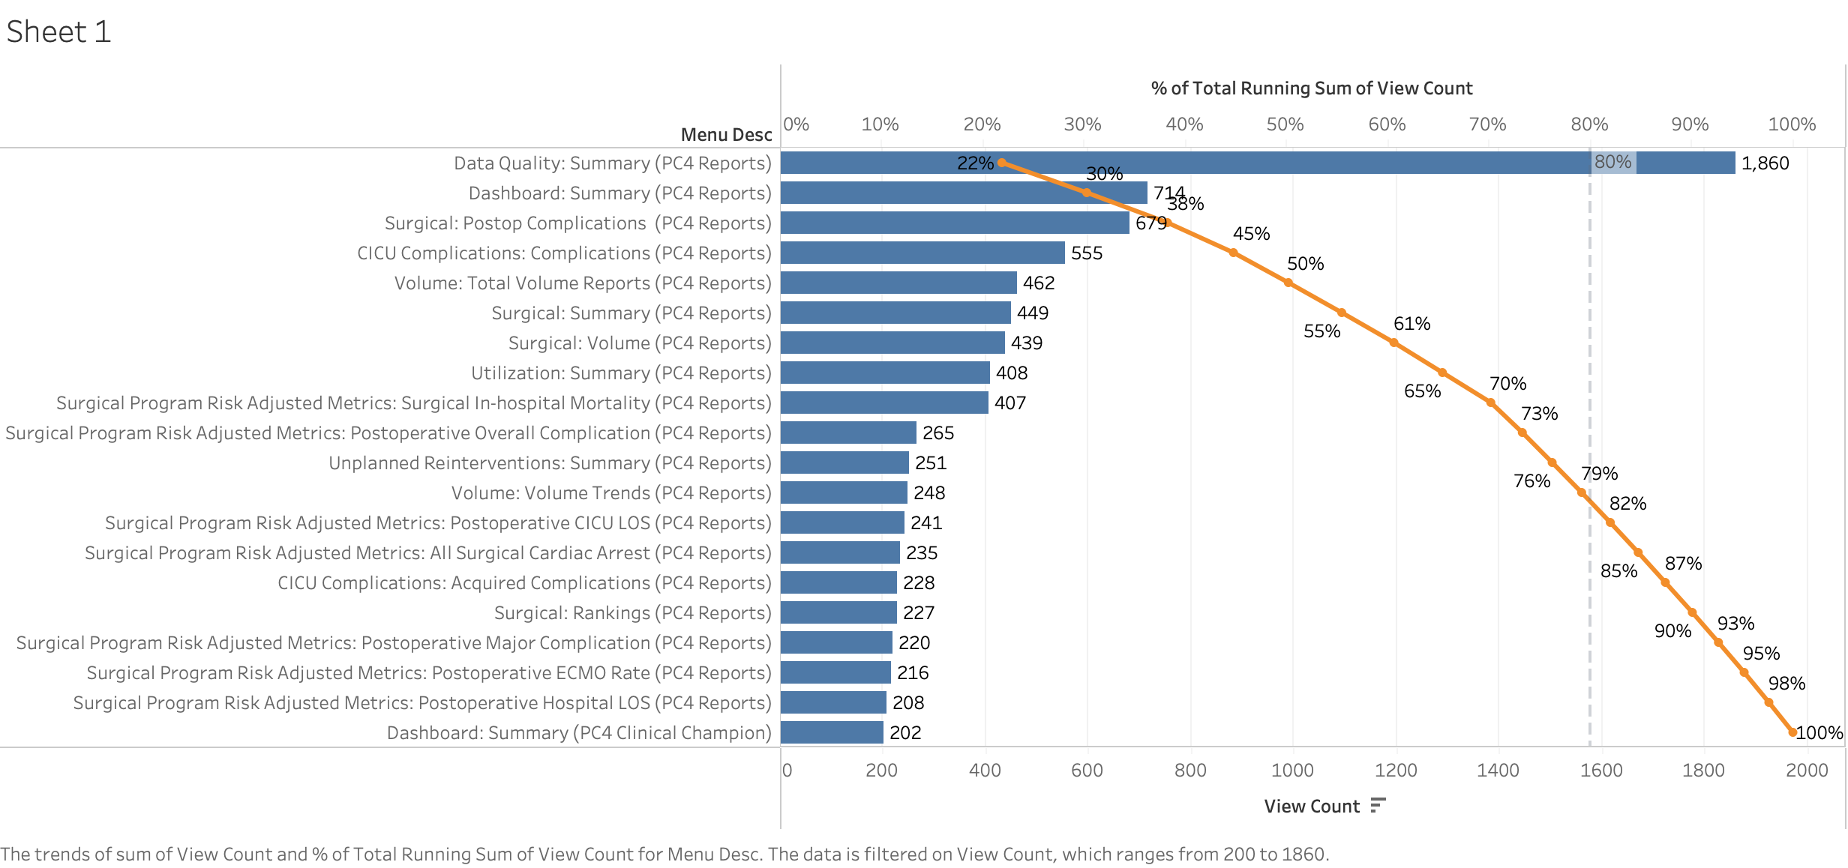
Most Popular Reports
(Pareto: Oct 2023 to Mar 2024)
Landing Page
Notes:
Landing page with login, exclude…

Slide 40
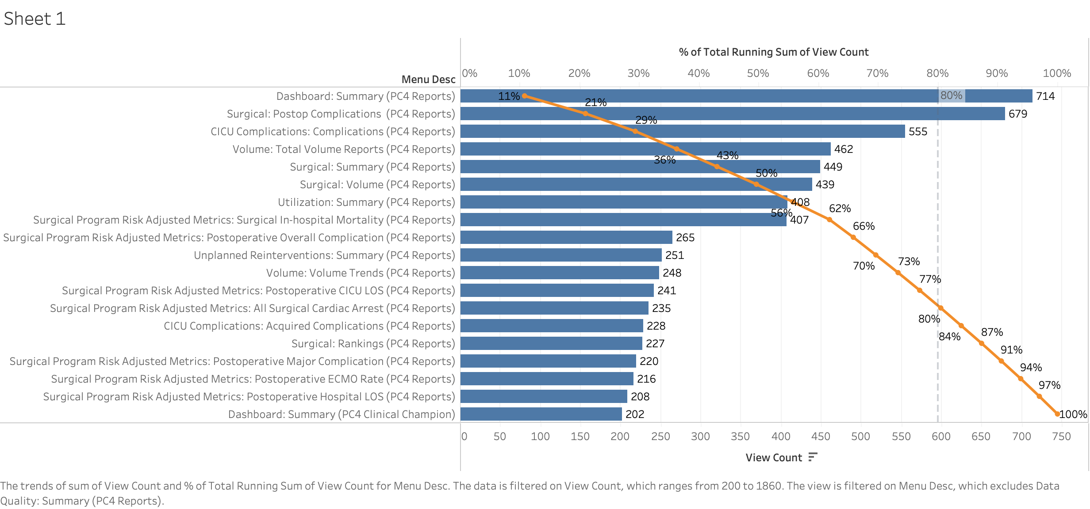
Most Popular Reports
(Pareto: Oct 2023 to Mar 2024)

Slide 41
Future
Site survey
  Next site survey to be released Fall 2024
Version 4 upgrade
  Database committee to convene Fall 2024
  Collaboration with PAC³ Database Committee, align
    Data definitions
    Metrics
  Alignment with STS data definitions
Platform enhancements
  Expanding P-chart measure coverage
  Filter additions (e.g. CPB)
Partnership with QI Committee
Notes:
Adding variables to Advanced Export

Slide 42
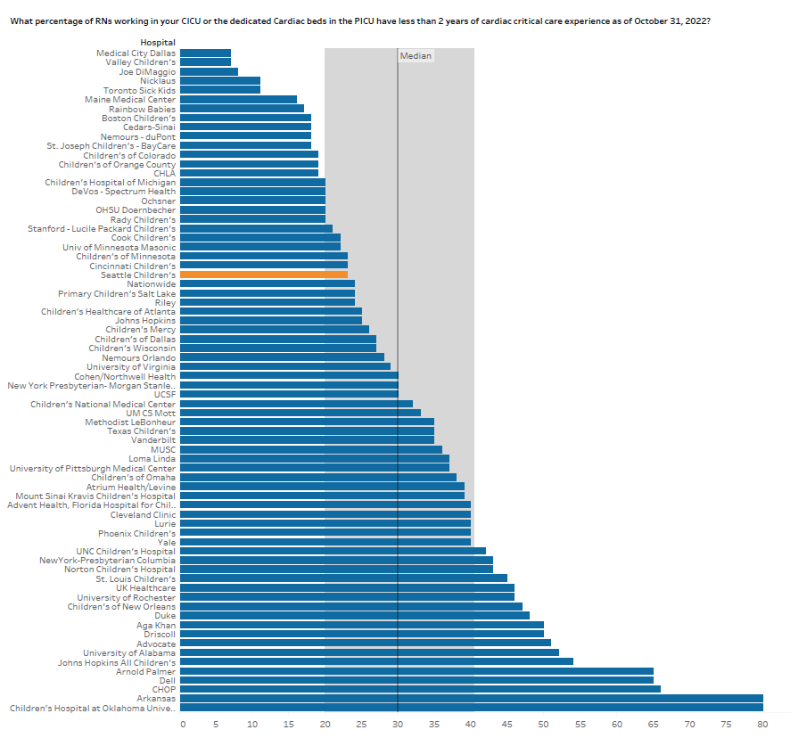
Site Survey Sample

Slide 43
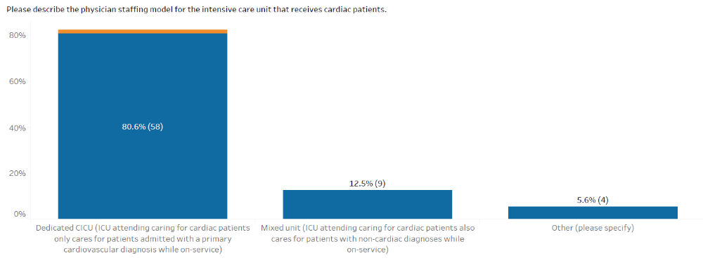
Site Survey Sample
Click on the box and see list of sites

Slide 44
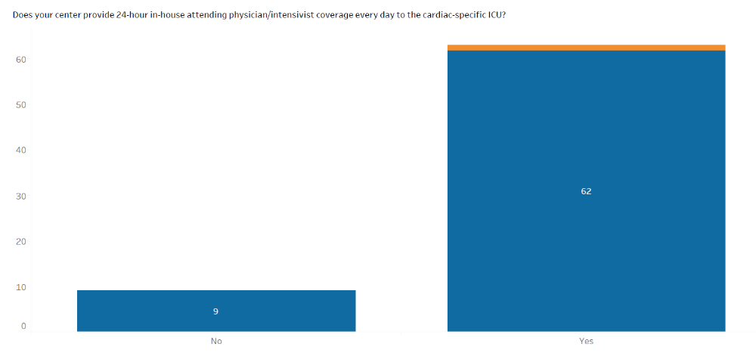
Site Survey Sample
Click on the box and see list of sites

Slide 45
Live Demonstration

Slide 46
Thank you to our partners
PC4 DCC
  Garret Reichle -Lauren Bush
  Kurt Schumacher -Michael Gaies
  Kim Gonzalez -Kate Mikesell
  Sarah Tabbutt
PC4 DB Committee Members
  Titus Chan
  Hayden Zaccagni
ArborMetrix
  Jordan Goodman

