Slide 1
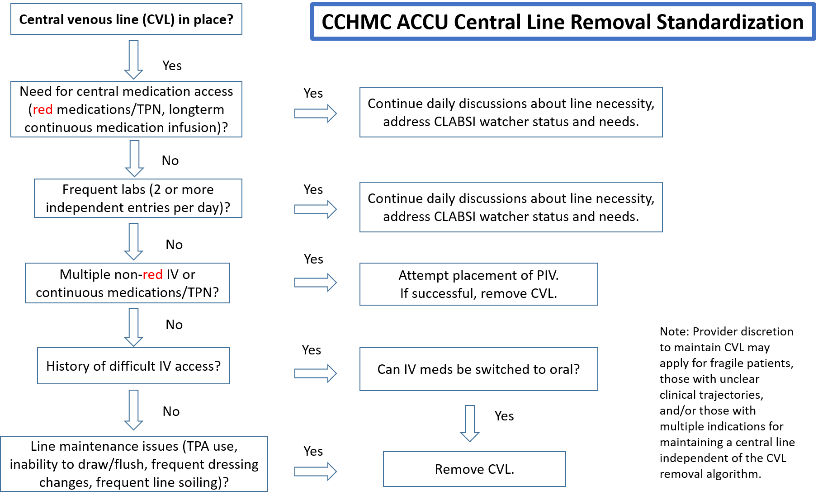
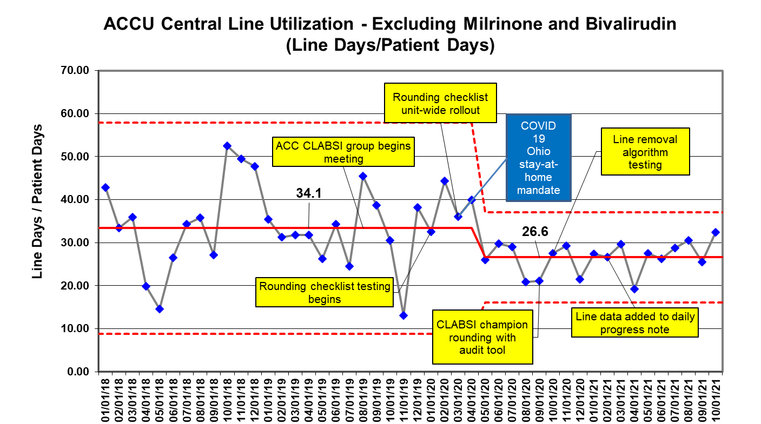
A Single Center Perspective on Standardized Practices for Central Venous Catheter Removal in Acute Care Cardiology
Megan Rodts¹; Nicolas Madsen²; Sheryl Bloomer³; Elizabeth Farmer¹; Kelsey Hart³; Brittany Frakes¹; Lisa Kohr¹; Kimberly Luebbe¹; Leah Mousa⁴; Anissa Taylor¹; Colleen Pater^{1,3,5}
¹Cincinnati Children’s Hospital Medical Center, The Heart Institute; ² UT Southwestern, Department of Pediatrics, Children’s Health; ³Cincinnati Children’s Hospital Medical Center, The James M. Anderson Center for Health Systems Excellence; ⁴University of California San Francisco; ⁵University of Cincinnati College of Medicine Department of Pediatrics
Purpose
Central venous catheters (CVC) are commonly utilized on acute care cardiology units (ACCU) CVC use is not standardized or evidence-based and use can be associated with morbidities including thrombosis and infection, with resultant increased hospital length of stay Much of the improvement efforts to reduce CLABSIs have focused on line care bundles to implement perfect care for line maintenance Standardization for central line necessity is lacking We aimed to standardize our central line utilization as well as define the prevalence of center-specific CVC removal protocols across North American ACCUs.
Results
Conclusion
In a single center, standardizing practice and situational awareness around CVC use reduced utilization in non-milrinone and bivalirudin patients without a significant increase in need for CVC replacement or peripheral IV complications CVC removal protocols are infrequent in the ACCU population although efforts towards standardized practices for CVC care are much more prevalent Further improvement efforts are needed to: Standardize CVC utilization and removal practices across all patient populations Establish any association between use of CVC removal protocols and reduction of CVC-related complications.
Figure 1: CCHMC ACCU Central Line Removal Standardization Protocol.
Design
Multidisciplinary ACCU QI initiative aimed to improve situational awareness of CVC presence and standardize utilization and removal practice (part of CLABSI improvement efforts) Methodology followed Model for Improvement with multiple Plan, Do, Study, Act (PDSA) cycles completed
Acknowledgements
The James M. Anderson Center for Health Systems Excellence North American ACCU survey participants CCHMC ACCU clinicians, patients, and families
Key Drivers
Identification and mitigation of at-risk patients
Engaged multidisciplinary champions and staff
Interventions
Increasing central line utilization situational awareness:
Documenting CVC use in daily progress notes
Outcome Measures
CVC utilization as defined by: CVC days per patient days, by month
Chronic milrinone and bivalirudin excluded
Balancing Measures
Reliable practice of standards of care
Incorporating CVC use into daily rounds discussion
Protocol development for CVC removal
Need to replace a CVC within 7 days
Peripheral IV infiltration rate
Comments? Ideas? Questions?
Please drop our team a post-it note!
Figure 2: XMR demonstrating ACCU central line utilization, defined as line days per patient days, per month, excluding patients on chronic milrinone and bivalirudin therapy.
No changes were seen in balancing measures. 5 CVCs needed to be replaced within 7 days due to changes in medical condition. There were no changes in peripheral IV infiltration rate.
Figure 3: Prevalence of protocols versus standard practices for CVC use across participating centers (n=18, out of 46 surveyed centers)
Contact: megan.rodts@cchmc.org The authors have no relevant disclosures.
Additionally, a short survey was sent to 46 North American ACCUs to investigate local CVC removal practice.

