Slide 1
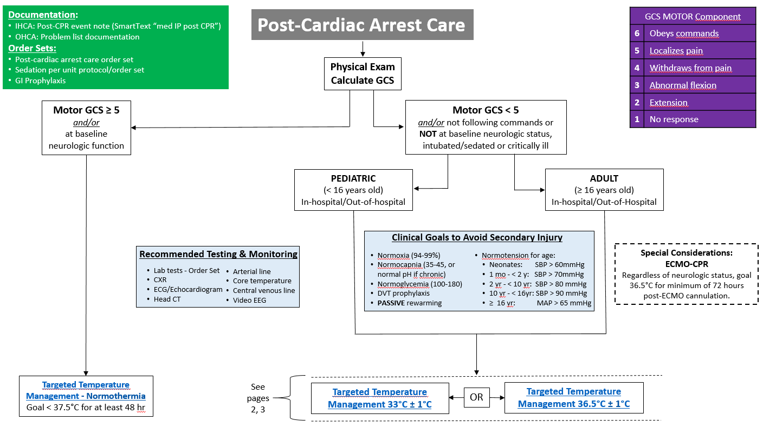
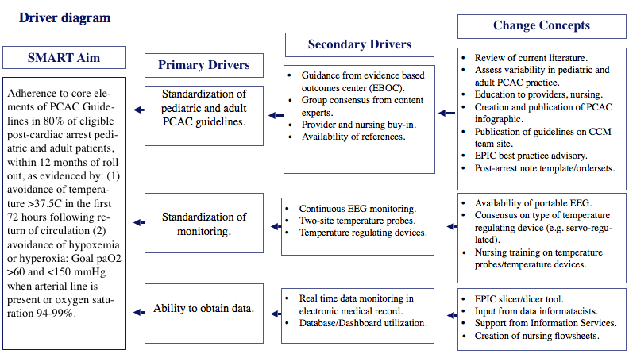
Post-Cardiac Arrest Care Guidelines Development and Implementation Across
Pediatric and Adult Congenital Cardiac Critical Care Units at a Single Center
d
Kelli J. Irwin¹, Venessa L. Pinto¹, Cameron Dezfulian¹, Aarti Bavare¹, Jamie Causey¹, Katie Lemming², Saul Flores¹, Jenny Erklauer¹, Yi-Chen Lai¹, Kiersten Betker Anderson³, Javier J. Lasa¹
(1) Division of Critical Care Medicine, Texas Children’s Hospital; (2) Pharmacy Department, Texas Children’s Hospital; (3) Critical Care Nursing, Texas Children’s Hospital
Background
Results
Stud Groups
Standardized Post-Cardiac Arrest Care (PCAC) is critical to mitigate secondary end-organ injury including optimizing neurologic outcomes across age groups and patient populations experiencing cardiac arrest.
Children and adults with underlying congenital heart disease are at high risk for cardiac arrest, emphasizing the role of high-quality evidence-based post-cardiac arrest care.
Joint Commission now requires standardized post-resuscitation care.
Review of past metrics of PCAC suggest deficiencies in temperature management and arterial blood pressure monitoring.
16.1% of in-hospital arrest patients with core temp. > 37.5°C in first 24 hours after arrest
Recent changes to care models within Texas Children’s Hospital (TCH) Heart Center have led to geographically distinct cardiac intensive care units (CICU) for children and adults.
We sought to organize a multidisciplinary group of stakeholders to develop and implement separate pediatric and adult PCAC guidelines across TCH pediatric (48 bed) and adult congenital (16 bed) CICUs.
Guidelines “go live” occurred in the Spring of 2021 preceded by educational initiatives launched for multi-disciplinary team members across the Heart Center and separate pediatric and adult EMR order-set deployment.
Overall challenges experienced with this initiative included (1) consensus building given paucity of evidence for pediatric age patients, (2) difficulty capturing out-of-hospital arrests and in-hospital arrests in areas without standard critical care charting, and (3) need for adaptability with ongoing debate in the literature for best practices surrounding temperature management.
Given the low frequency of events, automated data capture from electronic medical record and post-processing is being conducted with business intelligence data visualization tools.
Patient Demographics
P = 0.3
P < 0.001
Discussion
Standardizing PCAC is critical to improvement in patient outcomes following cardiopulmonary resuscitation.
Focus on adherence to PCAC recommendations while engaging content experts and stakeholders are key elements to successful development and implementation of PCAC guidelines across both pediatric and adult congenital cardiac ICUs within a large institution.
Although assessment of our SMART aim via PDSA cycle #4 is ongoing, we summarize challenges and successes in our efforts to adapt scientific guidelines surrounding PCAC to a complex cardiac care model in the hope of informing other pediatric heart centers’ PCAC efforts.
Methods
Our efforts were modelled by Plan-Do-Study-Act (PDSA) methodology.
SMART AIM: Adherence to core elements of PCAC Guidelines in 80% of eligible post-cardiac arrest pediatric and adult patients, within 12 months of roll out, as evidenced by (1) avoidance of temperature >37.5C in the first 72 hours following return of circulation (2) avoidance of hypoxemia or hyperoxia: Goal paO2 >60 and <150 mmHg when arterial line is present or oxygen saturation 94-99%.
Outcome, process, and balancing measures developed included (1) avoidance of fever, hypotension, hyper/hypoxia, hyper/hypocarbia during first 72 hours after return of circulation, (2) order set utilization, (3) use of cEEG monitoring in comatose patients, (4) appropriate DVT prophylaxis for adults, (5) need for neuromuscular blockade to treat shivering, and (6) incidence of severe bradycardia related to induced hypothermia.
PDSA cycles:
PDSA 1: Development of TCH PCAC guidelines.
PDSA 2: Development of ordersets/ flowsheets.
PDSA 3: Guideline revisions in light of TTM2 trial and ILCOR updates.
PDSA 4: Data capture and post-processing.
Kelli Irwin, DNP, APRN, CPNP-AC
Advanced Practice Provider, Cardiac Intensive Care Unit | Texas Children’s Hospital
Instructor, Pediatric Critical Care Medicine | Baylor College of Medicine
kelli.irwin@bcm.edu
kjirwin@texaschildrens.org

