Slide 1
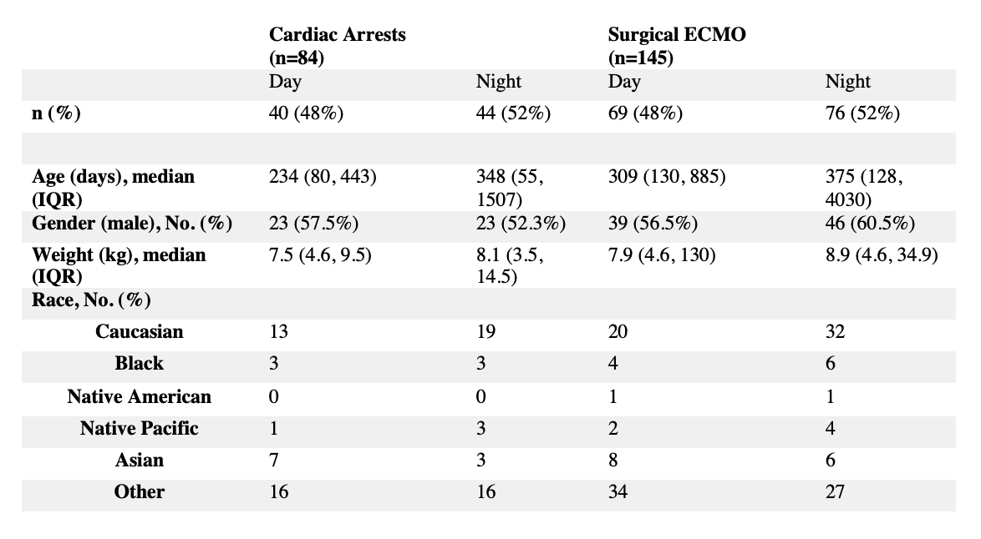
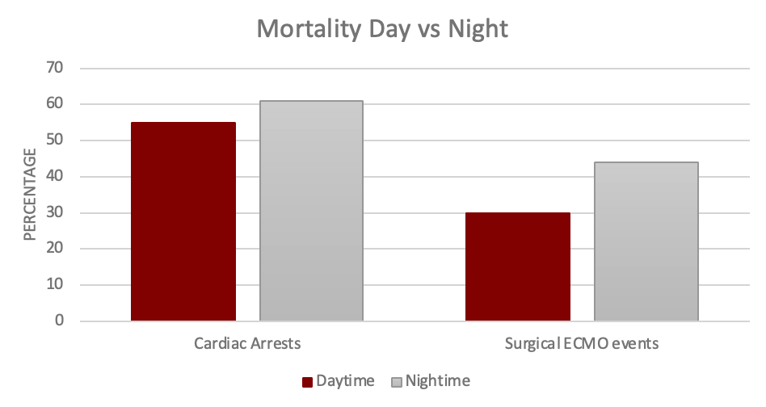
Outcome Differences For Life-Threatening Events Between Day and Night Shifts and The Impact of Organizational Characteristics Among Pediatric Cardiac Critical Care Units
A Preliminary Single Center Analysis
Brian S Han MD¹, Dennis Delany MD², David Werho MD³, Andrew Koth MD⁴ , Andrew Y Shin MD¹
¹Department of Pediatrics, Division of Pediatric Cardiology, Lucile Packard Children’s Hospital, Stanford University, Palo Alto, CA; ²Department of Pediatrics, Division of Anesthesiology and Critical Care Medicine, Johns Hopkins Children’s Center, John Hopkins University, Baltimore, MD; ³Department of Pediatrics, Division of Cardiology, Rady Children’s Hospital, University of California San Diego, San Diego, CA; ⁴ Department of Pediatrics, Division of Critical Care Medicine, Seattle Children’s Hospital, University of Washington, Seattle, WA
Background
Results
Plans for Analysis
Over the past decade, contemporary intensive care units have undergone significant growth and expansion.
Thoughtful analysis of determinants of outcomes have primarily focused on patient- and surgery-specific factors.
Impact of unit-level factors have remained relatively unexplored.
Previous studies show worse outcomes with night shifts in adult and pediatric hospitals.
Pediatric cardiac intensive care units (pCICU) may also be at risk for worsened outcomes during the night.
Nighttime medical staffing models may play a role in the differences in outcome.
We will include all patients ages 0-18 years of age admitted to a dedicated pediatric cardiac ICU.
We will look at life-threatening events (LTEs), composed of three events: cardiac arrests, ECPR, and ECMO cannulation (non-ECPR).
Demographic and clinical information for LTEs will be collected and risk factors will be identified.
Outcomes for LTEs between night and day shifts will be compared.
We plan to compare medical staffing models and provider characteristics of participating PC4 centers and identify potential risk factors for worsening outcomes.
The proposal for this project has been submitted to the PC4 committee for approval.
Single Center Data
CVICU admissions were reviewed for a single institution’s dedicated pCICU between 1/1/2018 to 7/13/2020.
Both cardiac arrest events and surgical ECMO cases were compiled.
There were a total of 1963 CICU admissions with 52% of them occurring during the night shift (defined as 4 PM to 7 AM).
84 cardiac arrest events occurred with 44 (52%) occurring during the night shift.
145 surgical ECMO events occurred with 76 (52%) occurring during the night shift.
Mortality for these events were higher during the night shift compared to the day shift.
Engagement Space
In my experience, there feels to be a difference in outcomes between arrest or ECMO events occurring during the night vs day.
Yes | No
Purpose
Suggestions for analysis/considerations!
We seek to determine whether life threatening events occurring during the night shift are more frequent and whether they are associated with worse composite outcomes than similar events occurring during the day shift.
We seek to determine whether medical staffing models and organizational characteristics will influence and impact outcomes for these events.
Author Disclosures: none

